Slide 1
Massachusetts Envirothon
Wildlife

Slide 2
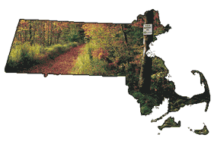
Pam Landry, MassWildlife
Education Coordinator
pam.landry@mass.gov
Photos by the late Bill Byrne
MassWildlife Photographer
unless otherwise noted
(revised 10/20200)

Slide 3
Massachusetts Division of Fisheries & Wildlife (MassWildlife)
The Massachusetts Division of Fisheries and Wildlife (DFW) is responsible for the conservation - including restoration, protection and management- of fish and wildlife resources for the benefit and enjoyment of the public: research, land protection, monitoring, public recreation and education, and regulation of possession or use of wildlife.
The conservation - including protection, restoration, and management - of Massachusetts' fauna and flora is the statutory responsibility of MassWildlife. Specifically, MassWildlife's charge is the stewardship of all wild amphibians, reptiles, birds, mammals, and freshwater and diadromous fishes in the state, as well as endangered, threatened, and special concern species, including native wild plants and invertebrates. This responsibility is established and articulated in the Constitution and General Laws of Massachusetts
The Division works to balance the needs of people and wildlife today so wildlife will be available for everyone's enjoyment today and for future generations.
Notes:
Understanding the state agency that oversees fish and wildlife resources in Massachusetts

Slide 4

Wildlife in Massachusetts
This presentation is not intended to address all possible strategies for preparation. The primary approach to preparation for taking and passing the test is …adequate study!
(the outline of this presentation is based on the curriculum guidelines & learning objectives established by the National Envirothon www.envirothon.org)
Notes:
Although there is a lot of information to learn about wildlife, and the other natural resource areas (soils, forest, water) it becomes more manageable being guided by the learning objectives from which this PowerPoint is based. Incorporating the wildlife information, along with the other topic areas, into your current issue presentation is valuable in reinforcing how all natural resource topics are linked to everything else!

Slide 5
Outline of Wildlife Learning Objectives
Knowledge of Wildlife
(natural history & distribution, identification, role within ecosystem)
Understanding Wildlife Ecology
(basic needs, habitat assessment, adaptations, predator-prey, food webs, limiting factors, carrying capacity, populations)
Conservation & Management
(conservation, management, agencies, hunting, fishing, trapping, game & non-game, wildlife management)
Issues Involving Wildlife & Society
(listed species, habitat loss/fragmentation, non-native, invasive, diseases, living with wildlife, current issue)
Notes:
Four key topic areas for the wildlife learning objectives and the multiple relevant learning objectives within each of the four key wildlife topic areas. More detailed descriptions of the learning objectives can be found at https://maenvirothon.files.wordpress.com/2015/06/ncf-wildlife-learning-objectives.pdf

Slide 6
What is Wildlife?
Non-domesticated species of plants and animals; includes but is not limited to, insects, spiders, birds, reptiles, fish, amphibians, and mammals;
ie. those species that do not rely on humans for food, water, or shelter
Notes:
In order for one to learn about wildlife one must first know what wildlife is. Can students name several examples of Massachusetts wildlife including insects, spiders, birds, reptiles, fish, amphibians, mammals?

Slide 7
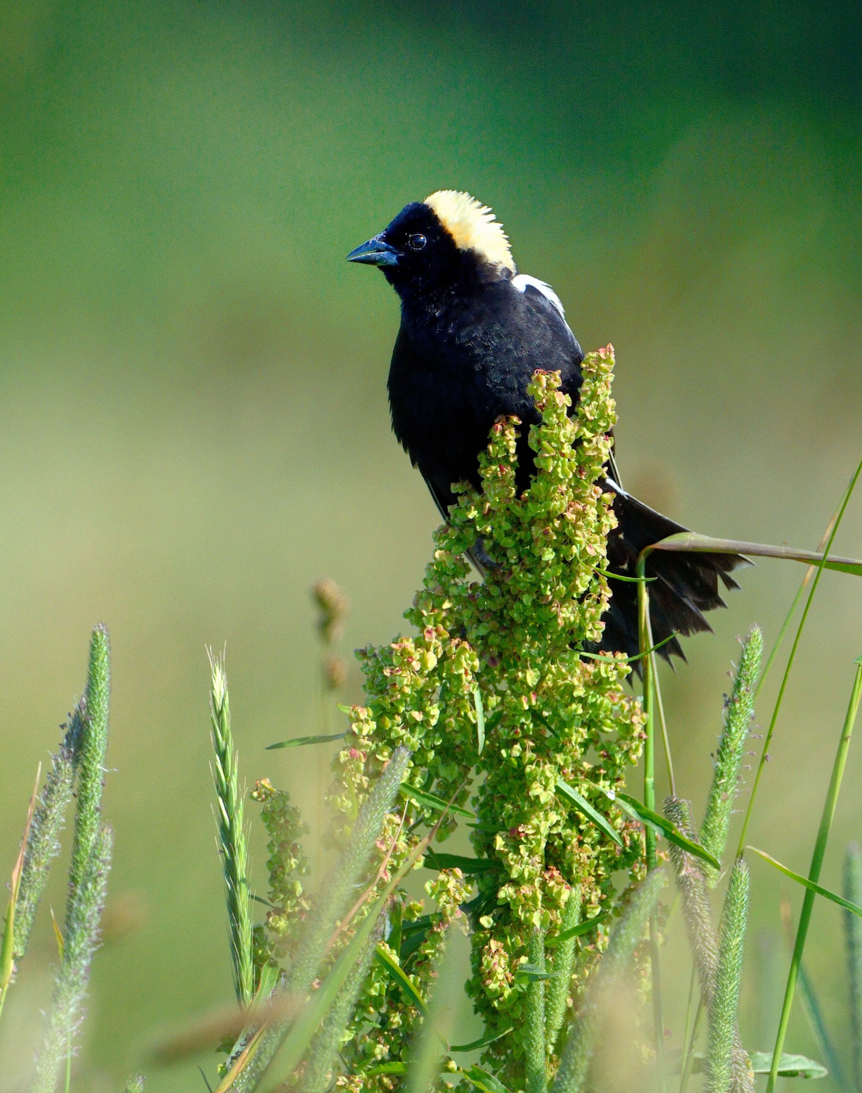
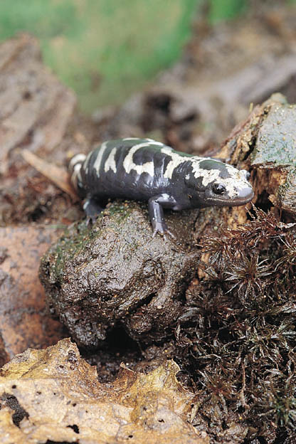
Natural History & Distribution
(characteristics, food habits, habitat, breeding, behavior)
Notes:
Identify species – How would you go about identifying these two species? (color, shape, size, habitat, group (amphib bird, mammal, etc.), use of resources (field guides, state list of wildlife), etc.
*HOMEWORK: using local field guide resources determine distribution, food habit, habitat, breeding & other behavior, size, state status (ie. Listed species?) of these two species.

Slide 8

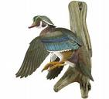



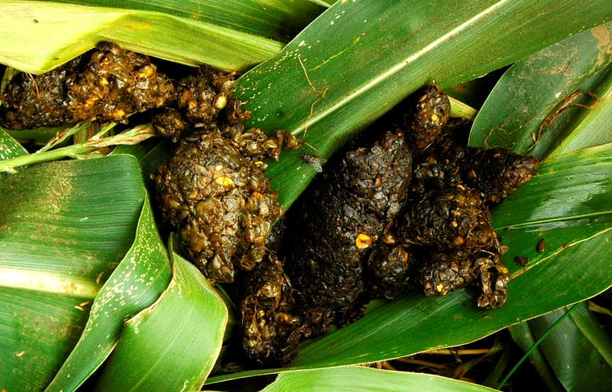

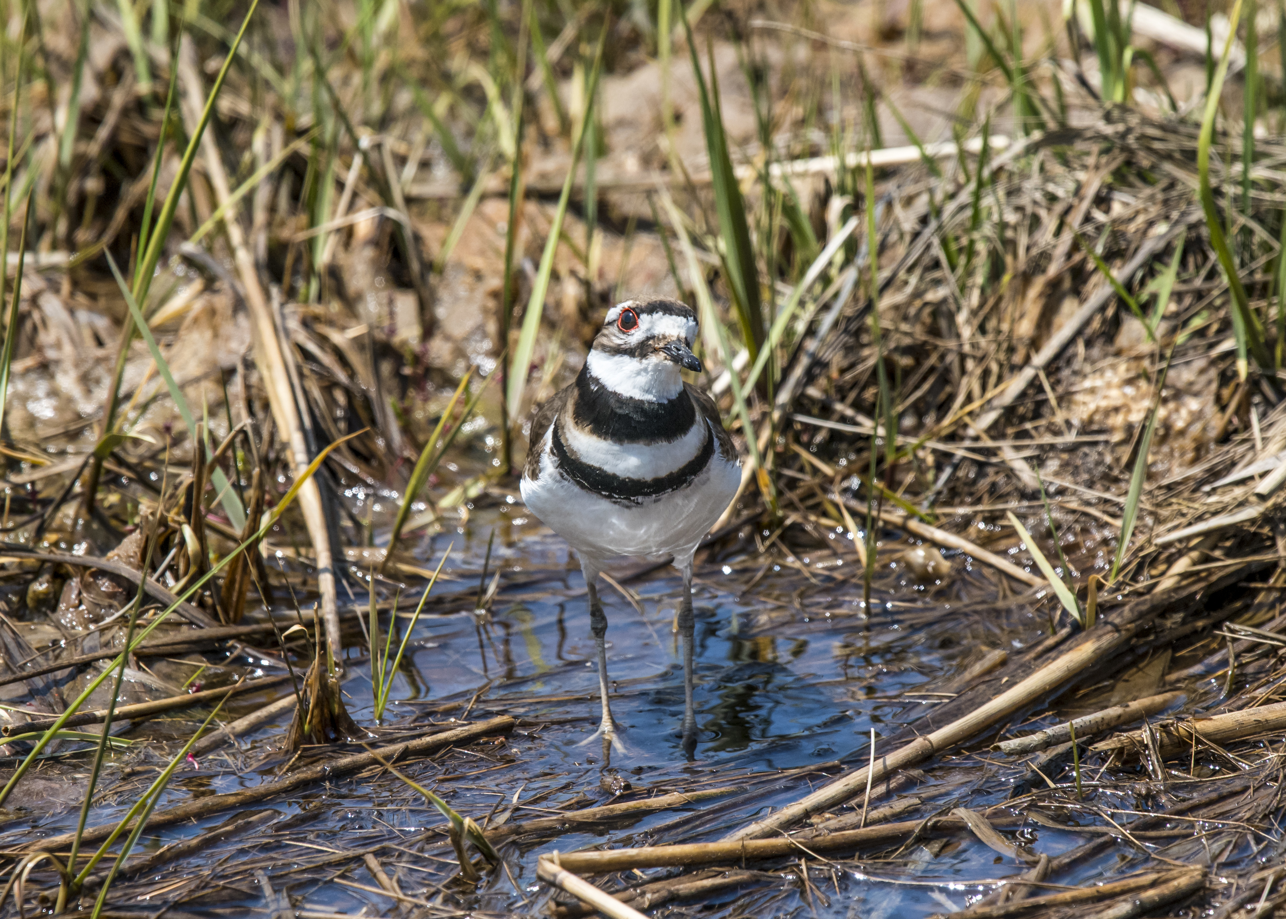

Identify Wildlife
(observation skills)
Notes:
*Understanding wildlife & their use of habitats by interpreting/identifying the animal and the signs they leave by becoming a nature detective and perfecting your observation skills. Become familiar with the wildlife that live in Massachusetts.

Slide 9
Outline of Wildlife Learning Objectives
Knowledge of Wildlife
(natural history & distribution, identification, role within ecosystem)
Understanding Wildlife Ecology
(basic needs, habitat assessment, adaptations, predator-prey, food webs, limiting factors, carrying capacity, populations)
Conservation & Management
(conservation, management, agencies, hunting, fishing, trapping, game & non-game, wildlife management)
Issues Involving Wildlife & Society
(listed species, habitat loss/fragmentation, non-native, invasive, diseases, living with wildlife, current issue)

Slide 10
Understanding Wildlife Ecology
(science of the interrelations between living organisms & their environment)
  Basic wildlife needs - habitat
  Adaptations
  Predator-Prey
  Food Webs
  Limiting Factors
  Populations
Notes:
Key topic areas to understand when learning about wildlife ecology

Slide 11
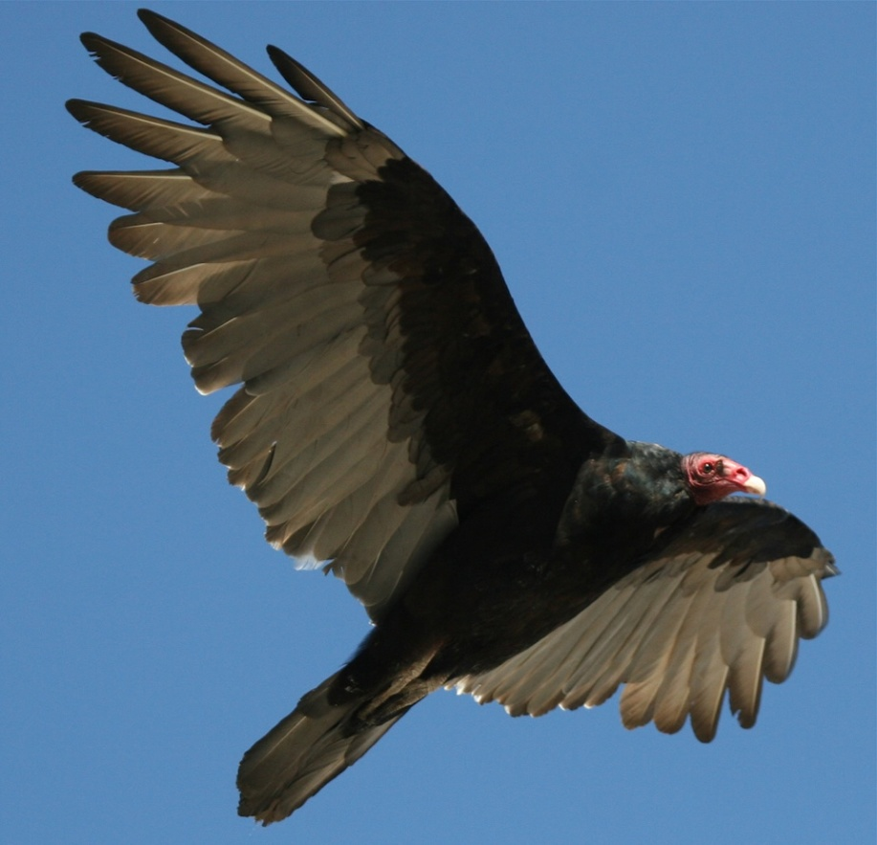
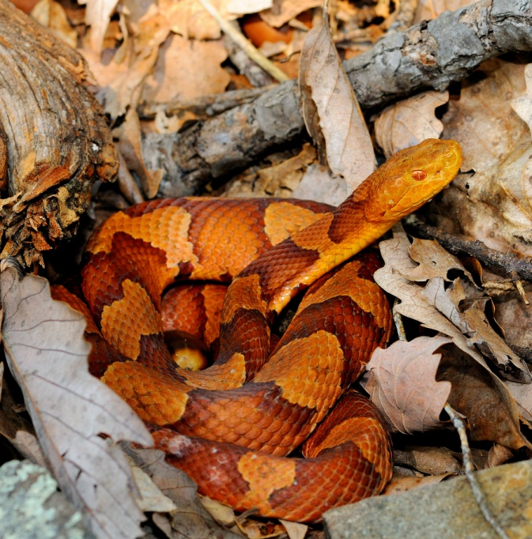
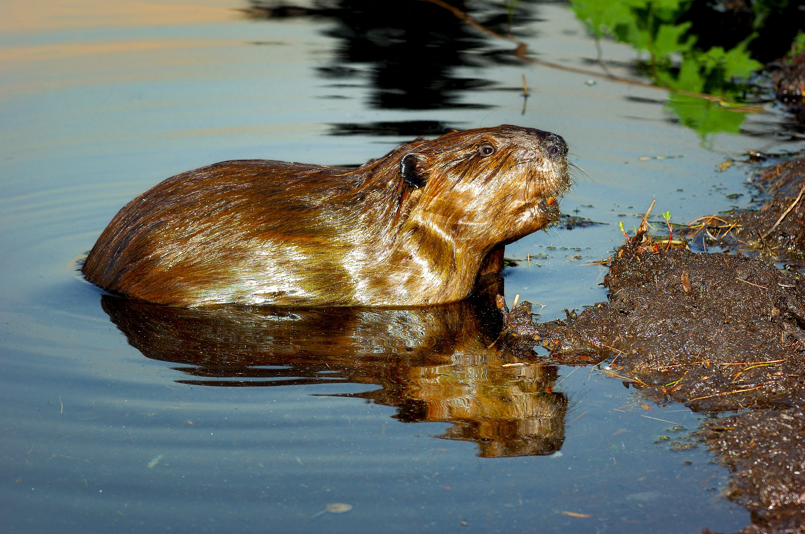
Role within the Ecosystem
(ecosystem is formed by interactions of plant & animal populations and abiotic conditions)
Notes:
*Abiotic = non-living ie. soil, air, water, sunlight, temperature, etc.
*Biotic = living organisma
*Looking at the bigger picture (ecosystem)
*Productivity of ecosystem is greater when species diversity is higher (biodiversity)
*Identify each of the species shown and explain their role within the ecosystem

Slide 12
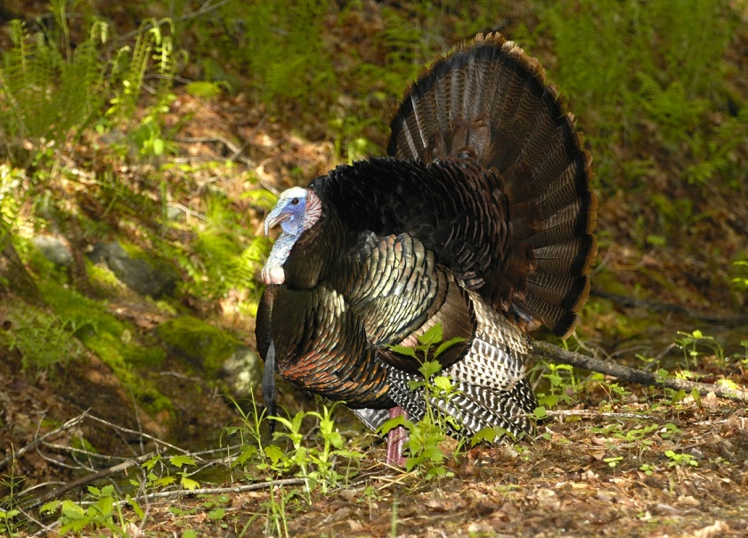
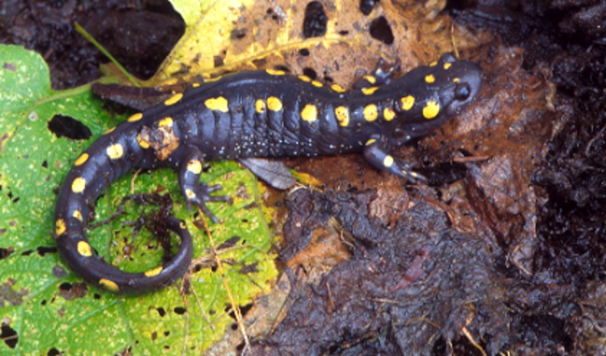
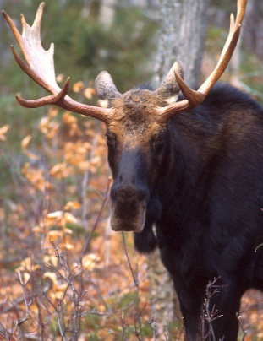
Basic Wildlife Needs
(food, water, shelter, space)
Notes:
The four factors you are going to assess to determine if a habitat is suitable for a garden spider, field mouse, brook trout, chickadee, dragonfly, timber rattlesnake, black bear or moose?
*May vary daily, seasonally and during the life stages of species
*Food-generalists and specialists
*Water-essential for all living organisms
*Food & water – may be variable throughout the year with regard to availability & quality
*Shelter – protection from adverse weather, escape predators, courtship displays, nesting/rearing young, roosting
*Space – wildlife requires areas to establish home ranges & territory as well as raise young. Every species has a
minimum space requirement for obtaining food, water, shelter
*Arrangement- how water, food, shelter, and space are positioned in relation to each other within a habitat
*Each species has its own set of specific habitat requirements

Slide 13
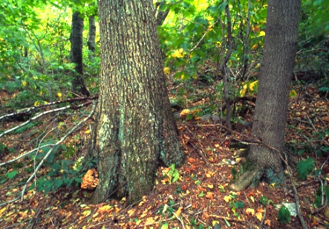
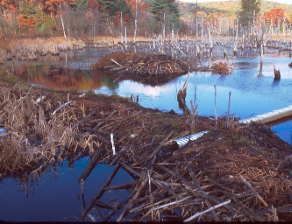
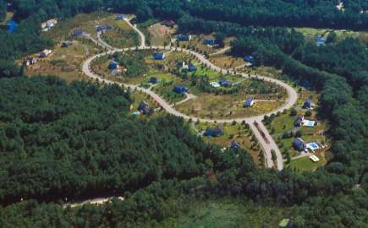
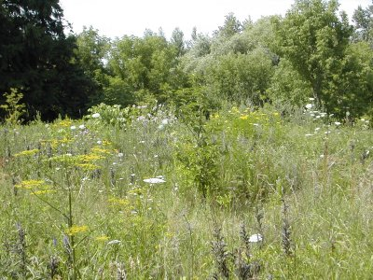
Habitat Assessment
Notes:
*What four factors are you going to assess to determine if a habitat is suitable for a garden spider, field mouse, brook trout, chickadee, dragonfly, timber rattlesnake, black bear or moose?
*reading the landscape is critical to wildlife management
*habitat changes over time – succession (gradual change in plant species)
*thoroughly describe each of the habitats shown – what do you observe starting from the foreground to the background
*the composition of wildlife changes as habitat changes
*wildlife is dependent on the vegetation that supports them
*wildlife often depends on several successional stages
*wildlife managers can alter succession to create habitat suitable for a particular species
*two major threats to biodiversity = habitat destruction & invasive species
*diversified ecosystems can recover from disturbances easier ie. diversity of habitat = diversity of wildlife
*

Slide 14
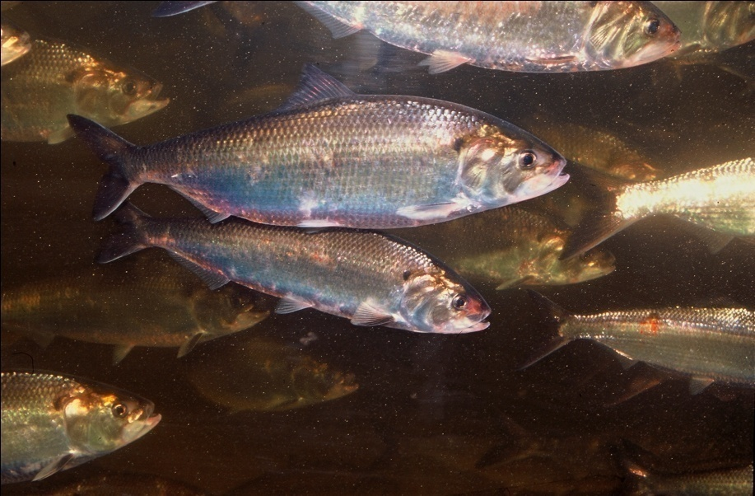
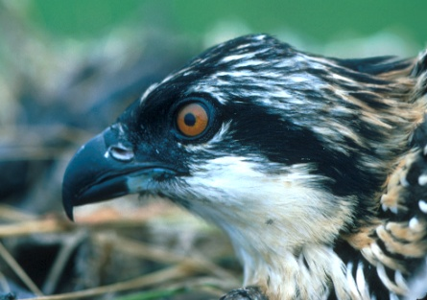
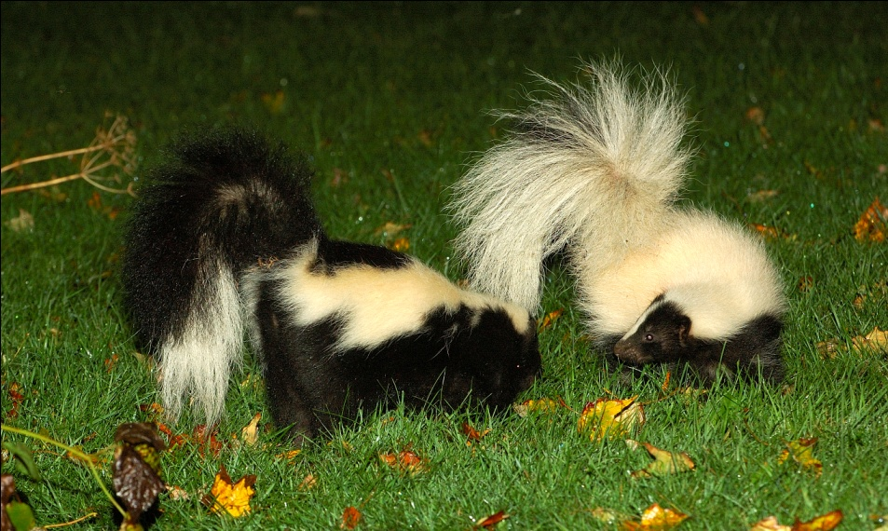
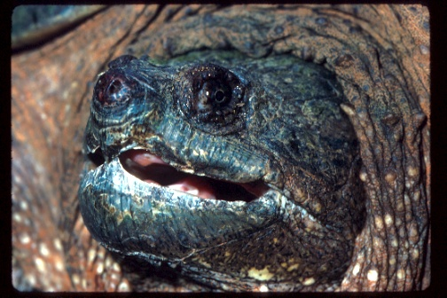
Physical Adaptations
(anatomical features)
Notes:
*adaptation = trait (behavioral, physical, physiological) that allows an animal to live successfully in its environment
*describe & explain the advantages of adaptations of wildlife to their environment
*anatomical adaptation entails a physical feature…shape, color, mouth, eyes, feet, etc.
* identify the wildlife in these photos and explain their physical adaptations for survivial

Slide 15

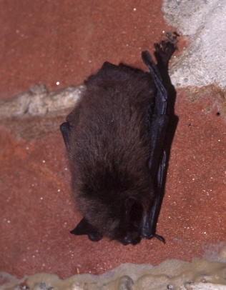
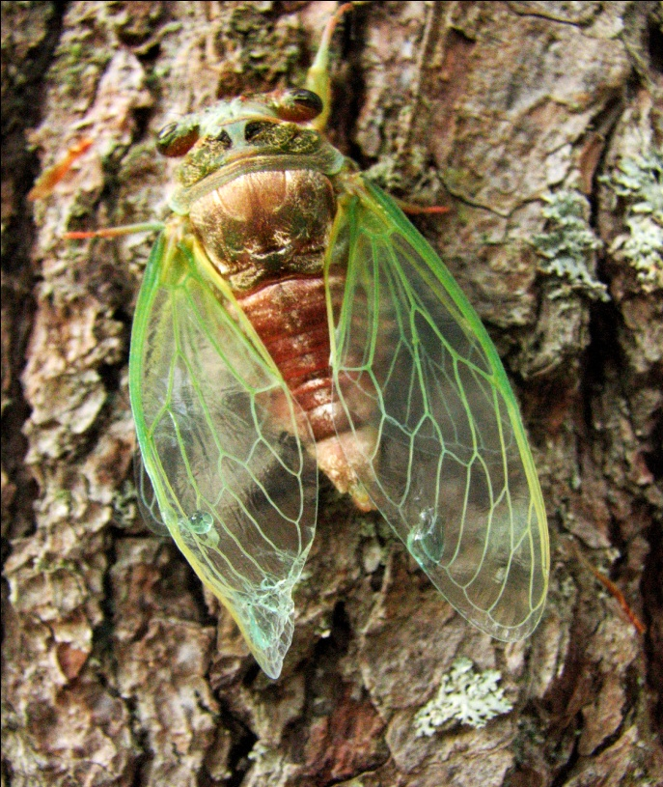
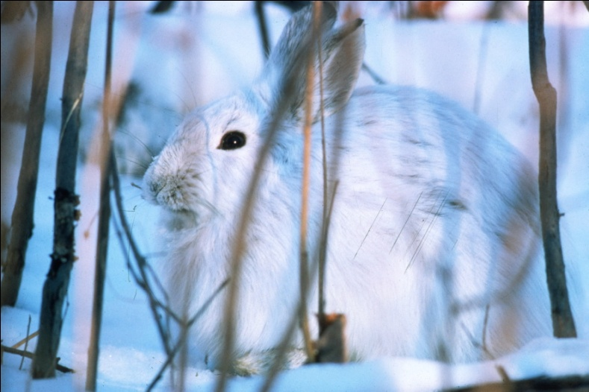
Physiological Adaptations
(perform special functions)
Notes:
*performs a special function – hibernation, change in fur color, migration, production of venom, aestivation, etc.
*identify the wildlife in these photos and explain their physiological adaptations

Slide 16
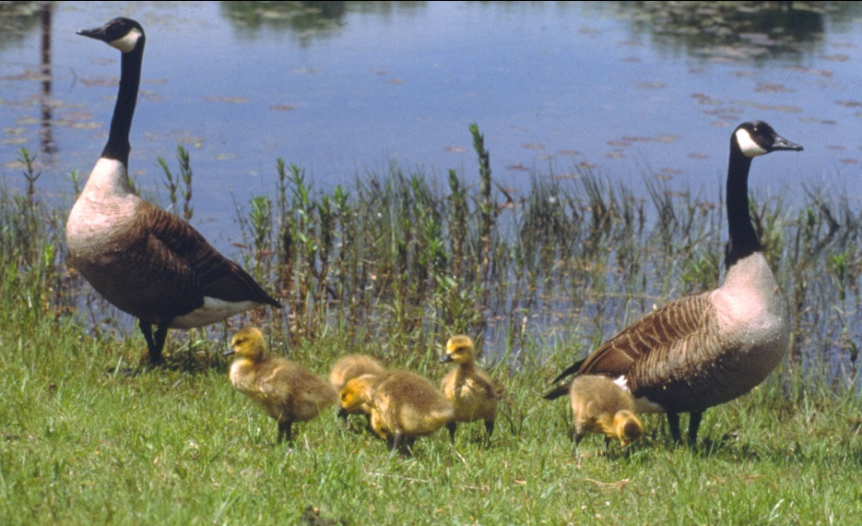
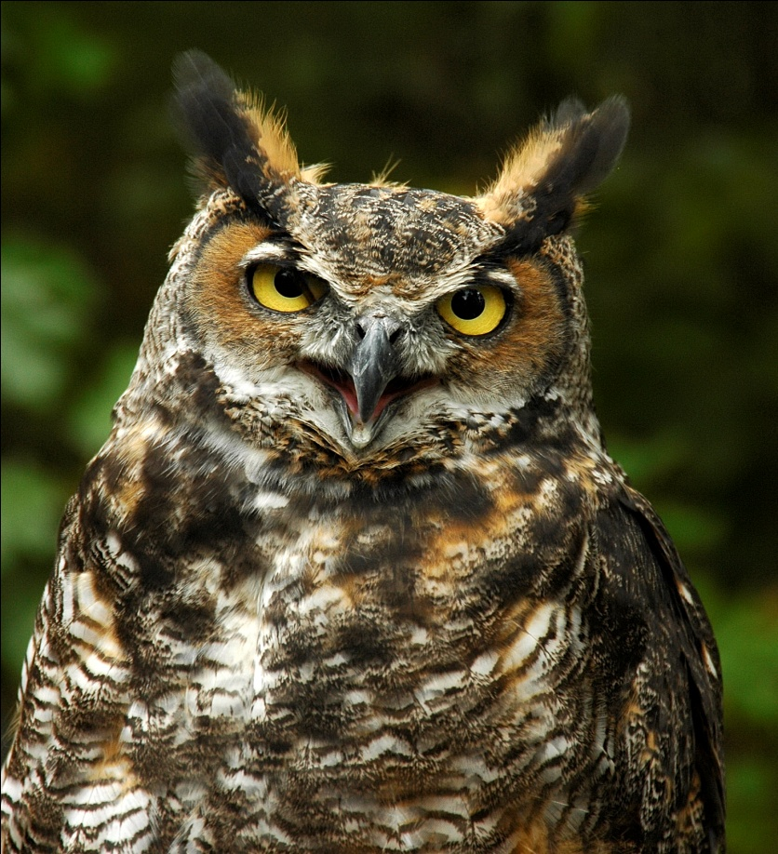
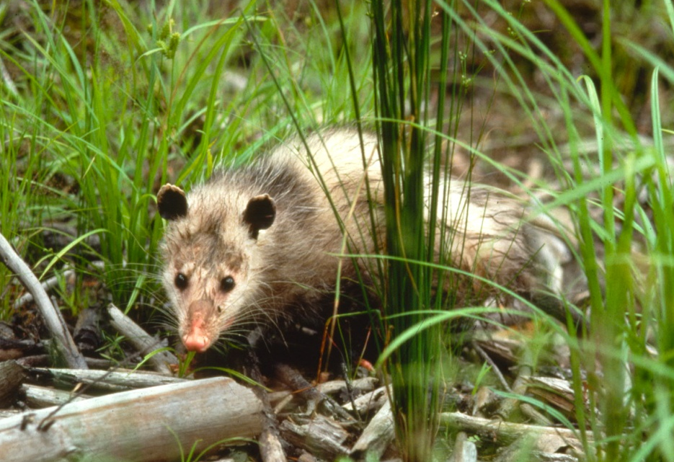
Behavioral Adaptations
(learned or inherited)
Notes:
*behaviors that have been learned or inherited
*identify the wildlife in these photos and explain their behavioral adaptations

Slide 17
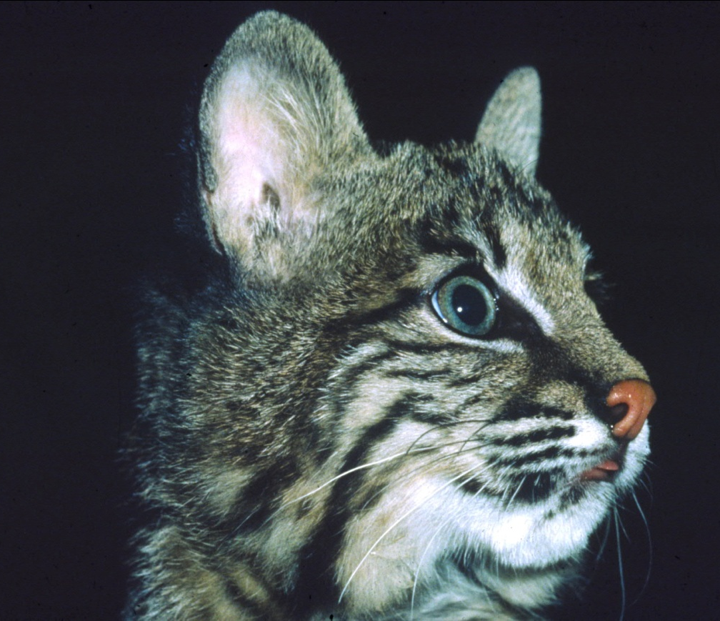
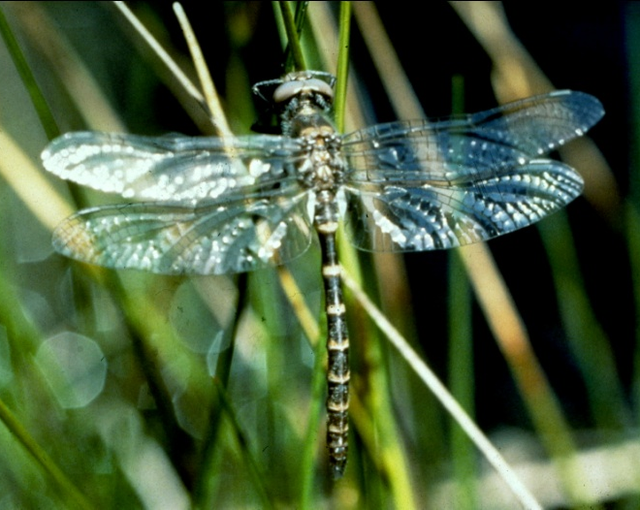
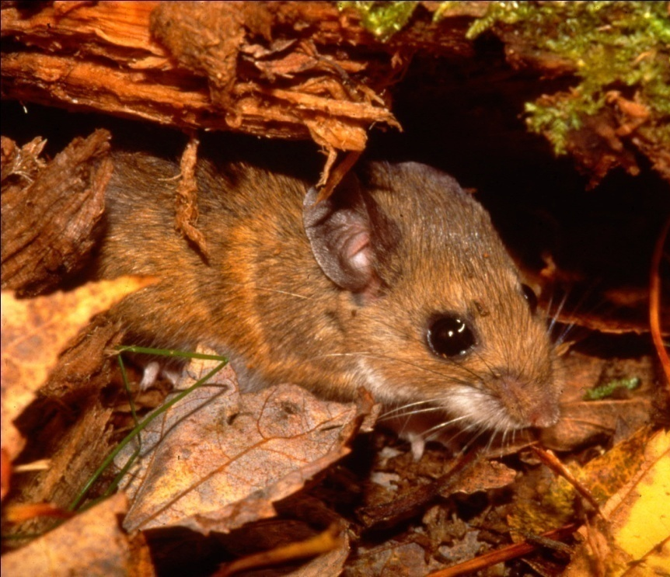
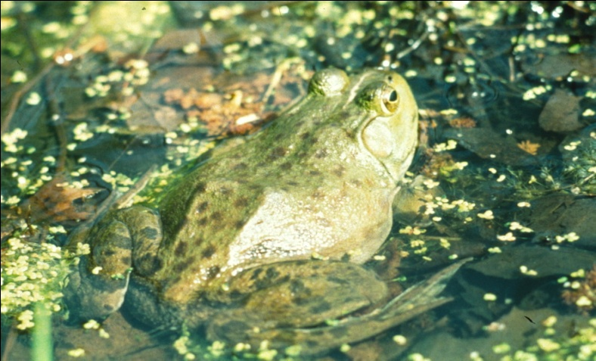
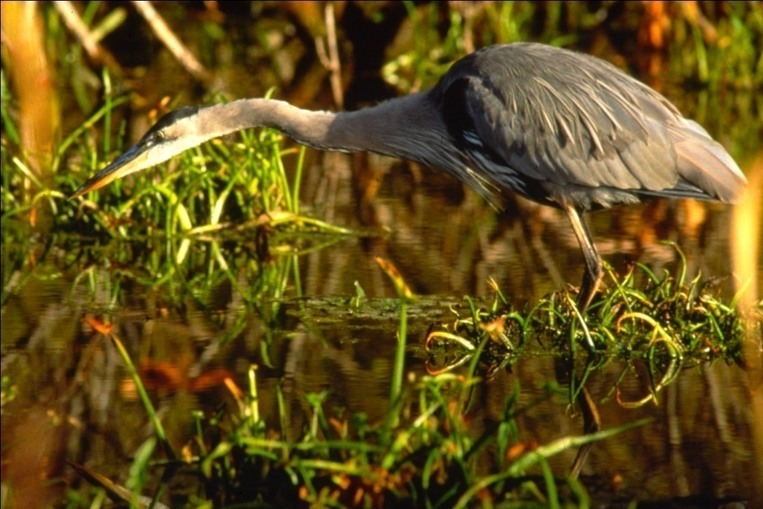
Food Chains and Food Webs
(passing the energy from one organism to another)
Notes:
*comprised of multiple predator & prey relationships
*predator/prey, scavengers, decomposers, omnivore, insectivore, herbivore, carnivore
*producers & decomposers
*primary consumers/secondary consumers/tertiary consumers

Slide 18
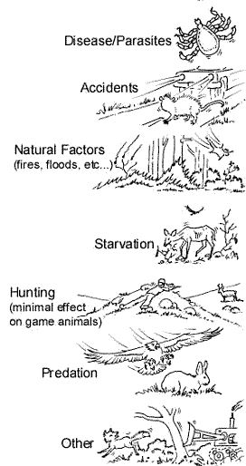
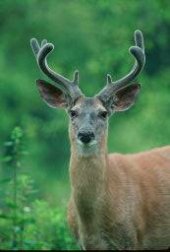
Limiting Factors
Influences in the life history
of any animal, population of
animals, or species that limits
growth, reproduction or distribution
International Hunter Education Association (IHEA)

Slide 19
Outline of Wildlife Learning Objectives
Knowledge of Wildlife
(natural history & distribution, identification, role within ecosystem)
Understanding Wildlife Ecology
(basic needs, habitat assessment, adaptations, predator-prey, food webs, limiting factors, carrying capacity, populations)
Conservation & Management
(conservation, management, agencies, hunting, fishing, trapping, game & non-game, wildlife management)
Issues Involving Wildlife & Society
(listed species, habitat loss/fragmentation, non-native, invasive, diseases, living with wildlife, current issue)

Slide 20
Conservation & Management
Conservation
The use of natural resources in a way that ensures their continued availability to future
generations
Management
The application of scientific knowledge & technical skills to protect, preserve, conserve, limit, enhance or extend the value of wildlife & its habitat
State Agencies:
Massachusetts Division of Fisheries & Wildlife (MassWildlife)
Natural Heritage & Endangered Species (NHESP)
Environmental Law Enforcement (EPO)
Federal Agency:
United States Fish & Wildlife Service (USFWS)
Notes:
*management = balancing the needs of public with needs of wildlife & their habitats
to ensure wildlife populations do not become overpopulated, wildlife managers must
carefully monitor population levels
* factors influencing management decisions = ecological, financial, social

Slide 21
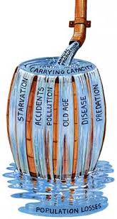

Carrying Capacity
Biological
Cultural
Michigan DNR
Notes:
*carrying capacity is the maximum number of individuals of a species that a habitat can support without degradation of that particular habitat
*throughout the year carrying capacity changes as the available resources change
*biological carrying capacity = when speaking of carrying capacity biological carrying capacity is what is being referred to
*cultural carrying capacity = human tolerance level of wildlife which depends on the attitudes of the public and human-wildlife conflicts

Slide 22
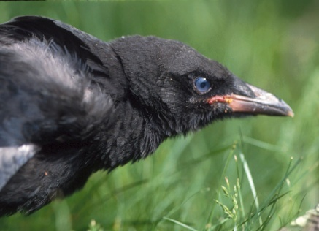
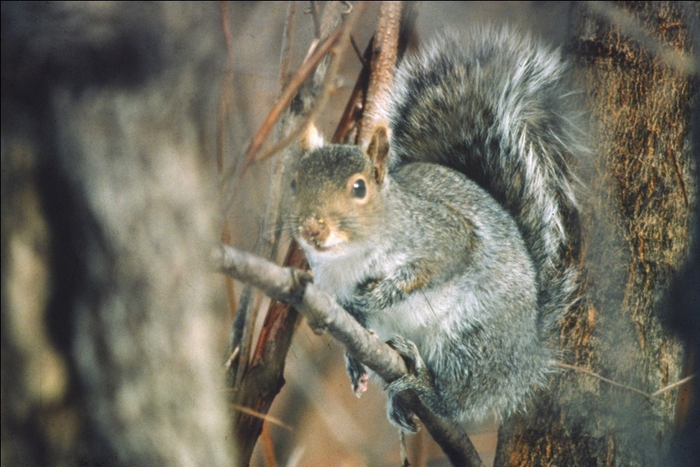
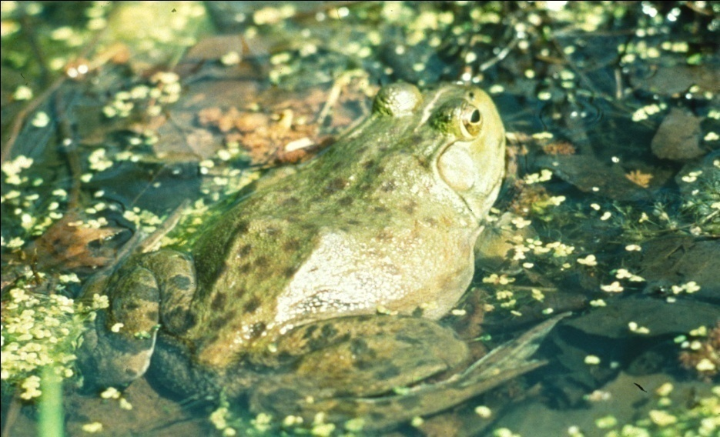
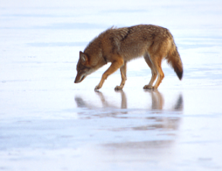
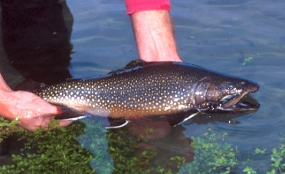
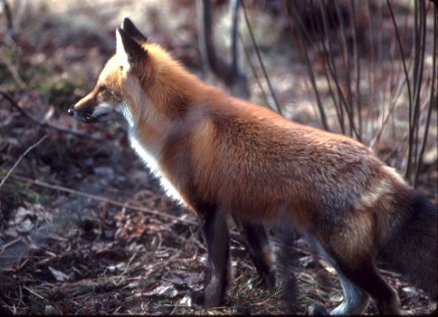
Hunting, Fishing, Trapping = Game
Highly REGULATED activities with SEASONS & BAG LIMITS
Notes:
*obtain and become familiar with what is expressed in the Massachusetts Guide to Hunting, Freshwater Fishing, and Trapping Laws https://search.mass.gov/?q=guide%2Bto%2Bfishing%2Band%2Bhunting
*regulated hunting and trapping is one way to control wildlife population levels – manage for constant
population size (sustained yield)
*hunter & trapper education for 1st time hunters/trappers
*licenses based on the activity you will engage in
*abstracts = fish & wildlife guide to hunting, freshwater fishing, and trapping

Slide 23
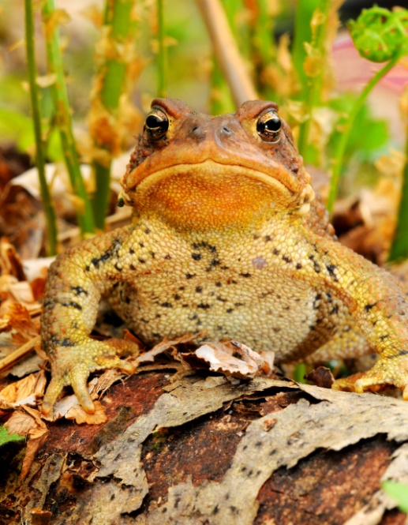
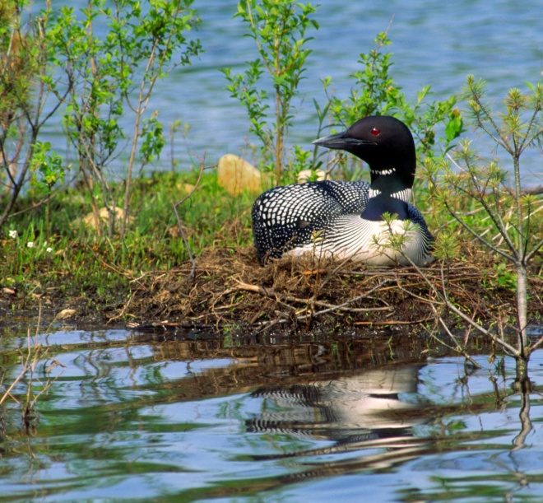
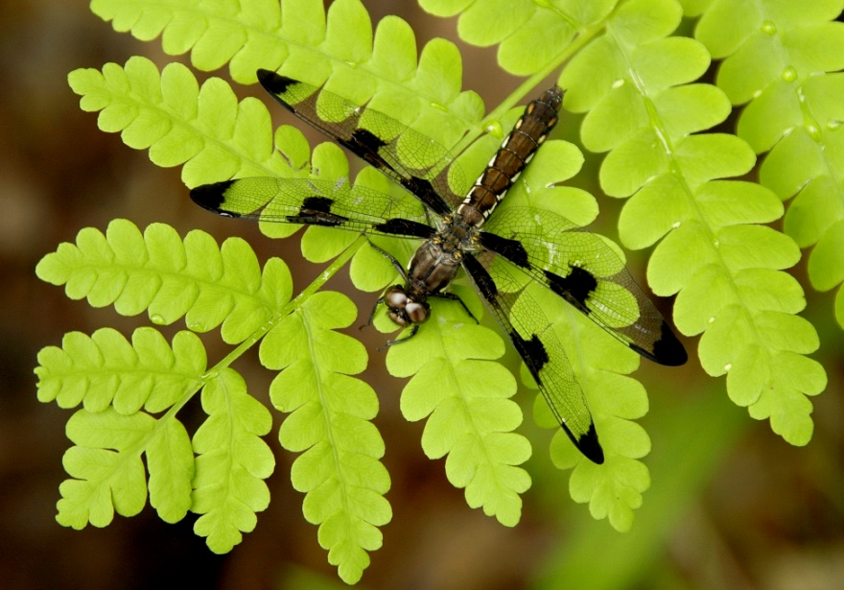
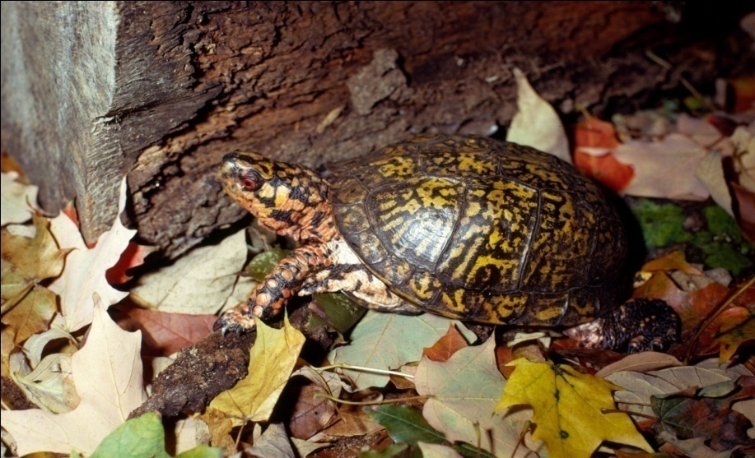
Non-Game Species
(Natural Heritage and Endangered Species)
Notes:
The Natural Heritage & Endangered Species Program is responsible for the conservation and protection of hundreds of species that are not hunted, fished, trapped, or commercially harvested in the state, as well as the protection of the natural communities that make up their habitats.
*identify the Massachusetts species in the photos and share their status as a listed species

Slide 24
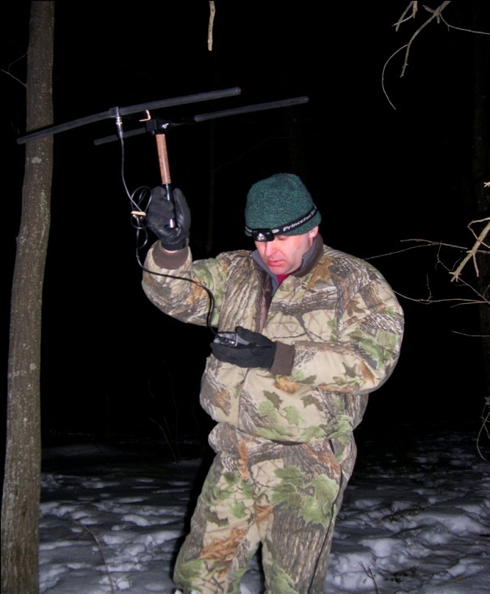
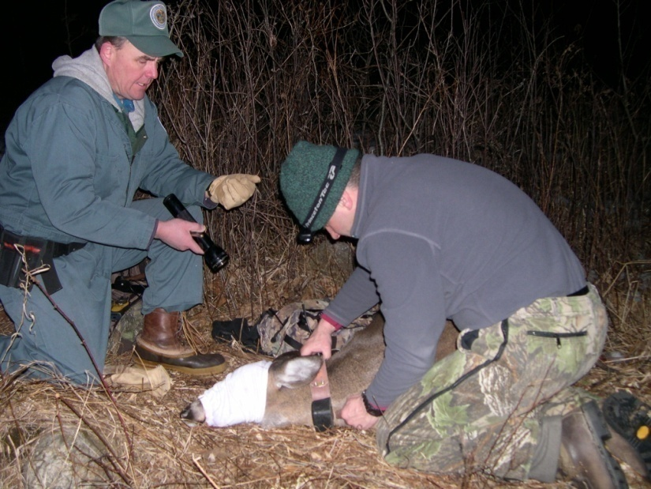
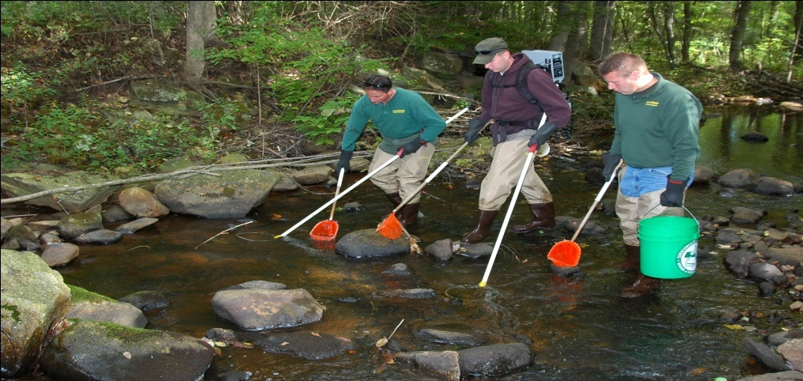
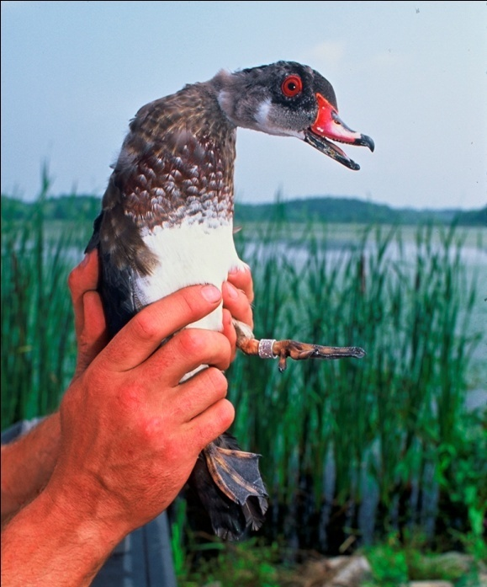
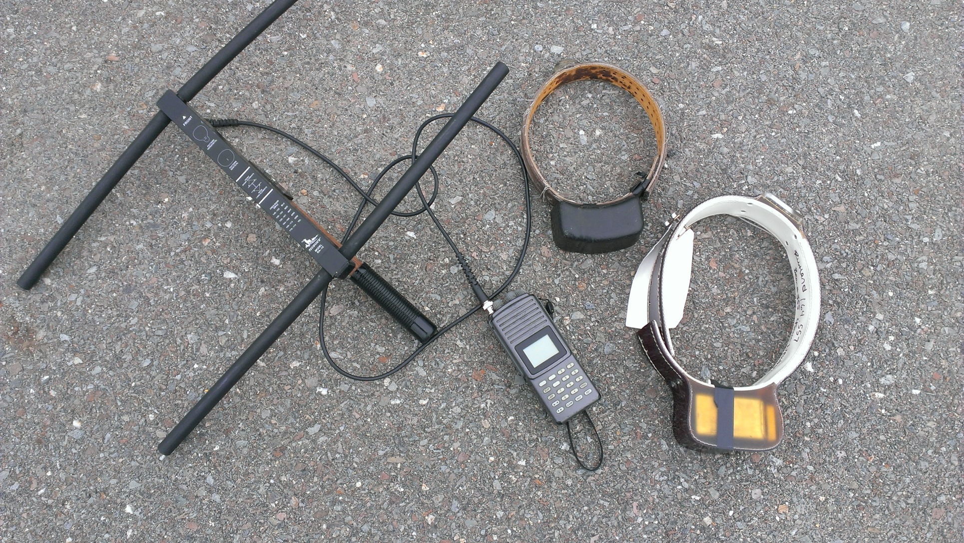
Methods used to determine abundance & distribution
Notes:
*GPS collars - expensive
*banding/tagging
*surveys – bird counts, pellet counts, breeding bird survey
*general public (citizen science) reporting sightings (turkey survey)
*auditory observations – seasonal roadside bird breeding surveys
*electrofishing – electrical current is utilized to momentarily stun freshwater fish
*seasonal data collected from hunters, trappers, anglers

Slide 25
Outline of Wildlife Learning Objectives
Knowledge of Wildlife
(natural history & distribution, identification, role within ecosystem)
Understanding Wildlife Ecology
(basic needs, habitat assessment, adaptations, predator-prey, food webs, limiting factors, carrying capacity, populations)
Conservation & Management
(conservation, management, agencies, hunting, fishing, trapping, game & non-game, wildlife management)
Issues Involving Wildlife & Society
(listed species, habitat loss/fragmentation, non-native, invasive, diseases, living with wildlife, current issue)

Slide 26
Listed Species
(Natural Heritage & Endangered Species)
Endangered:
Native Species which are in danger of extinction throughout all or part of their range, or which are in danger of extirpation from MA, as documented by biological research & inventory
Threatened:
Native species which are likely to become endangered in the foreseeable future, or which are declining or rare as determined by biological research & inventory
Special Concern:
Native species which have been documented by biological research or inventory to have suffered a decline that could threaten the species if allowed to continue unchecked, or which occur in small numbers or with restricted distribution or specialized habitat requirements that they could easily become threatened

Slide 27
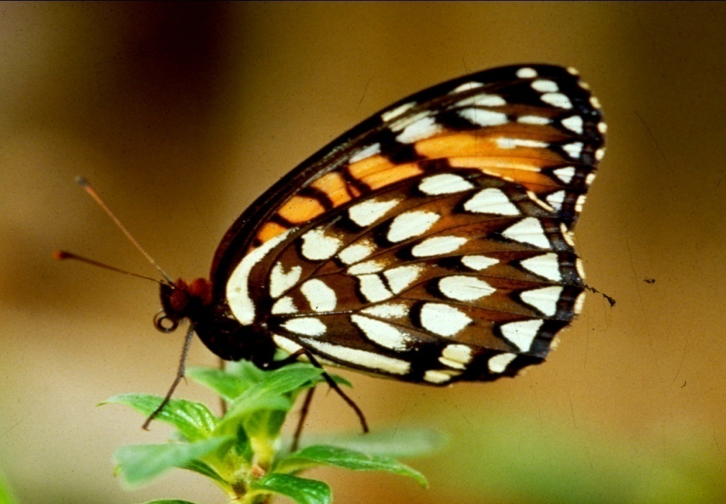

Extirpated:
Missing from native range but not extinct
http://www.mass.gov/eea/agencies/dfg/dfw/natural-heritage/species-information-and-conservation/mesa-list/list-of-rare-species-in-massachusetts.html
Notes:
*identify these two extirpated Massachusetts species

Slide 28




Special Concern, Threatened, Endangered
Habitat loss, unregulated or illegal killing or collecting, pesticides, pollution, competition with other species, disease, predation
Notes:
*wildlife resources are under constant pressure caused by:
human population growth
environmental degradation
habitat reduction

Slide 29
Endangered Species Protection
1973 Federal Endangered Species Act was passed which provided protection for animal & plant species endangered or threatened with extinction; protects ecosystems on which they depend
1990 Massachusetts Endangered Species Act (MESA) (M.G.L. c. 131A) was enacted offering additional protection to rare plant & animal species and their habitats. Prohibits the ‘taking’ of species. Important role in maintaining biological diversity, preventing species extinctions & contributing to imperiled species recovery in Massachusetts.
October 2010 modifications to the MESA regulations
Notes:
*Federal and State laws that provide protection for animal and plant species

Slide 30
Massachusetts Endangered Species Act (MESA)
Protects state-listed species and their habitats by prohibiting the “Take” of any listed species.
“Take” – In reference to animals, means to harass, harm, pursue, hunt, shoot, hound, kill, trap, capture, collect, process, disrupt the nesting, breeding, feeding or migratory activity or attempt to engage in any such conduct, or to assist such conduct. In reference to plants, means to collect, pick, kill, transplant, cut or process or attempt to engage or to assist in any such conduct.

Slide 31

Habitat Loss, Degradation & Fragmentation
Notes:
*habitat loss, degradation, & fragmentation is just one of many factors that may have a detrimental effect on wildlife
*generalists – flexible in its habitat adaptability
*specialists – narrow requirements so experience severe population fluctuations with changes in the environment
*corridors – areas of continuous habitat that permit animals to travel securely from one habitat to another

Slide 32





Non-native Species, Invasive Species,
Introduced Species
U.S. Geological Survey Archives
Invasive.org.
Donald Duerr, USDA Forest Service
Notes:
*impacts biodiversity
no natural predators
grows quickly
reproduces efficiently – large #
*can pose biological, economic, or human-health related harm
*identify these non-native species found in Massachusetts and the impact they are having on the environment

Slide 33
Invasive
What makes a good invader?
tolerates a variety of habitat conditions
grow & reproduce rapidly
compete for resources
lack natural enemies/predators
low susceptibility to disease
generalists & adaptable
Environmental Impacts
decreases biodiversity
causes native species extirpation
alters natural processes
can hybridize & displace natives
decreases food sources & impact food webs
Economic Impacts
altering ecosystem & ecological services
reduces productivity in forestry, agriculture, and fisheries
causes export & import trade restrictions
costs associated with prevention & management
impacts on recreation & tourism
Reduce property values as result of changes in ecosystem
Societal Impacts
can cause intro & spread of disease
allergies & irritations
reduce recreational & tourism opportunities

Slide 34
Wildlife Diseases
Rabies
Lyme Disease
West Nile Virus
Chronic Wasting Disease
Avian Influenza
Raccoon Roundworm
White-nose syndrome
Eastern Equine Encephalitis (EEE)
www.mass.gov/masswildlife
Notes:
*there are a variety of wildlife diseases that impact wildlife with some able to be spread to humans and other wildlife

Slide 35



Living with Wildlife
Managing people, wildlife & habitat

