Slide 1

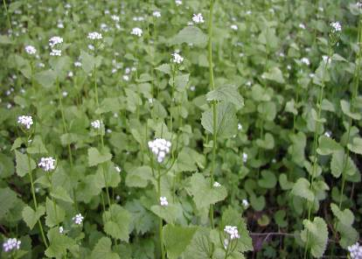
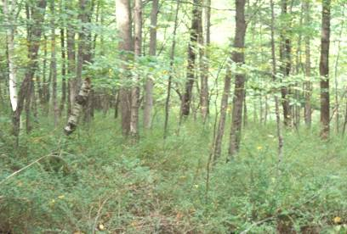
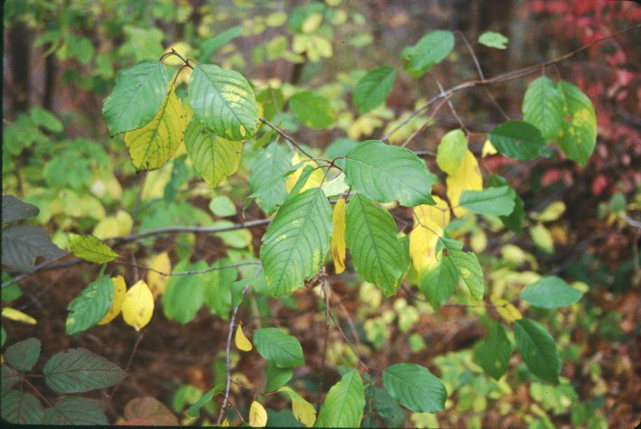
Invasive Species on Land Trust Lands
What can land trusts do?
Dr. Julie Richburg
Regional Ecologist, The Trustees

Slide 2
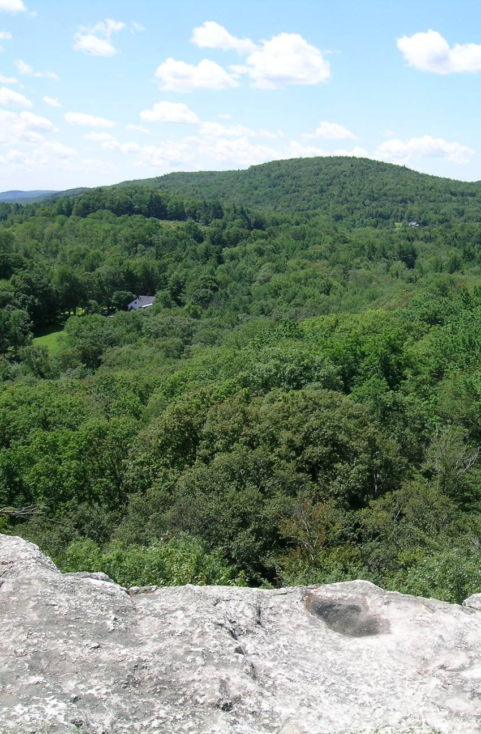
What I’ll cover:
Land Trust information
Deciding what to do
Invasive species projects
Chapel Brook Reservation

Slide 3





What is a land trust?
Massachusetts is home to the country’s first land trusts, arising during the late1800s to protect land for public use.
1890
1900
1910
(TTOR 1891, Sierra Club 1892, MAS 1896, USFS 1905, NPS 1916)

Slide 4

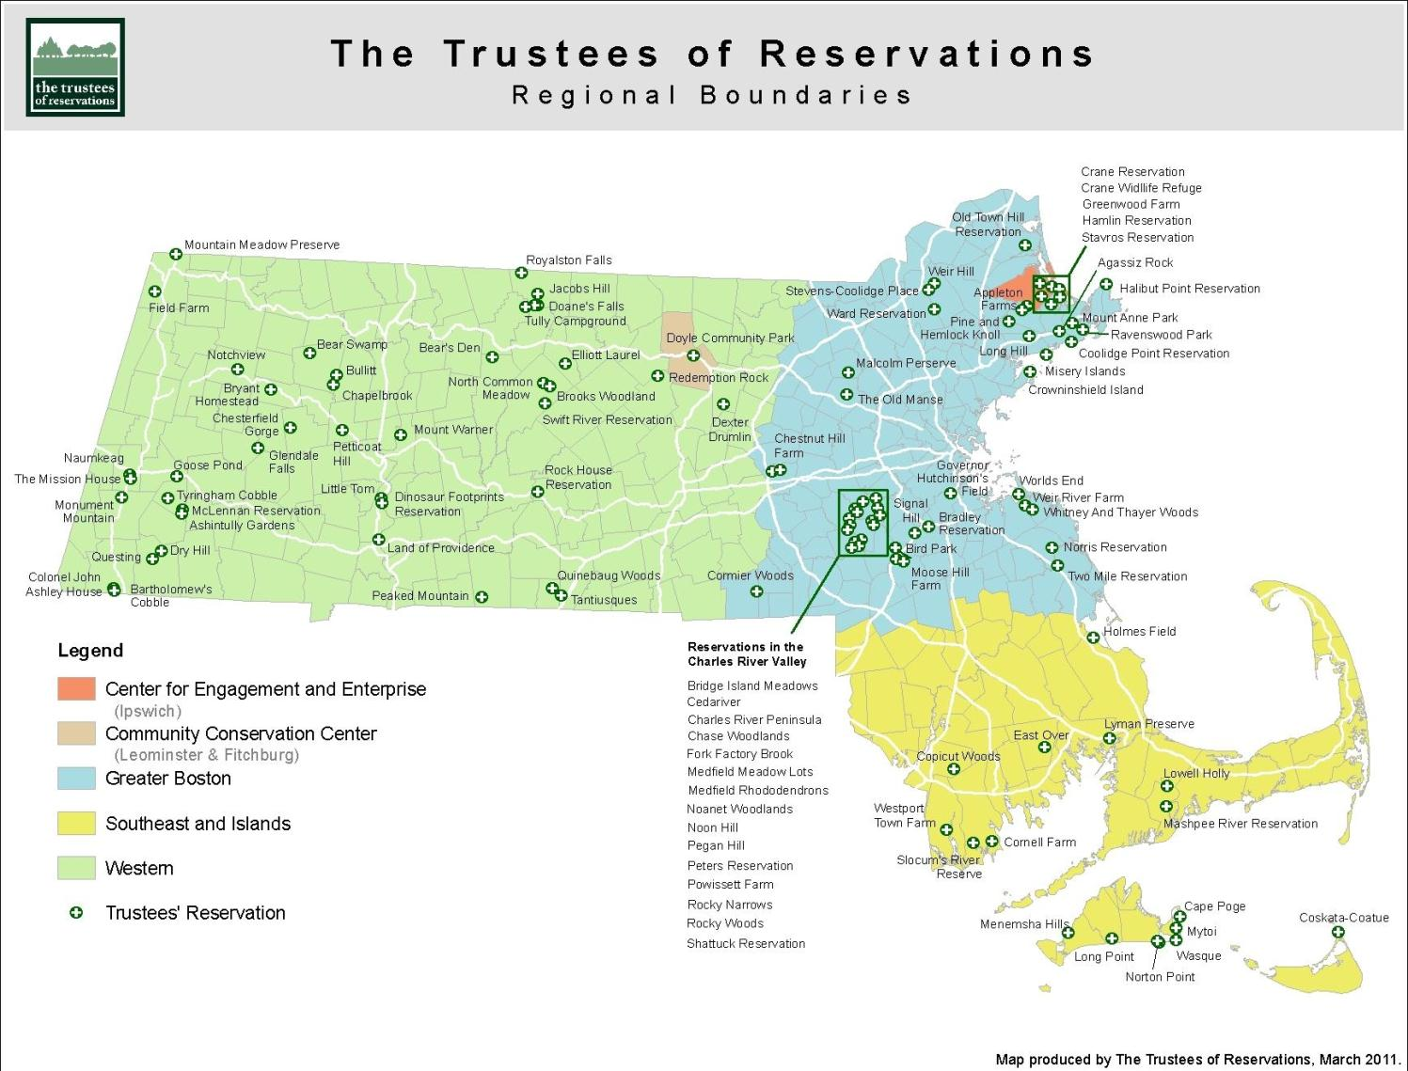
110+ reservations & growing!
More than 25,000 acres +19,000 acres in CRs
Notes:
4
Many of you have known us for a little while now, and have probably seen us grow. We’re up to 105 properties across the State now…
GOAL: WHO WE ARE, WHAT WE DO AND WHERE WE’RE GOING...
WHAT ARE SOME OF OUR PROPERTIES?

Slide 5

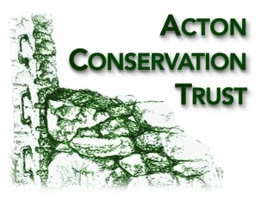



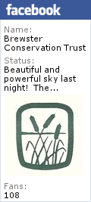




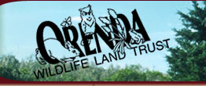
Do you know of a land trust
in your community?
National
Statewide
Regional
Local
Currently there are over 140 land trusts in the Commonwealth.

Slide 6
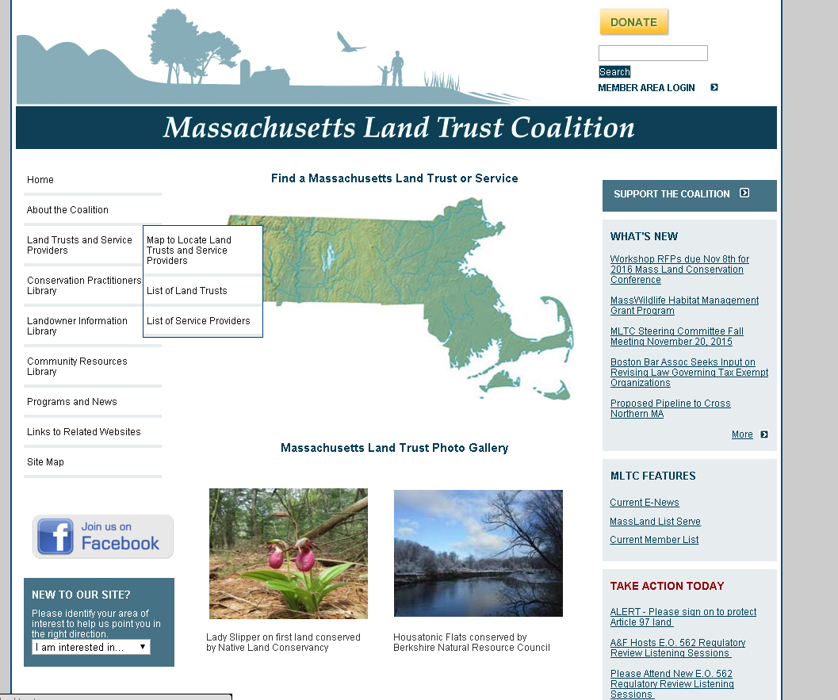

Slide 7






Other groups doing invasives management
Town Conservation Commissions
Town Open Space Commities
Watershed Societies
State Parks – Friends Groups
Sportsmen’s Clubs

Slide 8
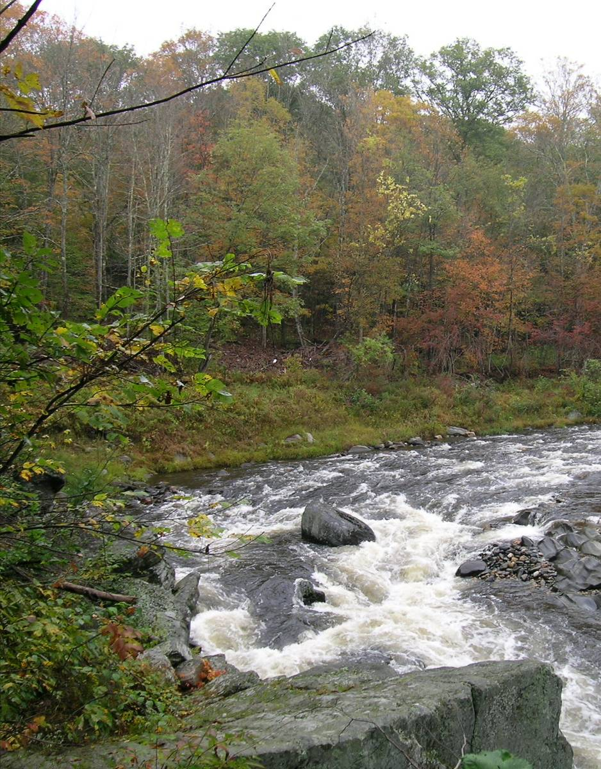
What I’ll cover:
Land Trust information
Deciding what to do
Invasive species projects
Chesterfield Gorge Reservation

Slide 9
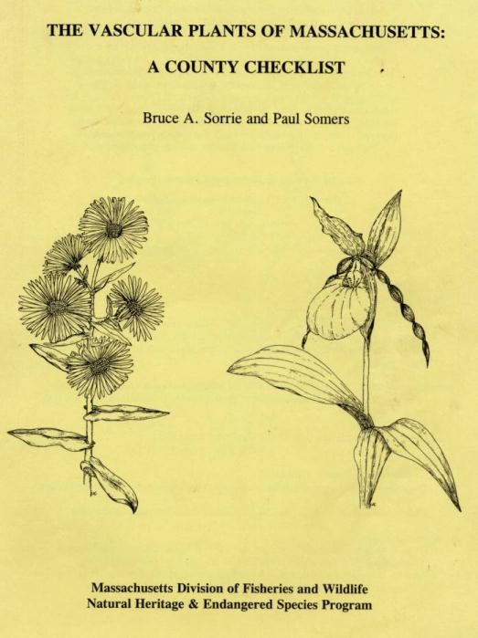
alien
introduced
non-native
Published in 2011
Almost 3,000 plant species
33% of species are non-native
Naturalized
Deliberately or accidentally
non-indigenous
exotic
Notes:
Also introduced. Deliberately or accidentally.

Slide 10
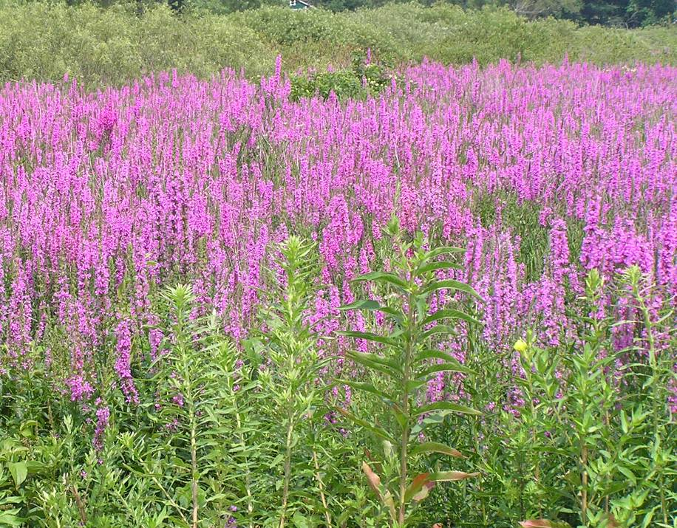
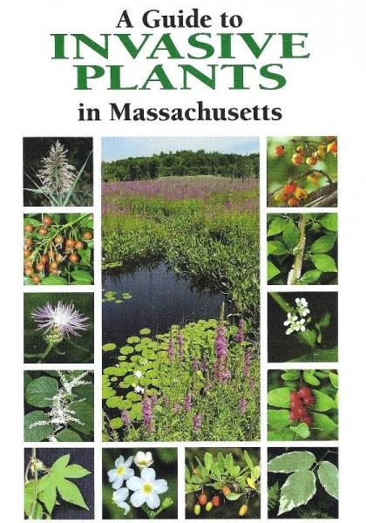
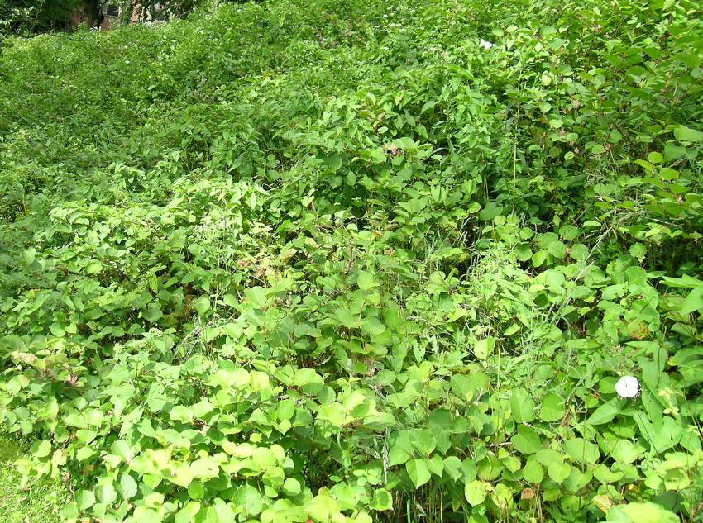
But only 10% of non-natives are
Invasive
Notes:
1/3 of Massachusetts plants are not native. Of these only 10% are considered invasive in natural areas

Slide 11
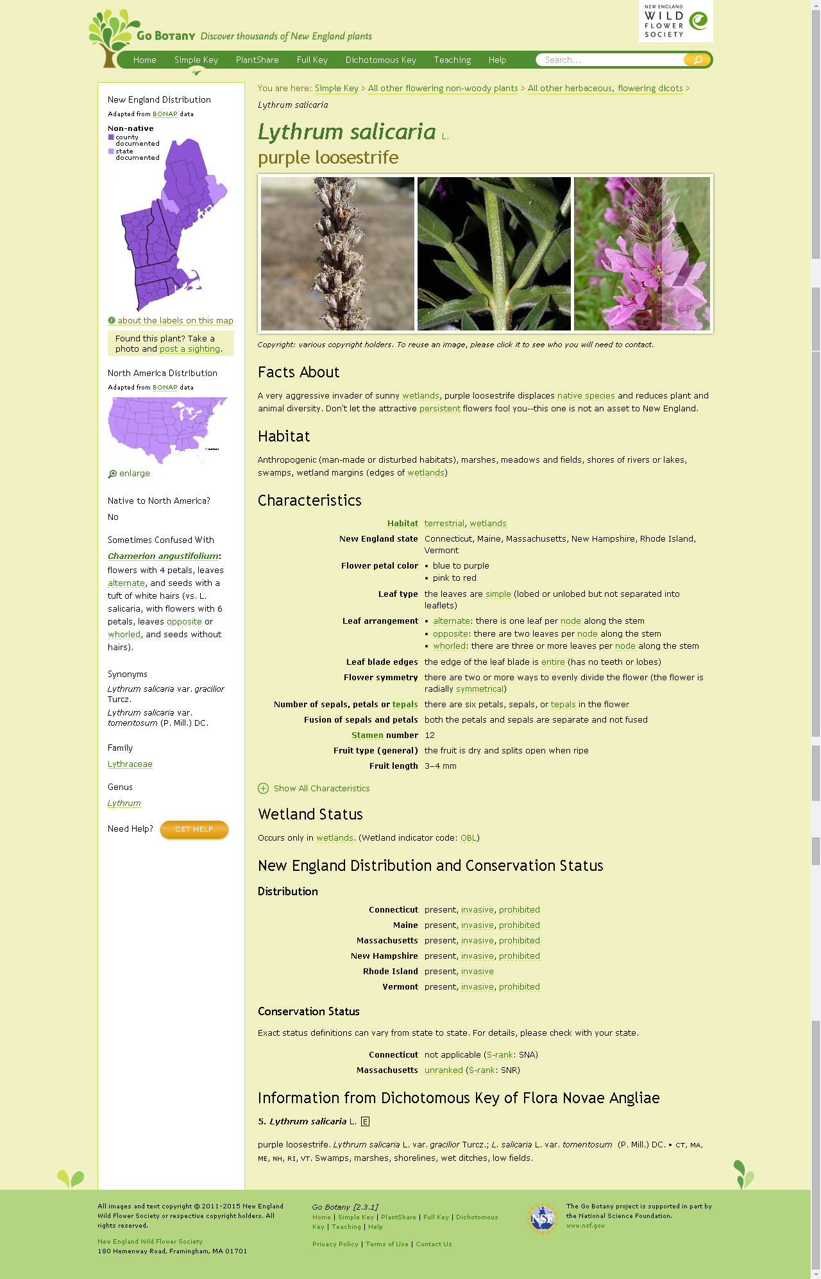

A good resource
for plant species
specific information

Slide 12
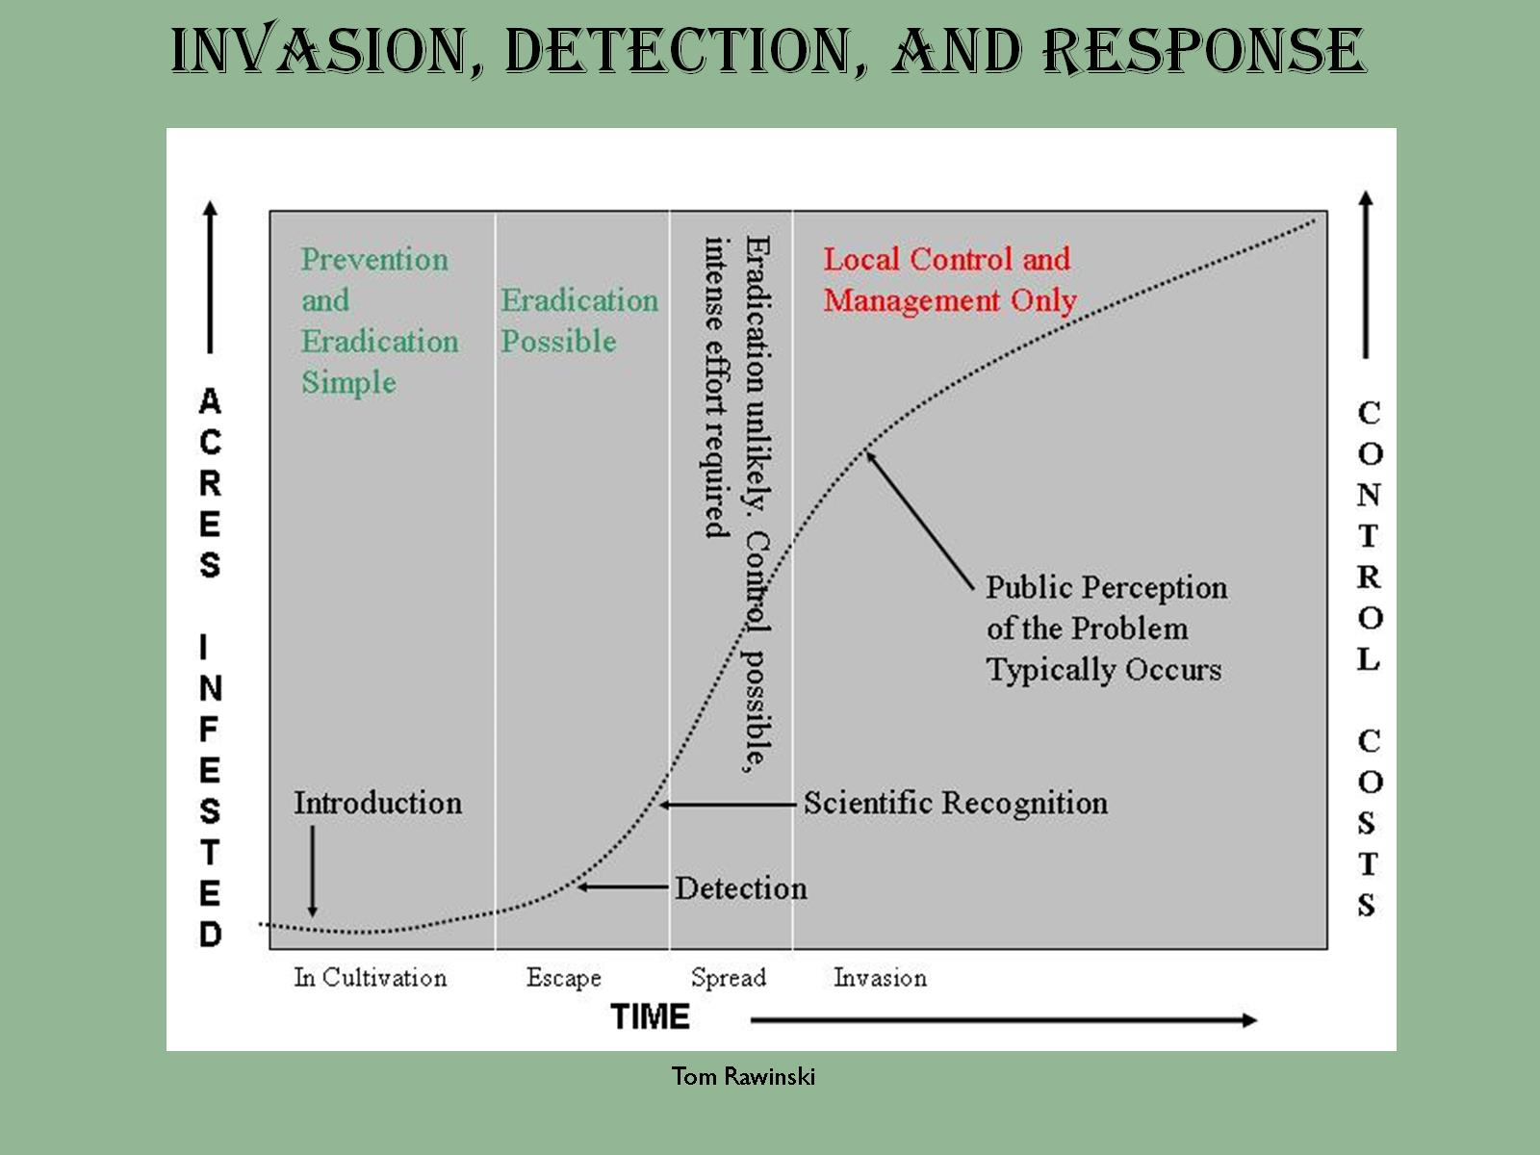

Slide 13
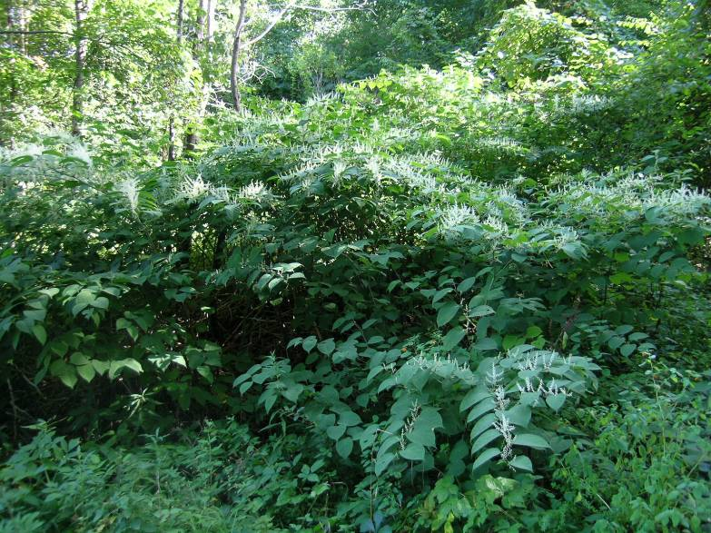

Invasive Plant Management:
Guidelines for Managers
2008
Prevention
Early Detection and Rapid Response
Control and Management
Education and Public Awareness

Slide 14
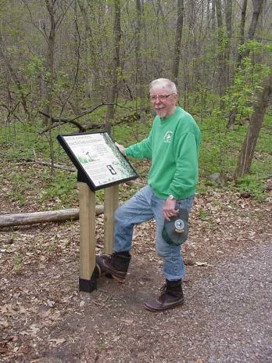
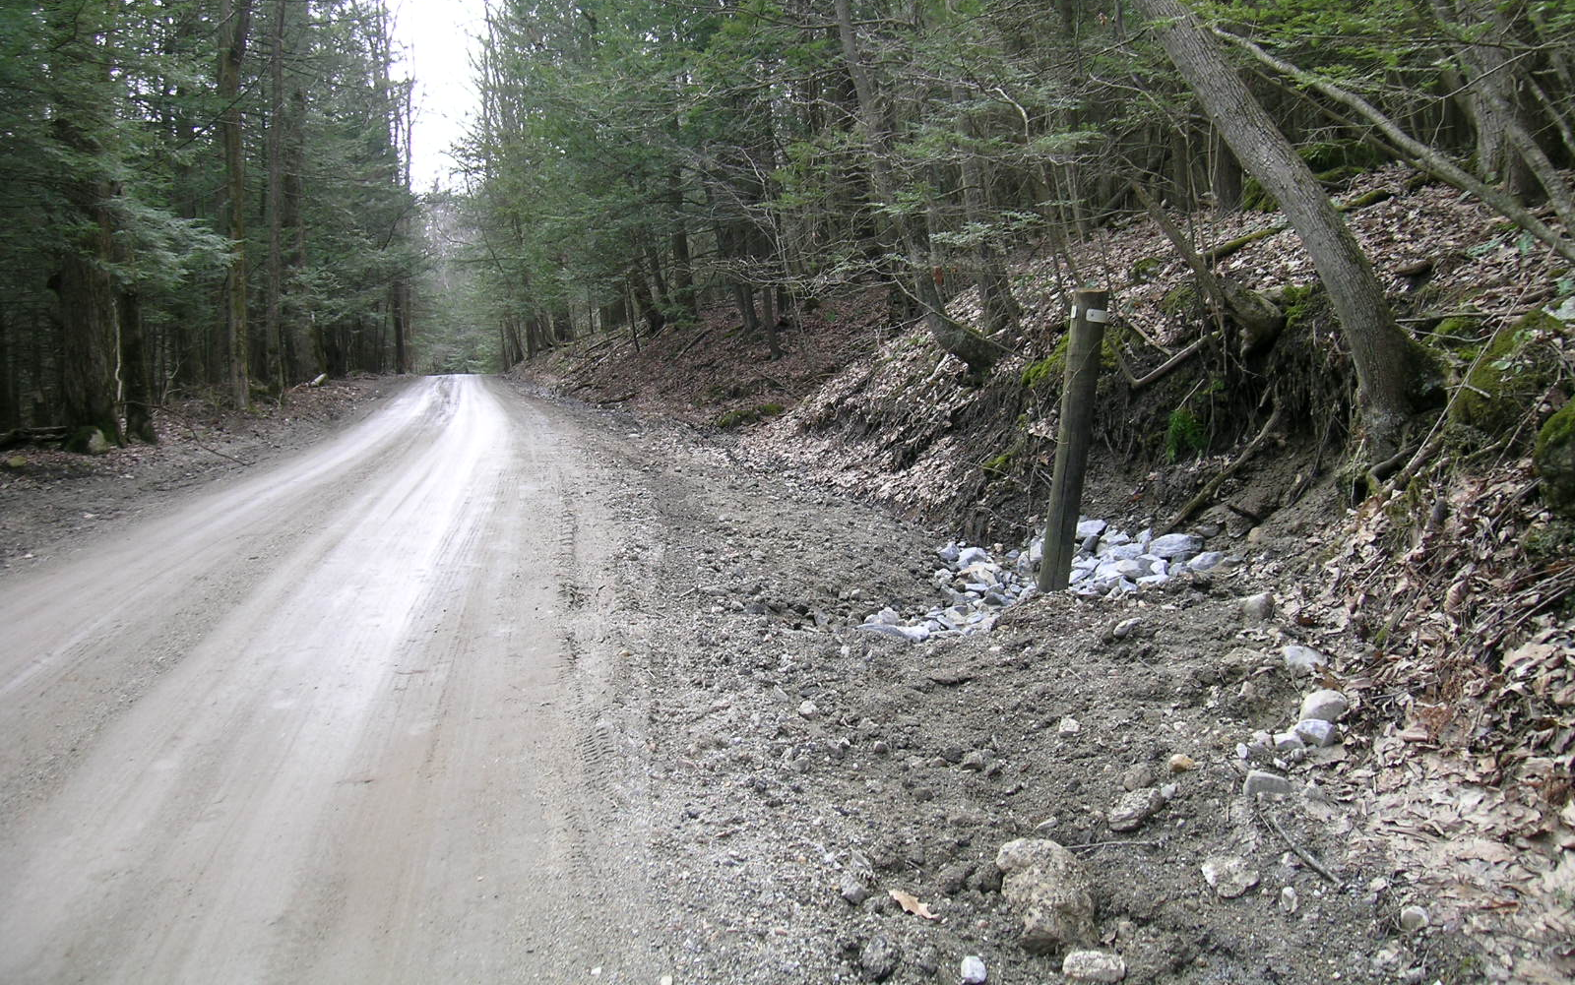
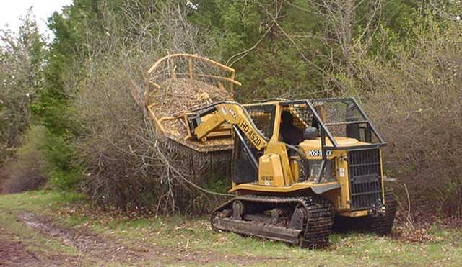
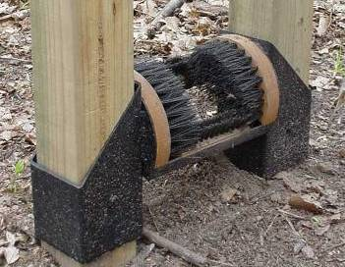
Prevention

Slide 15
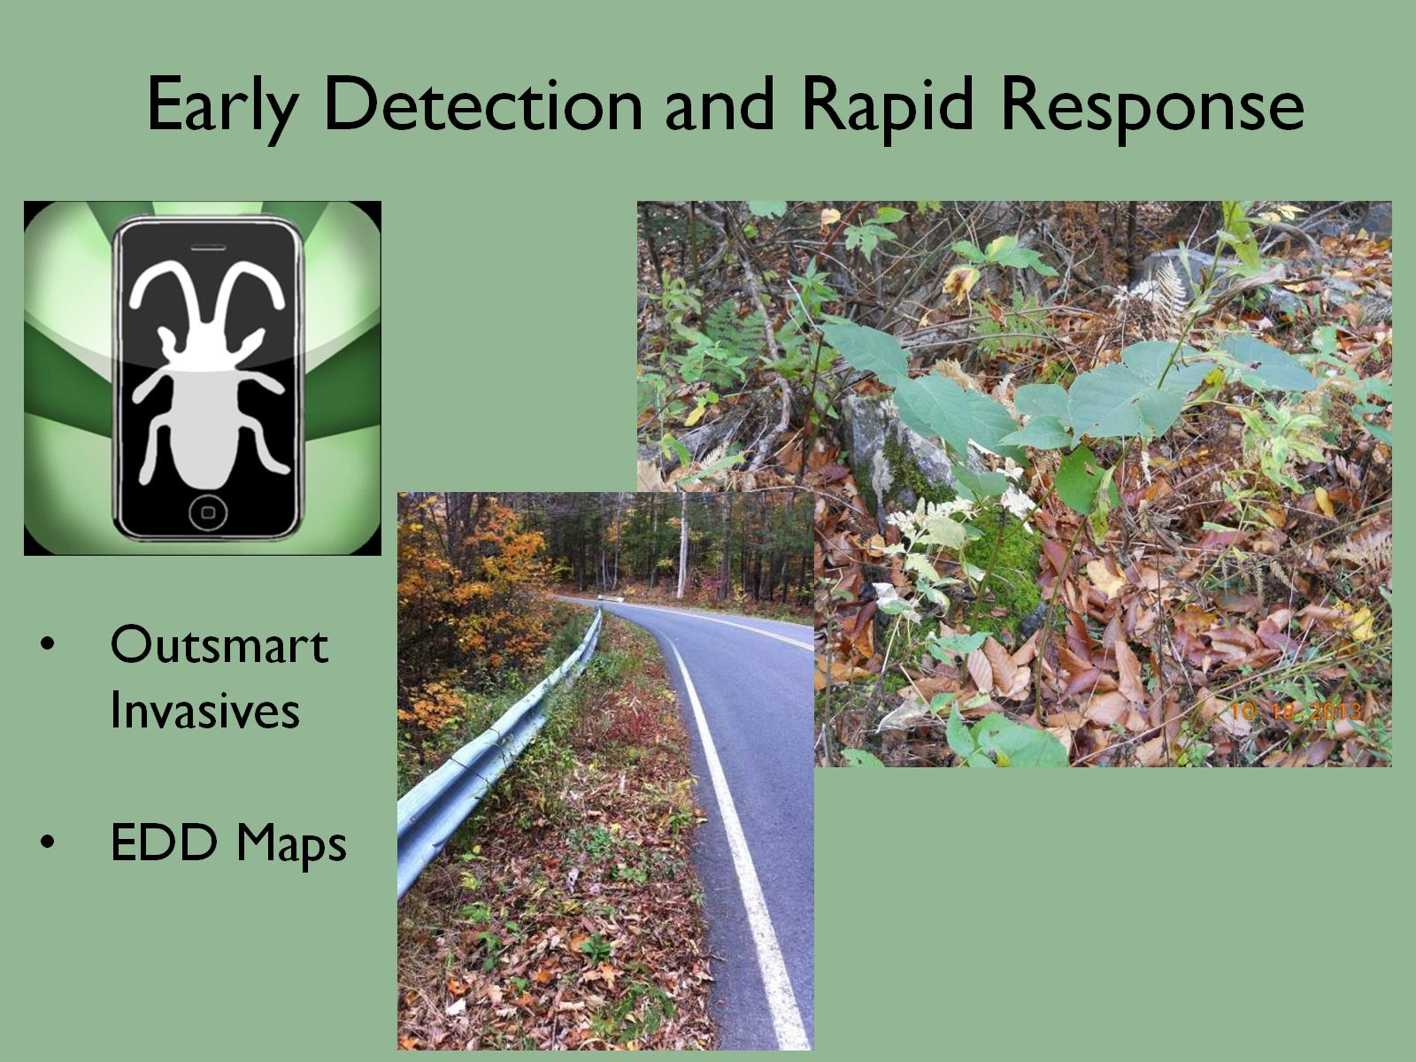
Training videos

Slide 16
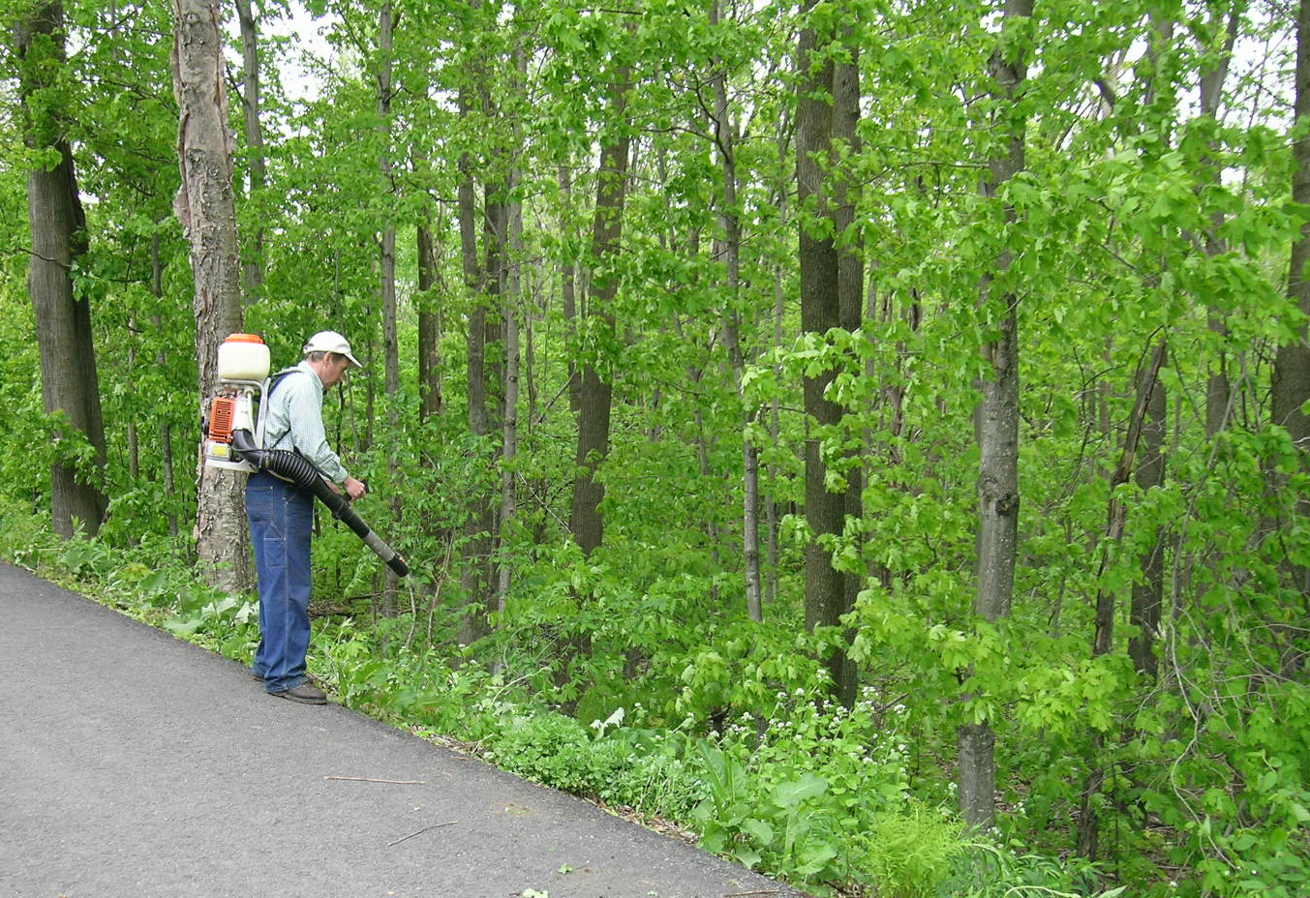
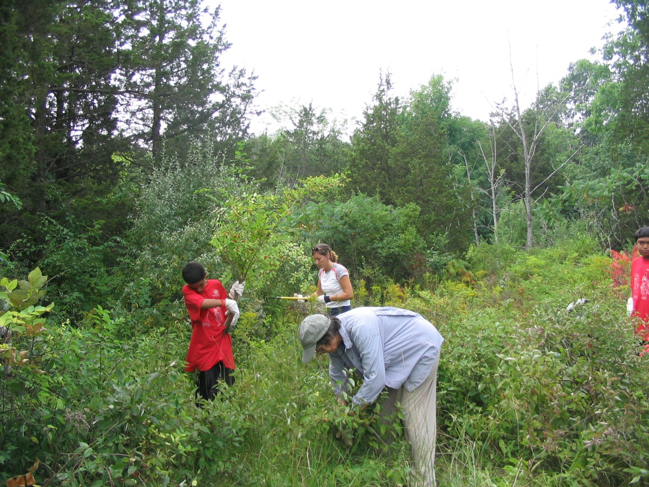
Control and Management
Where should I work?
What species should I control?

Slide 17
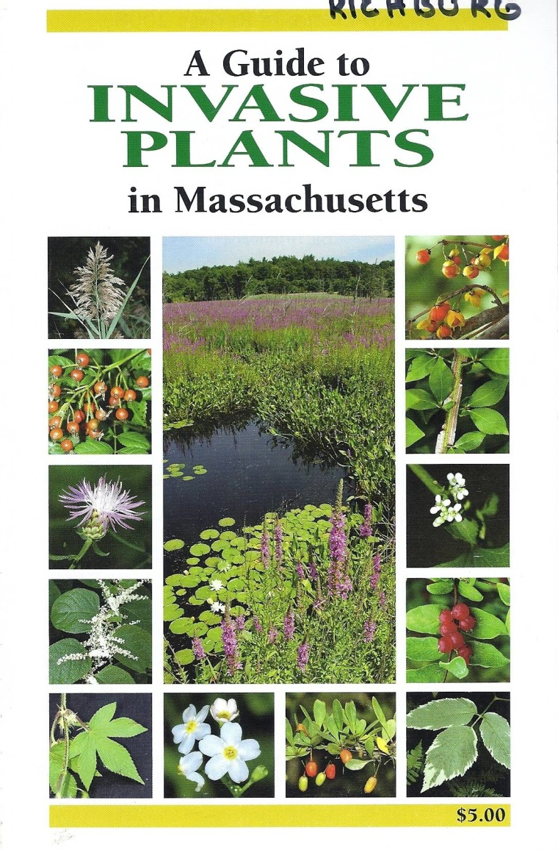
Principles
Control of all non-native species is impractical
and not necessary
33% of our Massachusetts flora are not native
But
only 10% of those are invasive

Slide 18
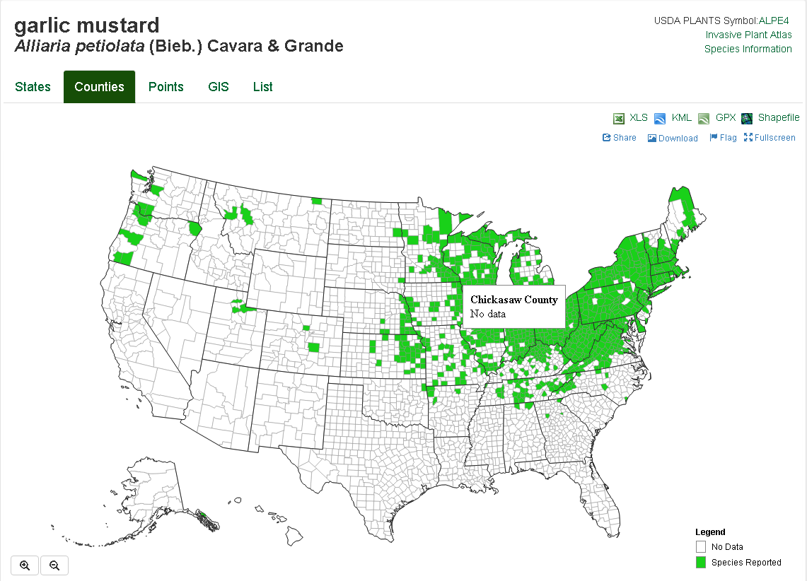
Principles
Control efforts need to be prioritized
at appropriate levels
Region
State
County
Watershed
Town
Property ………

Slide 19
 | Weed-led | Site-led
Purpose | Prevent new weed species. | Protect valuable places.
Scale | Look at entire region or statewide. | A defined area within a management unit.
Species focus | “New” species | Often widespread weeds.
Sites | All infestations within a region, on sites of any quality and ownership | Infestations within the place
Success when….. | The species is eradicated or contained within the region. | The native species or natural community responds in a desired way

Slide 20
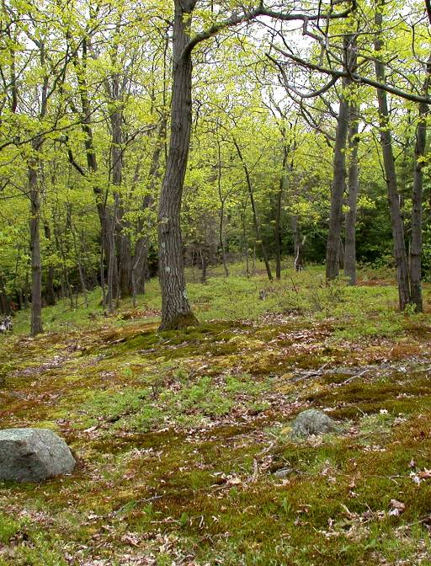
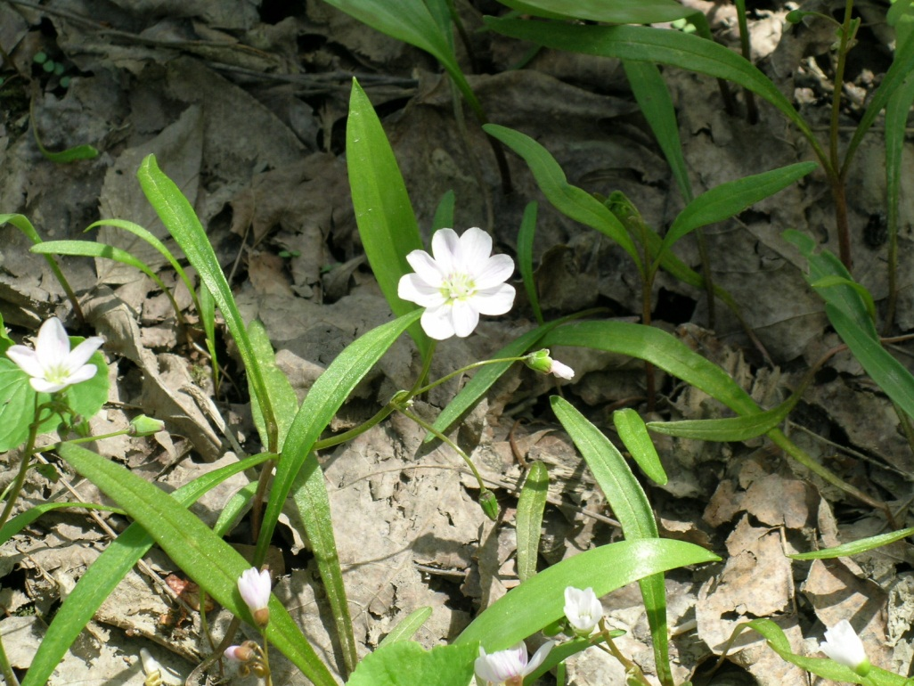
Principles
Control efforts should focus on important values
and features

Slide 21
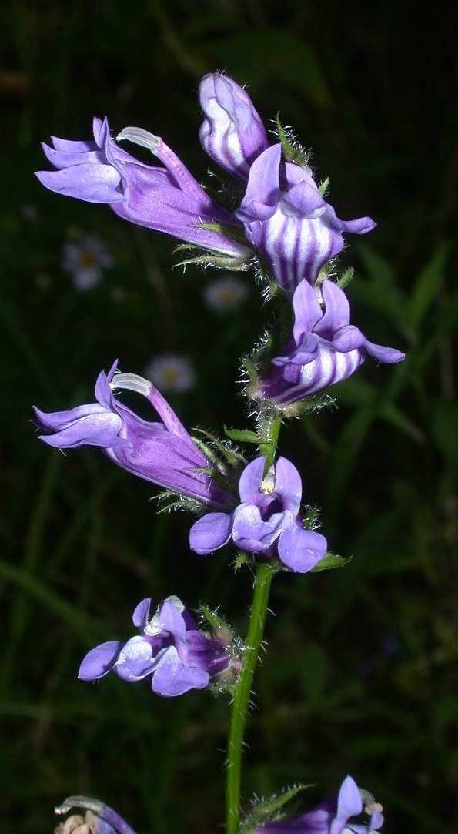
Identify important resources
TTOR control efforts will focus on invasive species that are:
threatening rare species or priority communities.
compromising the ecological integrity of habitats.

Slide 22
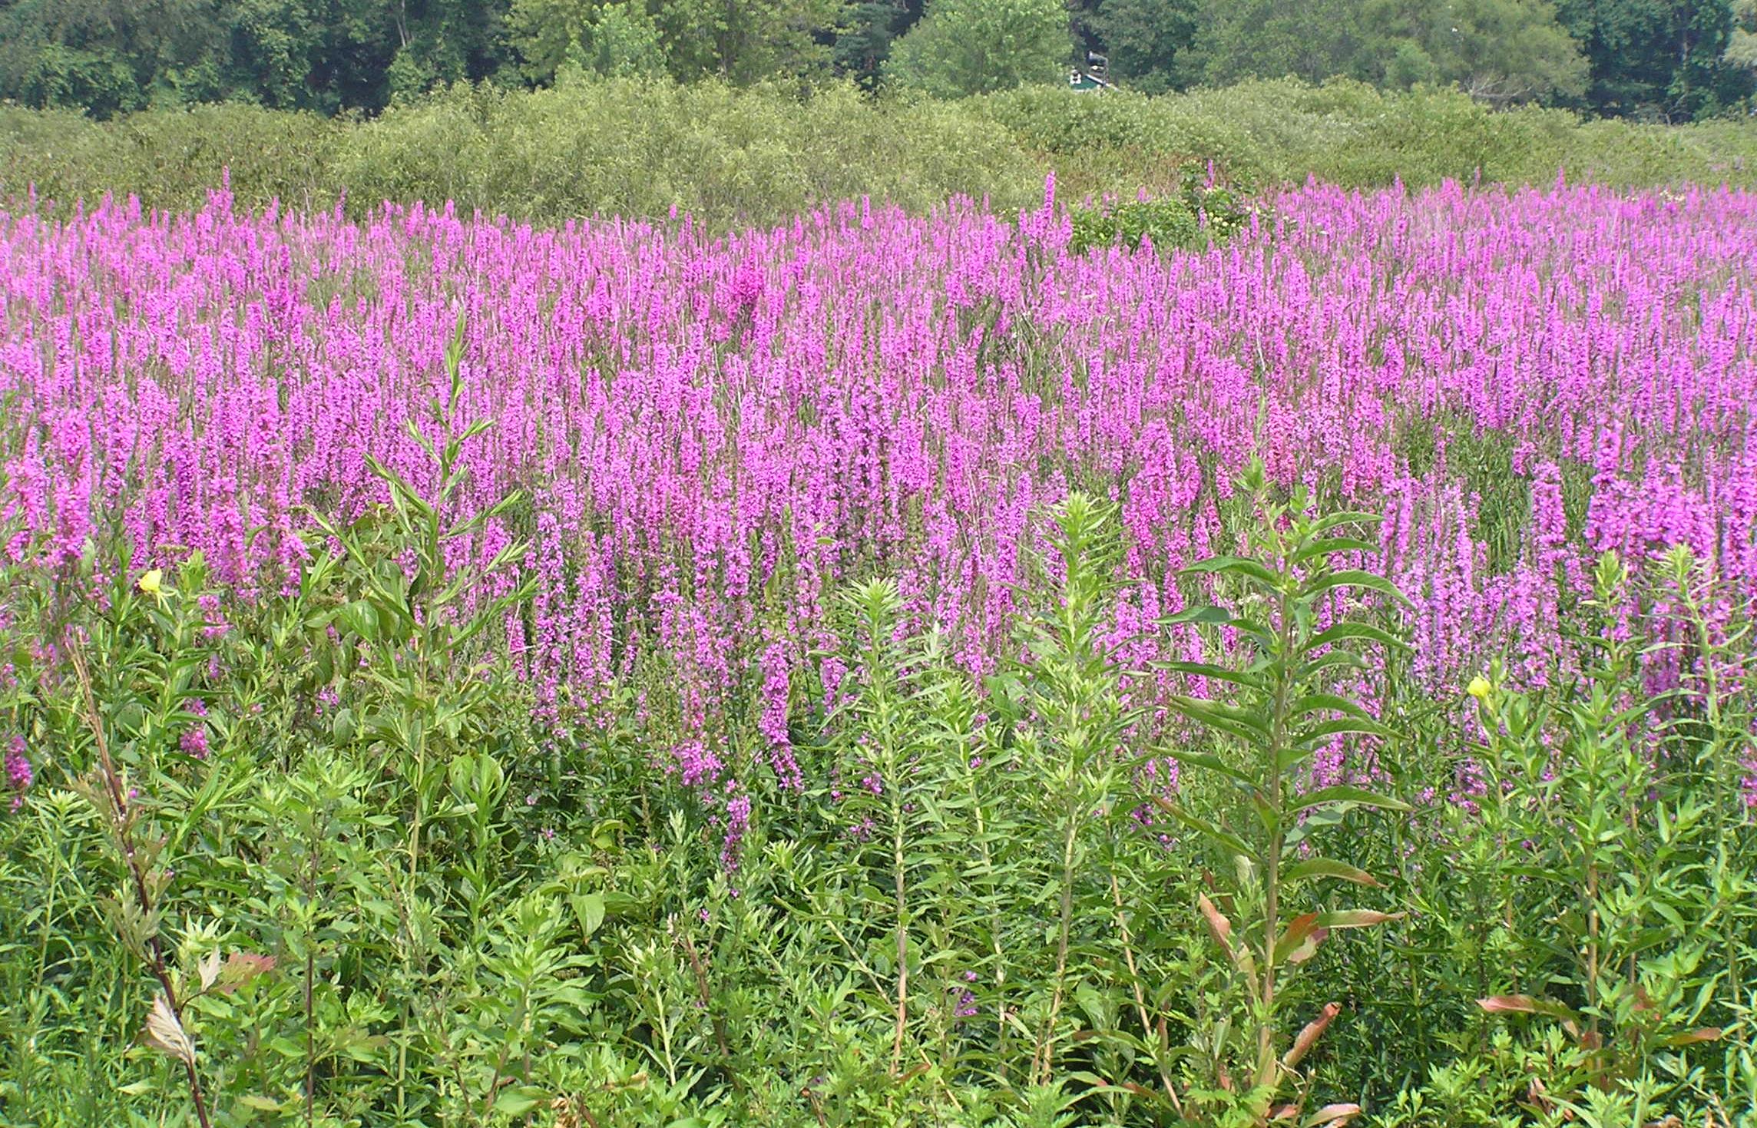
Principles
Resources should be used wisely

Slide 23
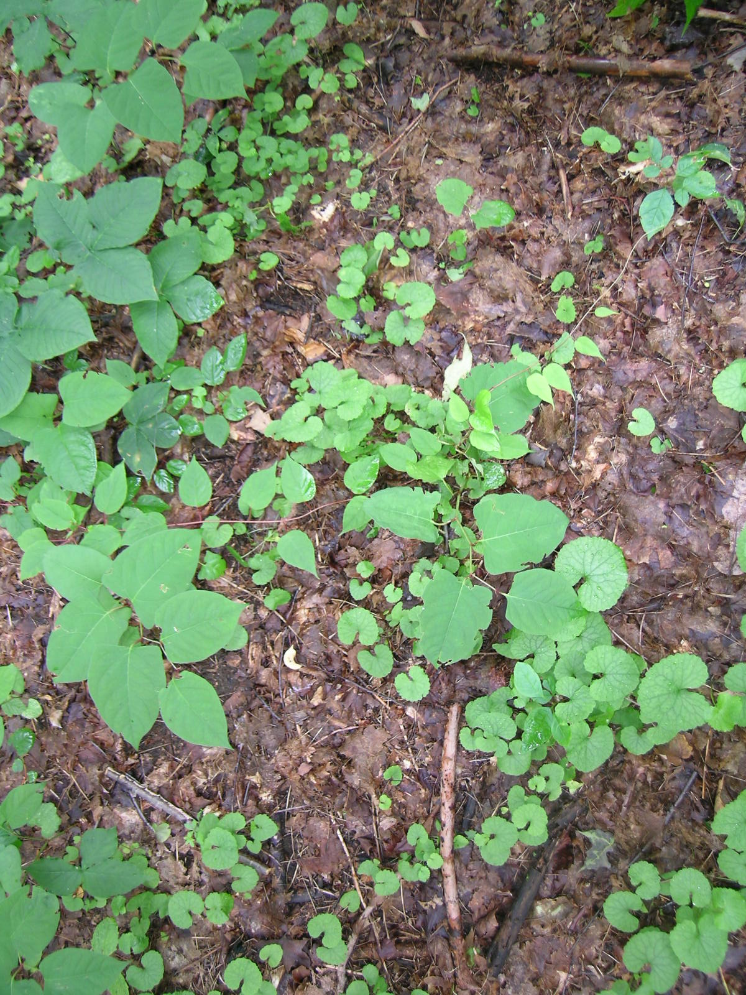
Identify invasive species population sizes & locations
New infestation or well-established
Patchy distribution or more uniform
Proximity to important resources
How invasive is the species in my area

Slide 24
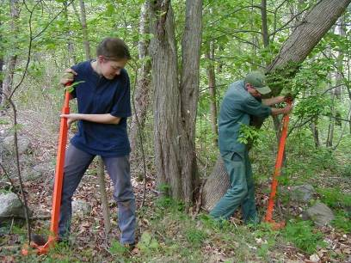
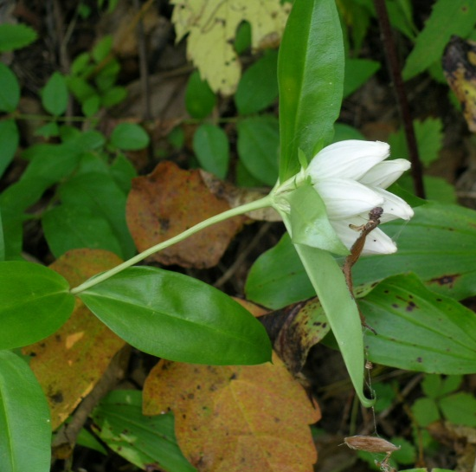
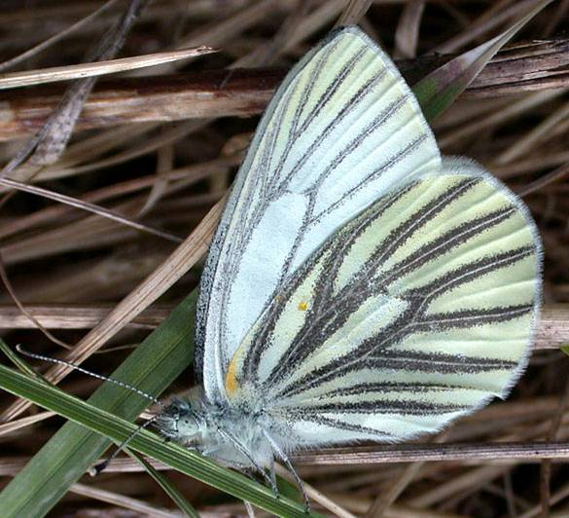
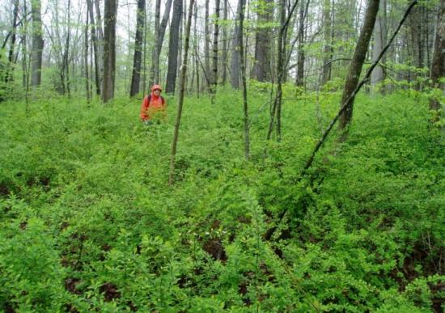
Prioritize populations for management
significance of the resource.
existence of effective control methods
potential for long-term control.
Eradicate, suppress, contain
Notes:
Eradication – completely remove (including seed bank) with low likelihood for reinvasion
Suppression – below a threshold that mitigates harm or impact
Contain – prevent them from getting into uninvaded areas

Slide 25
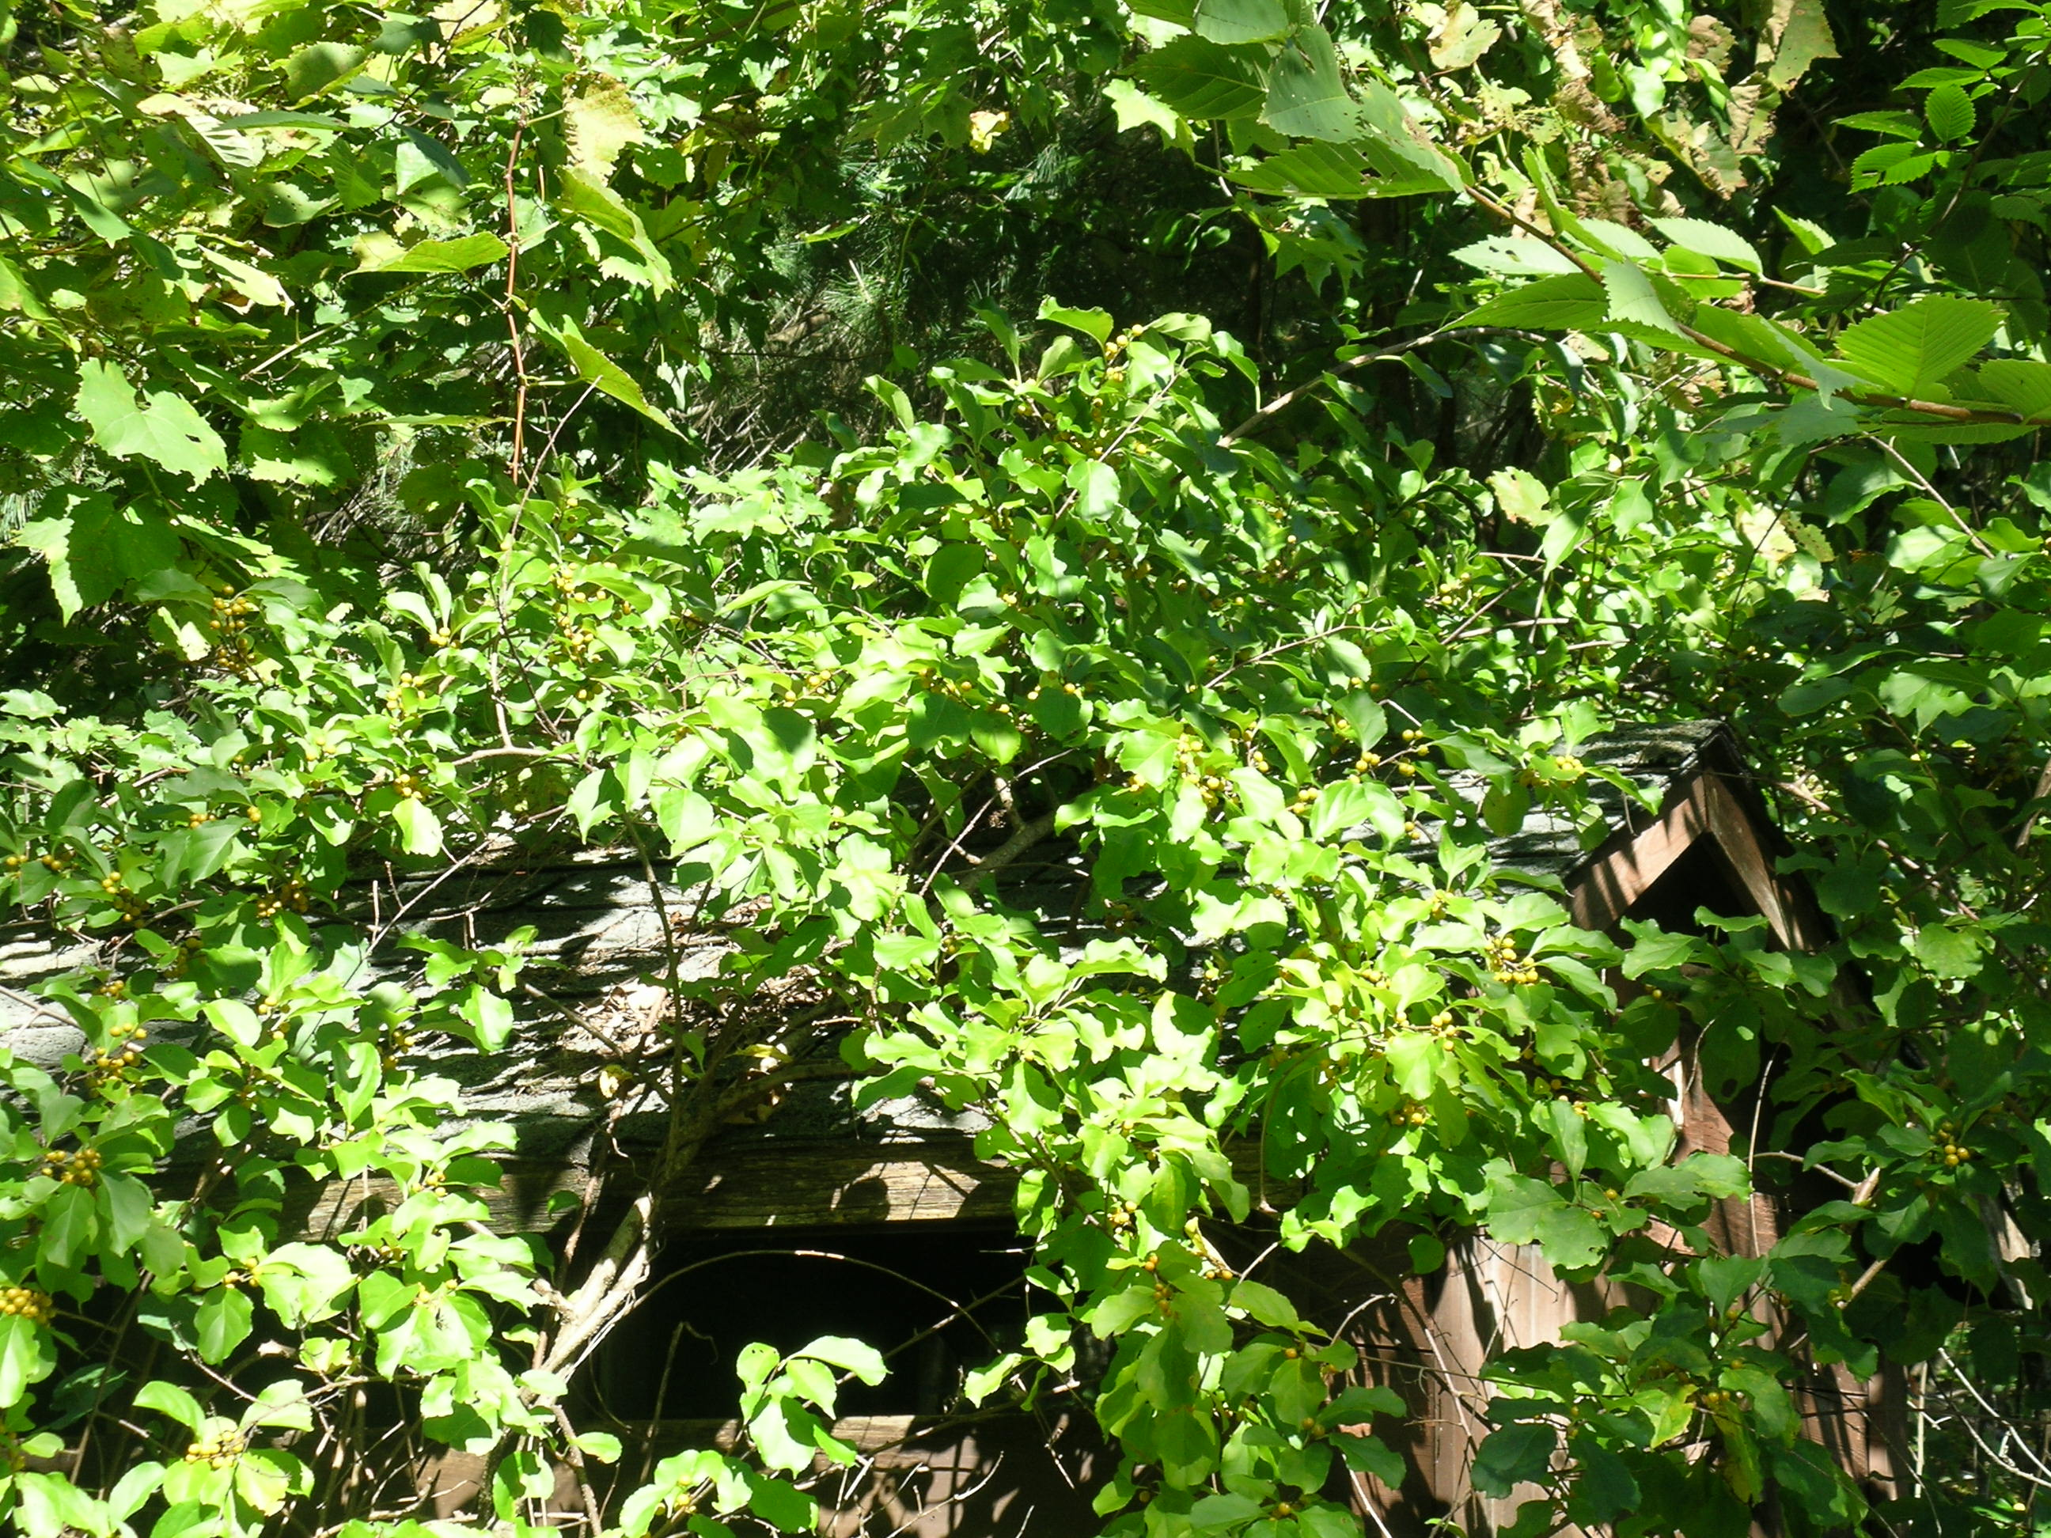
The hardest decision is to decide
NOT to do anything

Slide 26
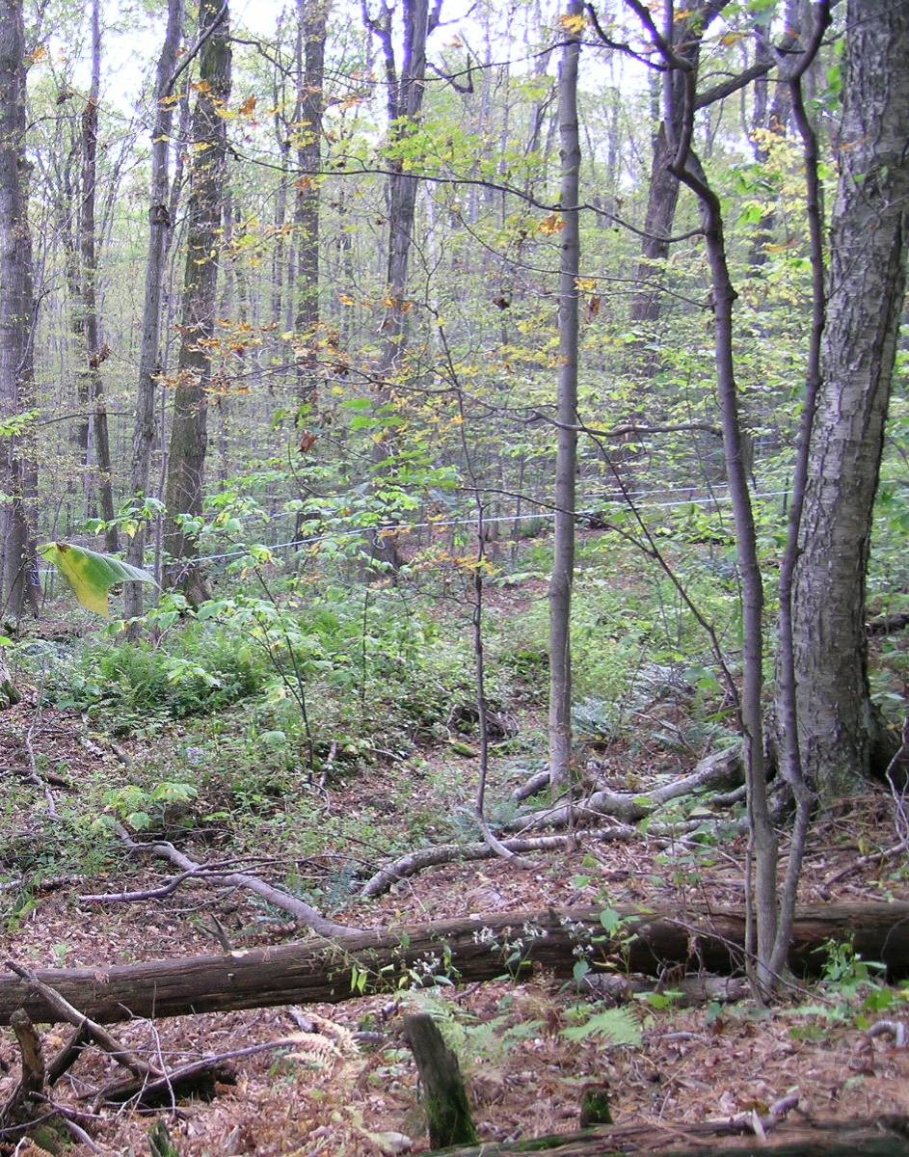
What I’ll cover:
Land Trust information
Deciding what to do
Invasive species projects
Bryant Homestead

Slide 27
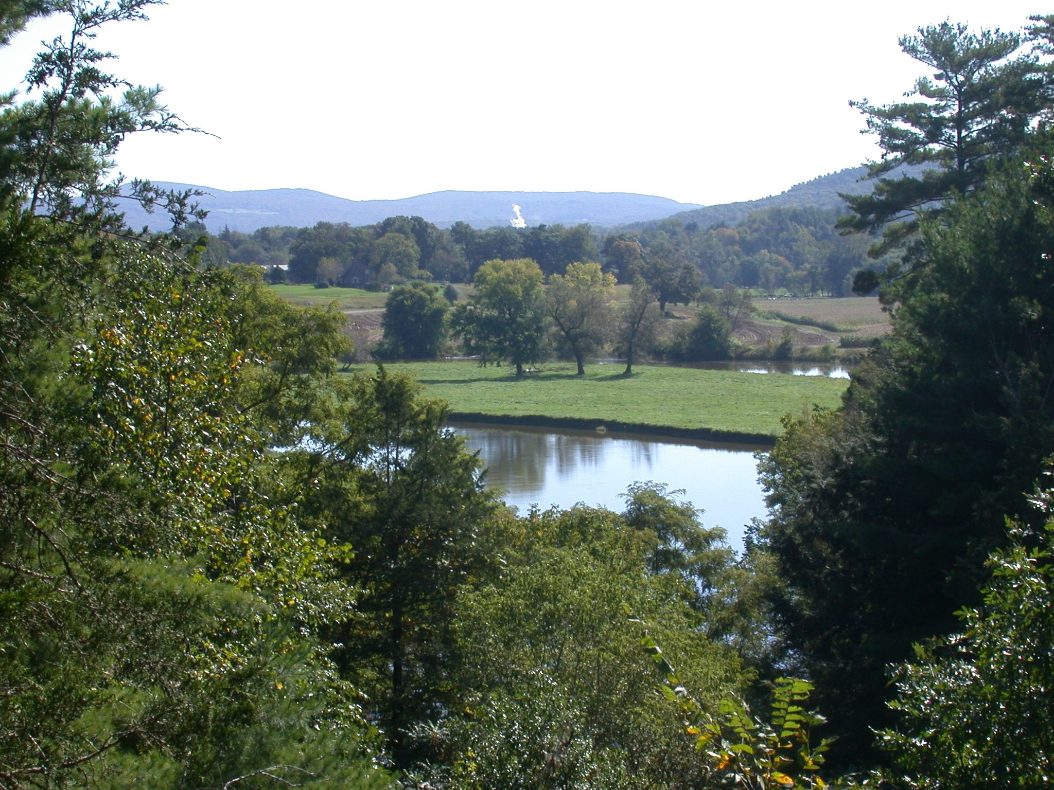
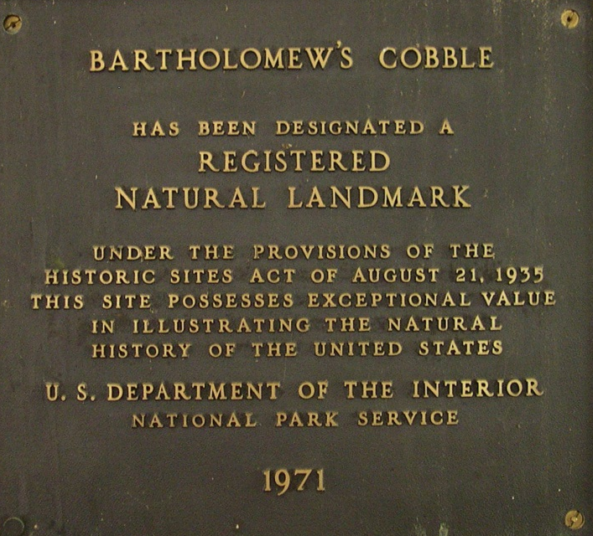
Bartholomew’s Cobble

Slide 28
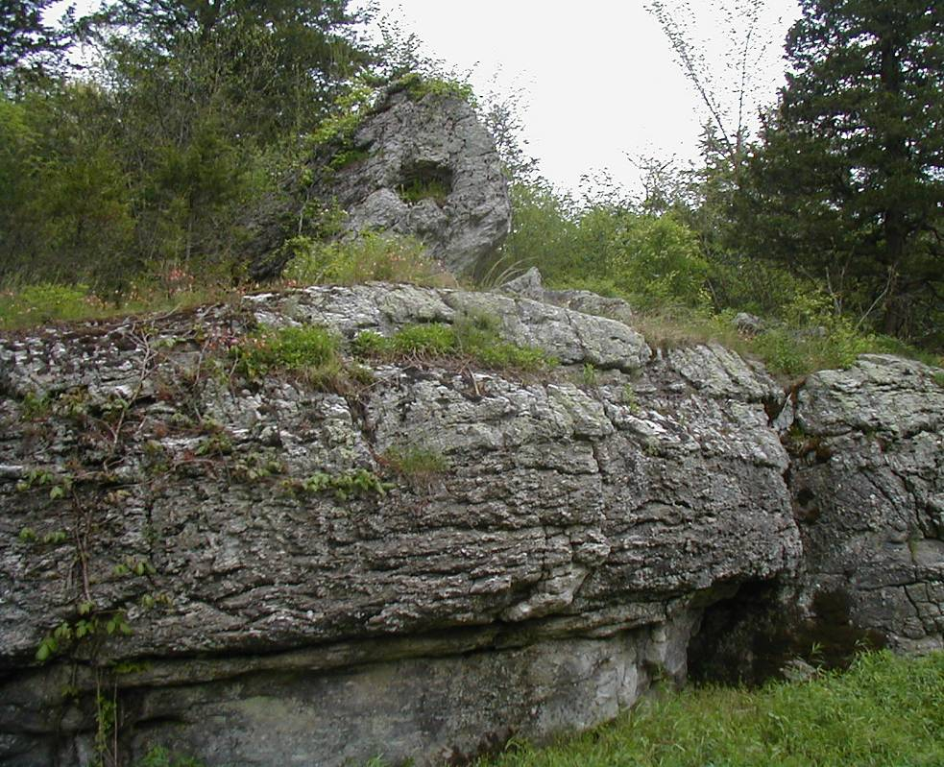
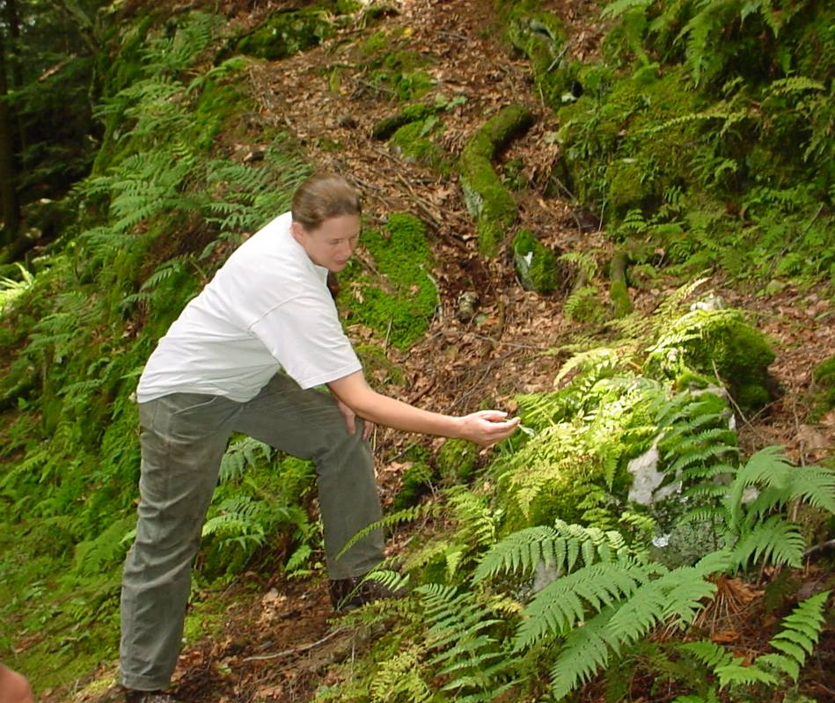
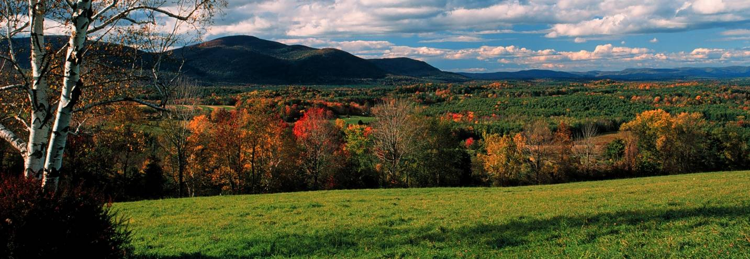
Bartholomew’s Cobble
Home to many rare species.

Slide 29
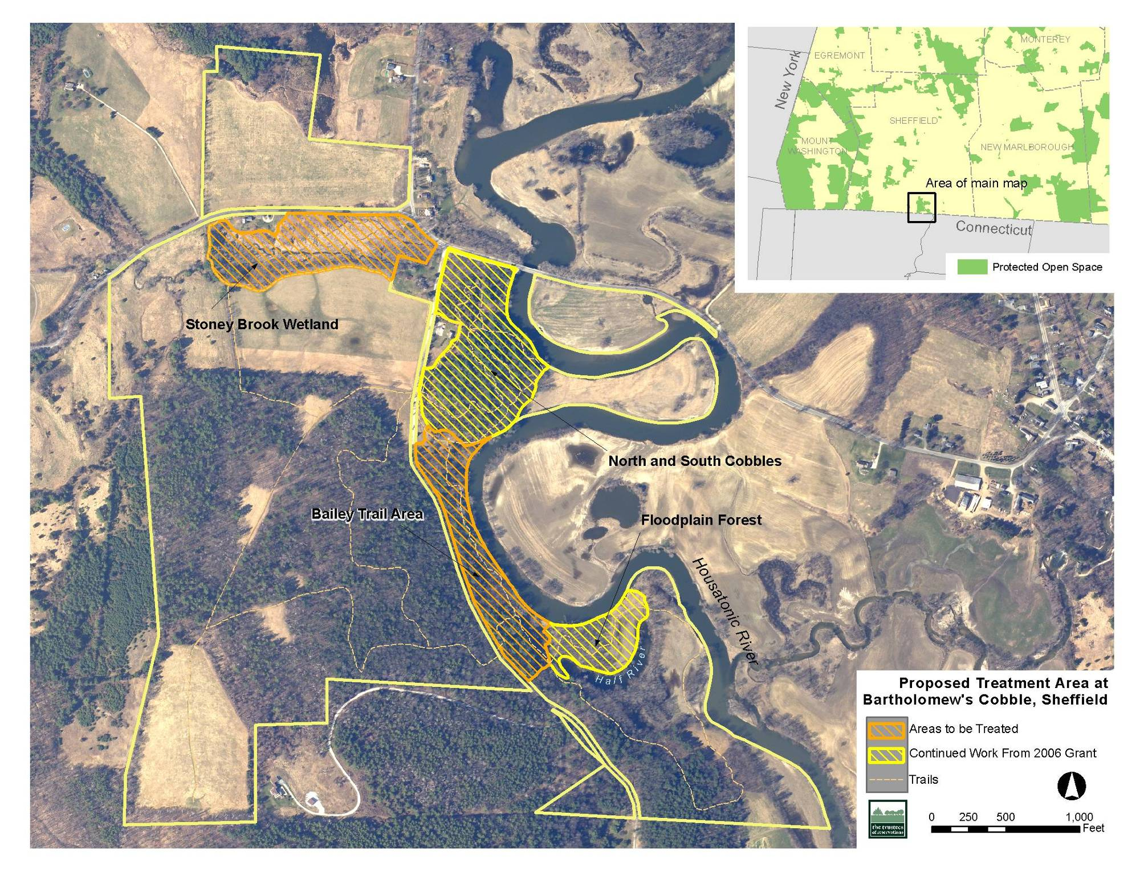

Slide 30
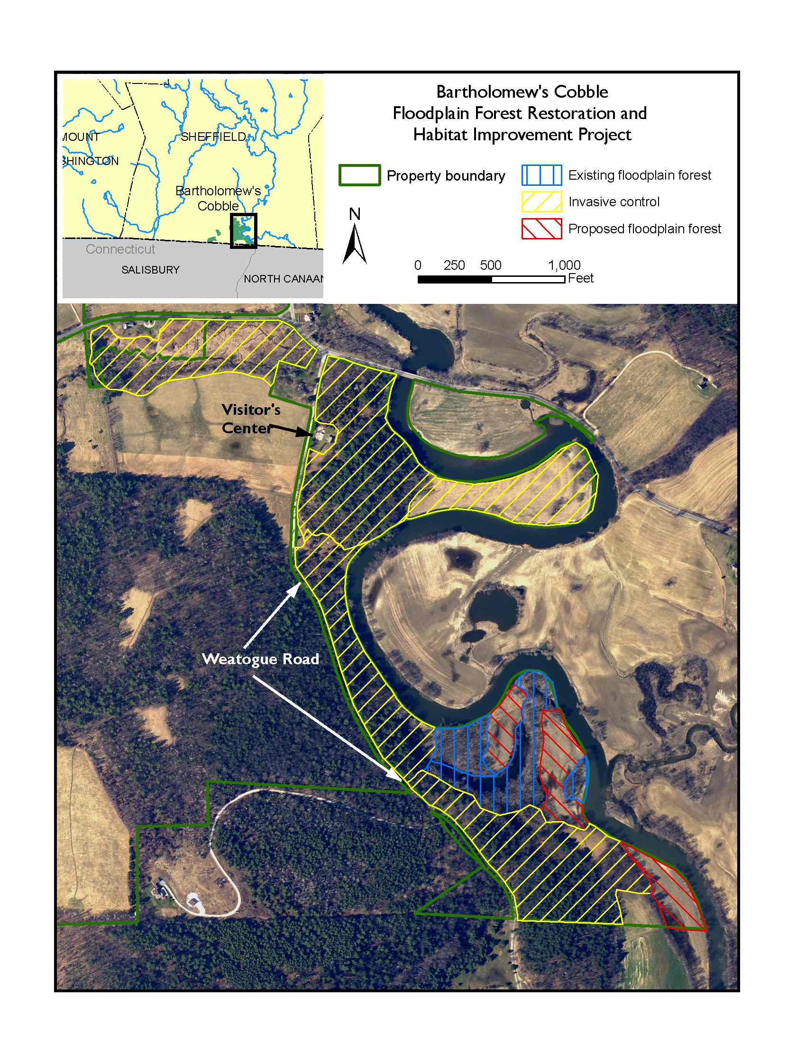
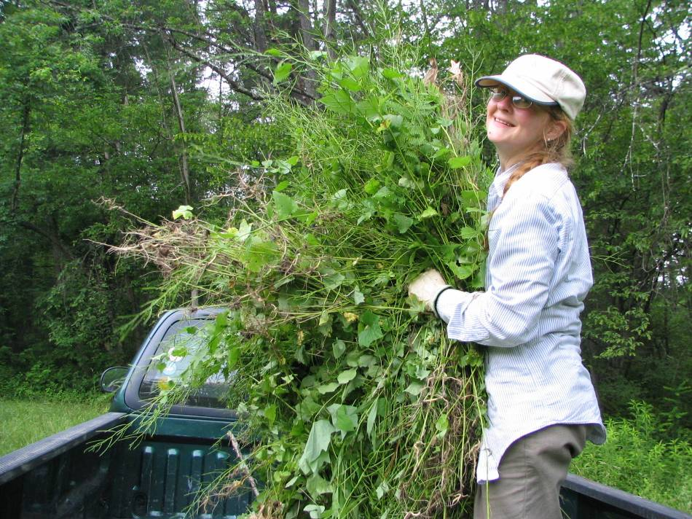


Slide 31
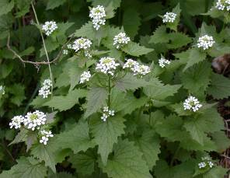
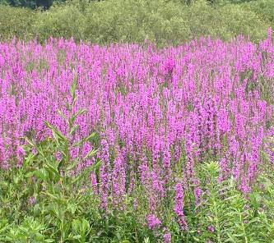
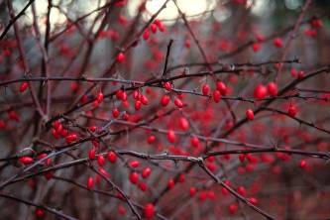
Bartholomew’s Cobble Invasive Species Plan
Species | Location | Comments (feasibility, impacts | Control Method | Prioritization Rank
 | South Cobble | Lots of rare species!! | Hand pull | High
 | Stoney Brook | Few individuals, keep from spreading | Dig & remove | Medium
 | Hurlburt’s Hill | Dense patches across > 50 acres | Foliar spray | No Action

Slide 32
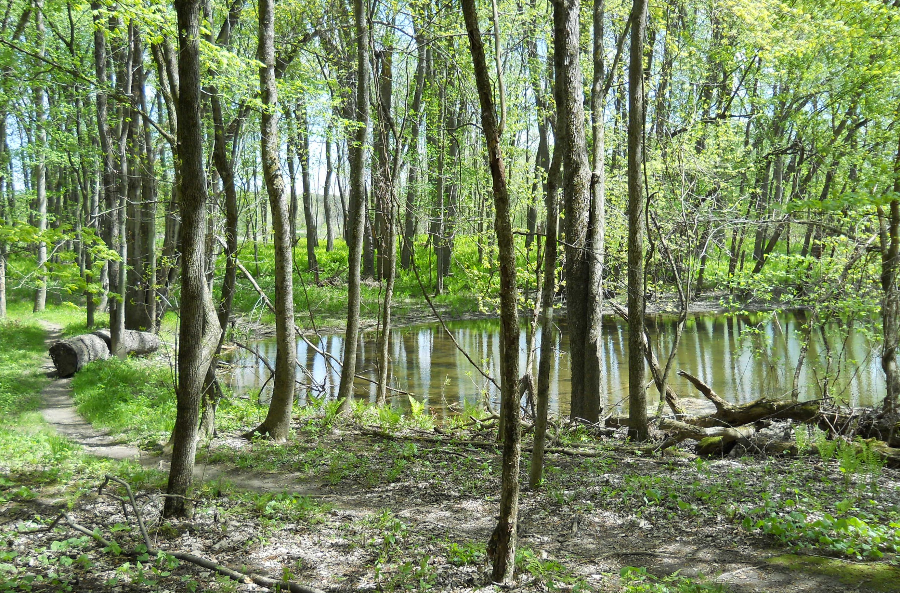

Slide 33

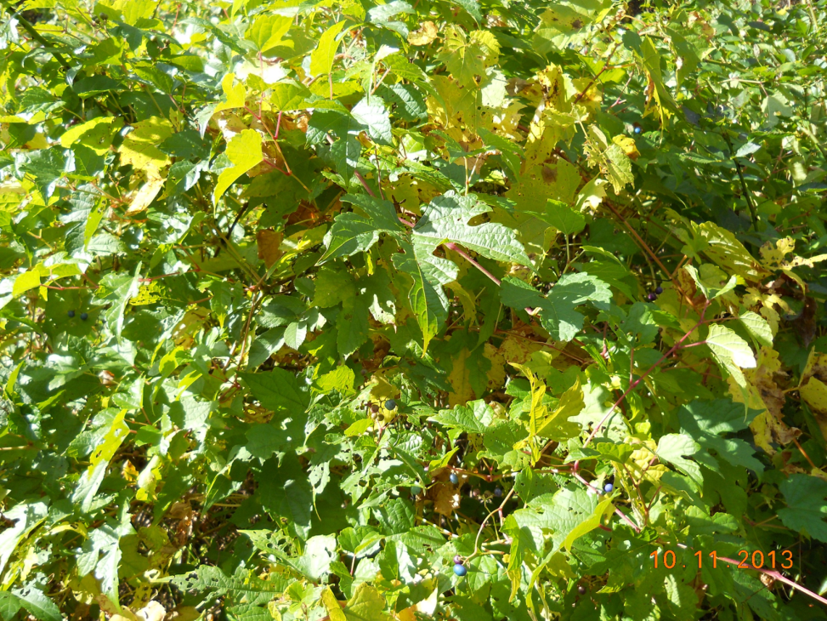


Adaptive Management

Slide 34


Dinosaur Footprints

Slide 35


8 acres along the Connecticut River
Rare species, footprints & Lots of invasive plants!

Slide 36



Notes:
Invasive plants present on all of our reservations, but to varying extents. What is the history of the property? Agricultural use, buildings, woodlot, pasture

Slide 37


Dinosaur Footprints Invasive Species Plan
Species | Location | Comments (feasibility, impacts | Control Method | Prioritization Rank
 | Footprint slab & surroundings | Rare species | Herbicide (targeted foliar) | High
 | Footprint slab, along trails, & surroundings | Population can be suppressed for benefit of native species | Hand pull or spray rosettes to suppress | Medium
 | Outside of rare species habitat | Dense patches |  | No Action

Slide 38

Any questions?

Slide 39

Know what doesn’t belong
Observe changes

Slide 40


Be Persistent

Slide 41



Be vigilant

