Slide 1
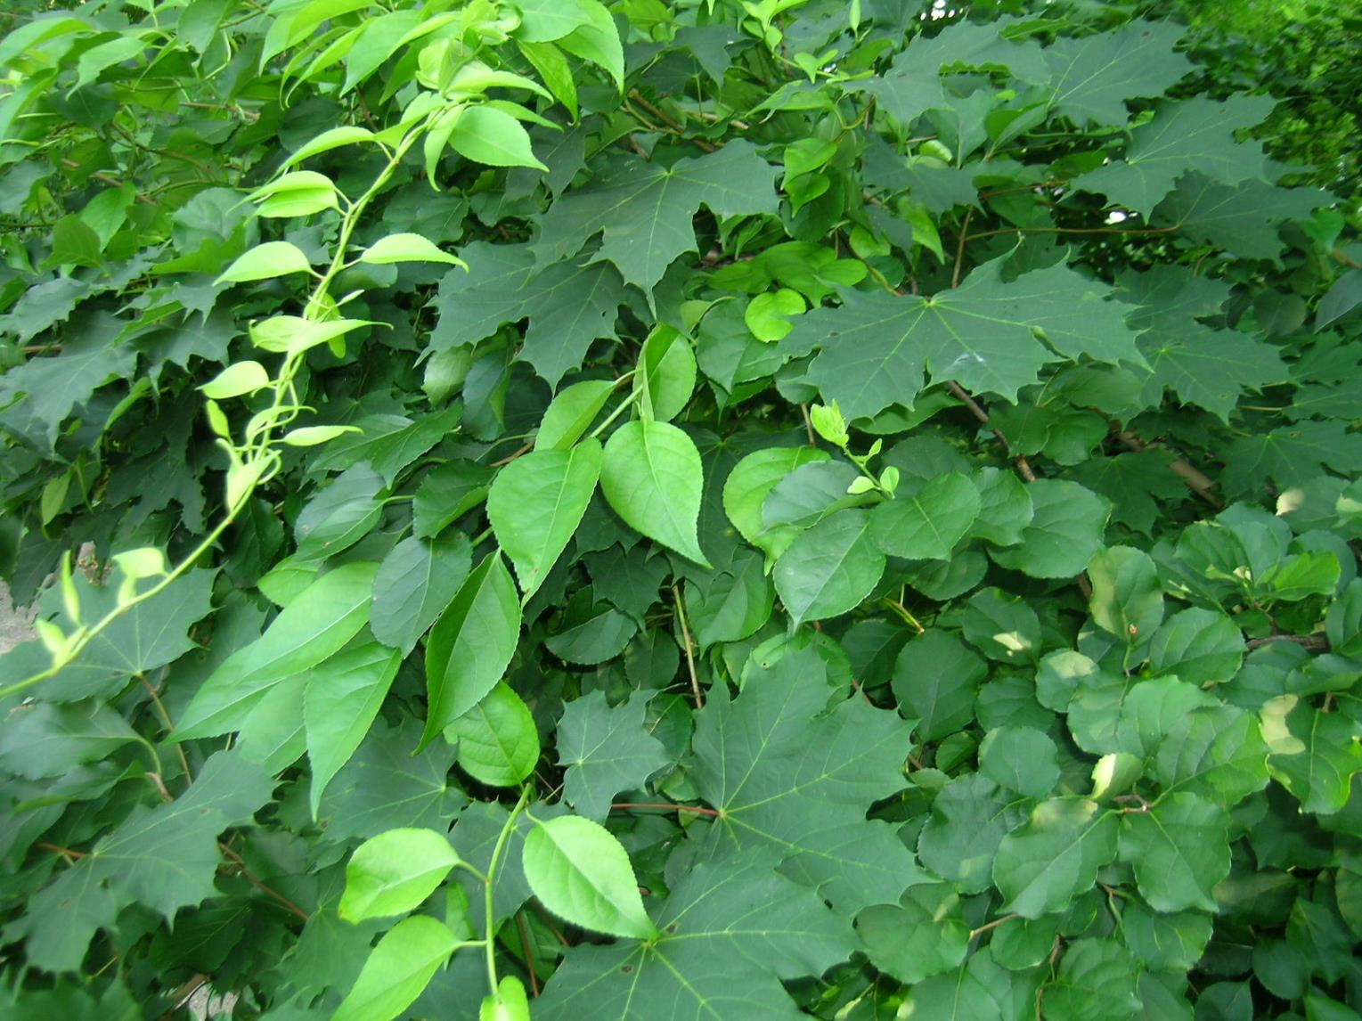


Cooperative Invasive Species Management Areas: what are they and what do they do?
Dr. Julie Richburg, West Region Ecologist
The Trustees of Reservations

Slide 2
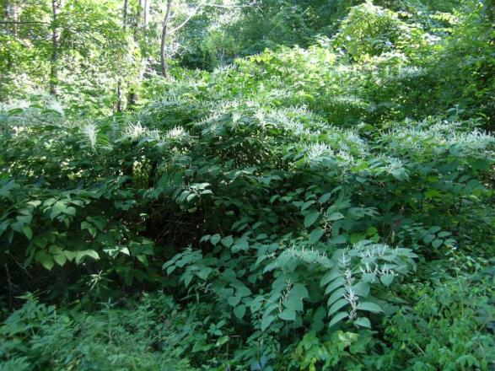

Invasive Plant Management:
Guidelines for Managers
2008
Prevention
Early Detection &
Rapid Response
Control &
Management
Education & Public Awareness

Slide 3

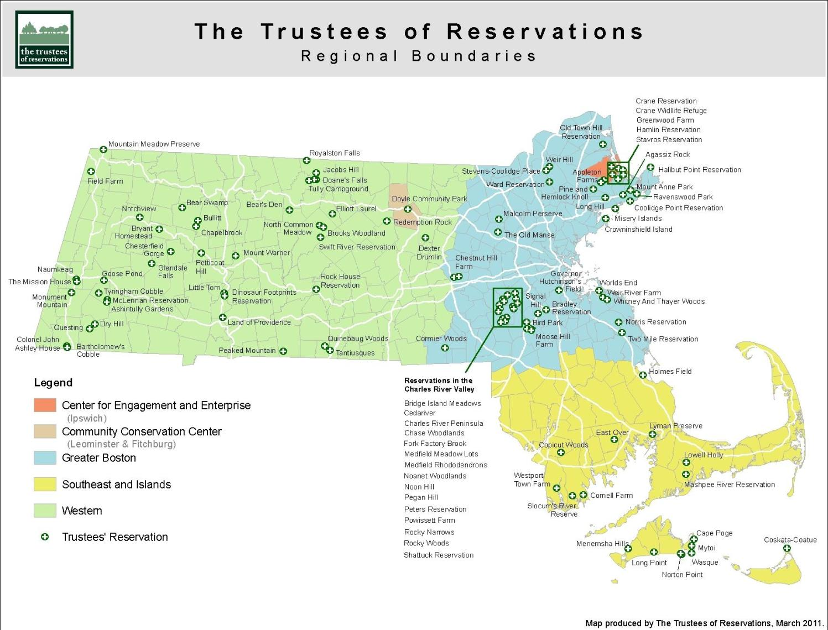
110+ reservations & growing!
More than 25,000 acres +19,000 acres in CRs
Notes:
3
Many of you have known us for a little while now, and have probably seen us grow. We’re up to 105 properties across the State now…
GOAL: WHO WE ARE, WHAT WE DO AND WHERE WE’RE GOING...
WHAT ARE SOME OF OUR PROPERTIES?

Slide 4
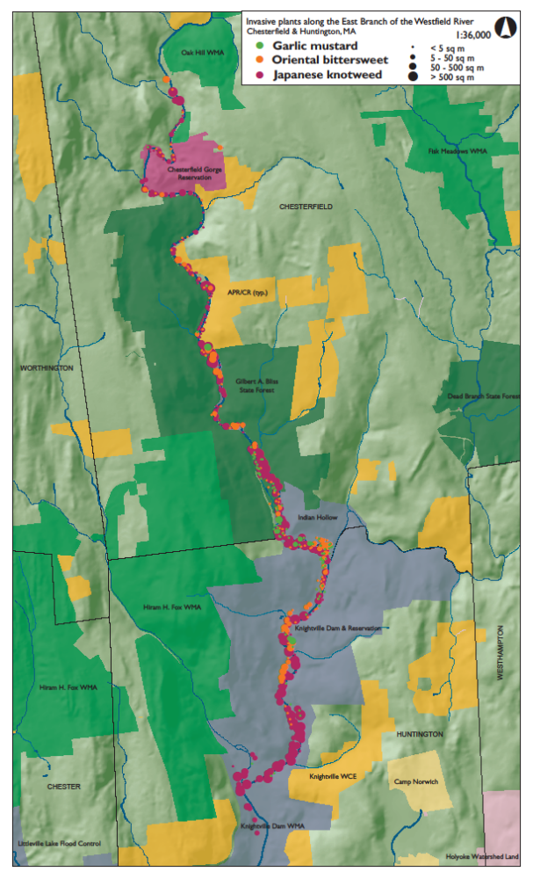





Invasive species do not pay attention to political boundaries
So we shouldn’t either!

Slide 5
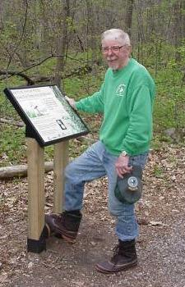
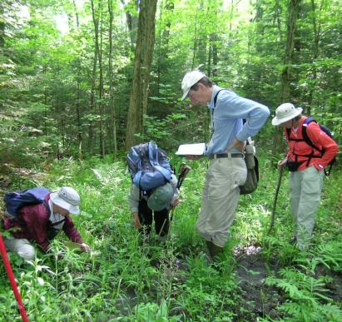
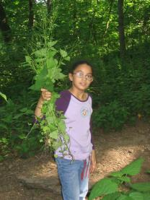
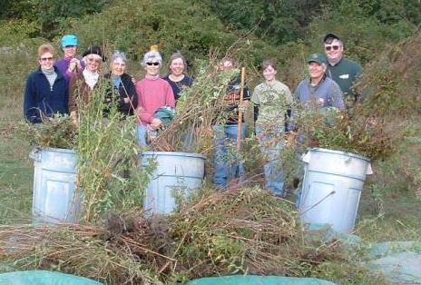
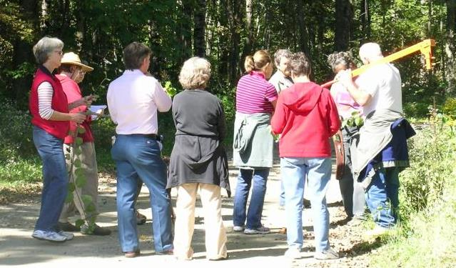

Prevention
Early Detection &
Rapid Response
Control &
Management
Education & Public Awareness
Notes:
People are in common amongst these categories

Slide 6
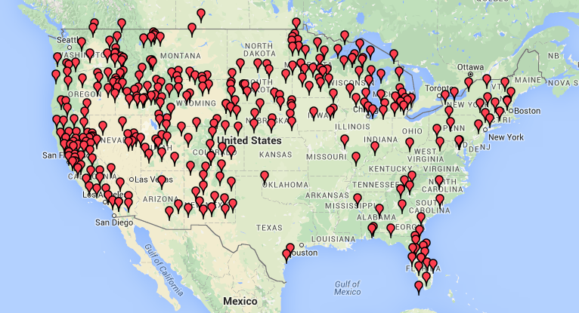
Cooperative Weed Management Areas (CWMA)
Coop. Invasive Species Man. Areas (CISMA)

Slide 7
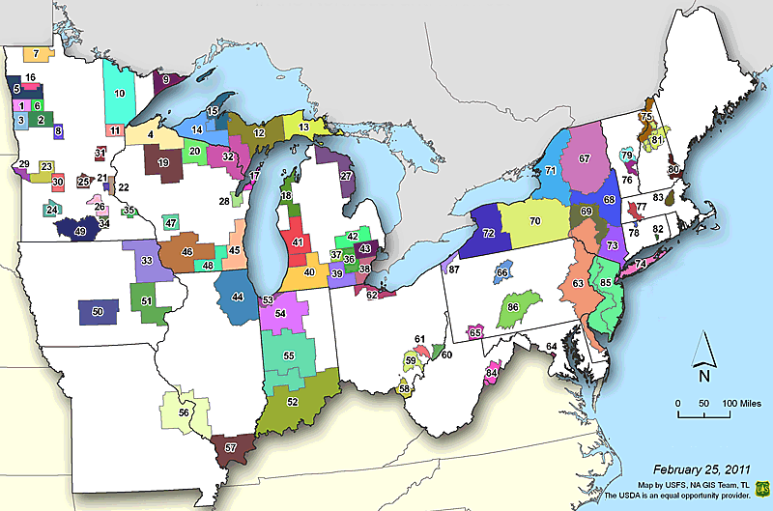
Cooperative Weed Management Areas
Cooperative Invasive Species
Management Areas (CISMA)
Notes:
Cooperative invasive species management areas are not new.

Slide 8
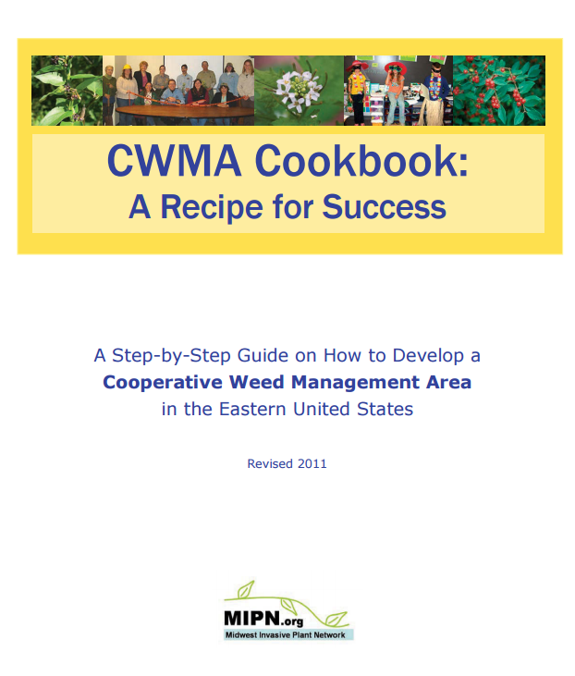
Select a leader or champion
Establish geographic boundaries
Identify potential partners and begin building support
Determine common goals
Select a name
Choose a fiscal manager
Establish a steering committee
Select officers
Develop an agreement
Develop a strategic management plan
Develop an annual operating plan
Consider hiring a CWMA coordinator
Implement plans
Celebrate success and get media attention

Slide 9
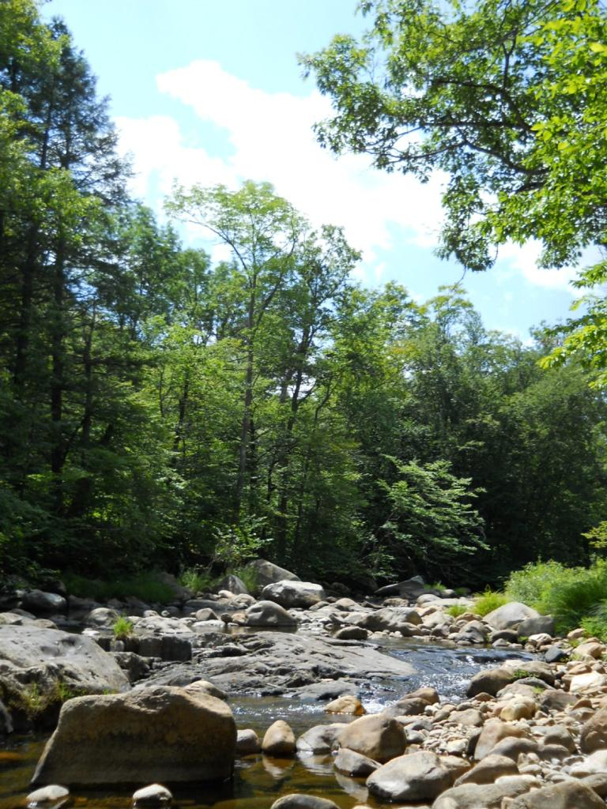
Westfield River Watershed Invasive Species Partnership
Started in late 2009
Group of organizations, agencies, and individuals
Concerned about the threat of invasive species in the watershed
Working together to reduce threats and impacts of invasive species

Slide 10
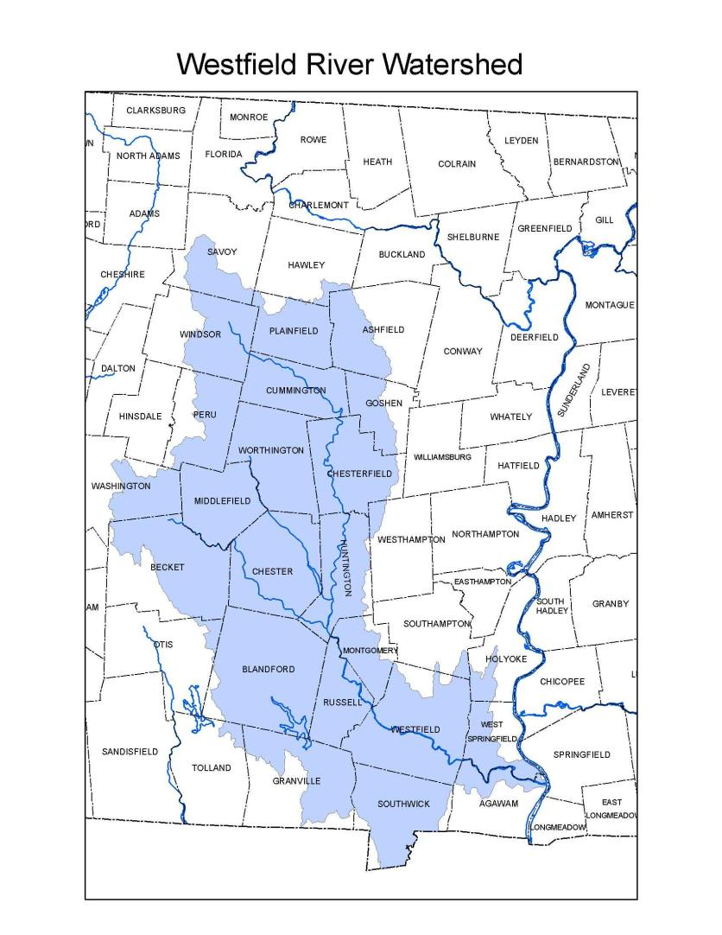









WISP Partners
Notes:
Sharing with colleagues and neighbors – we need to pool our resources and complement efforts - WISP was born

Slide 11
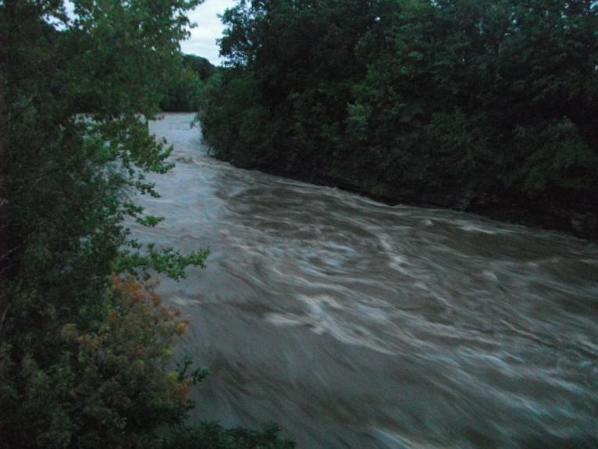
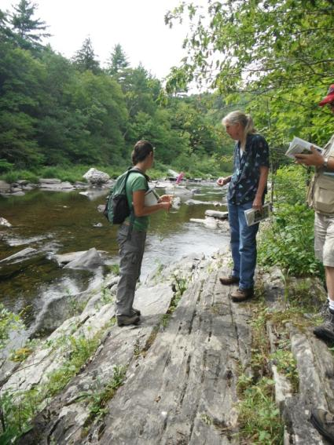
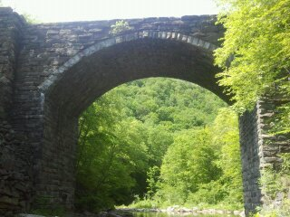
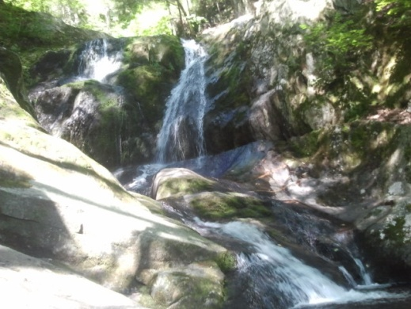
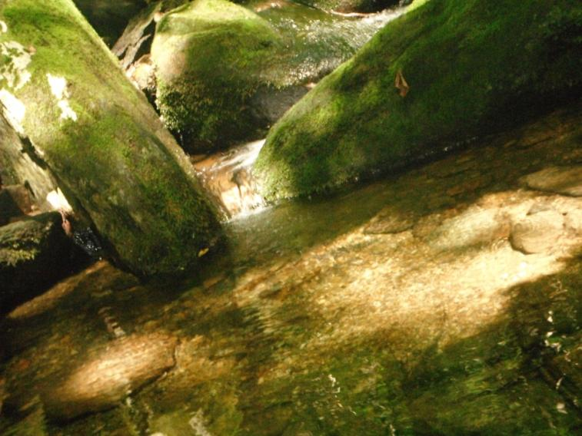
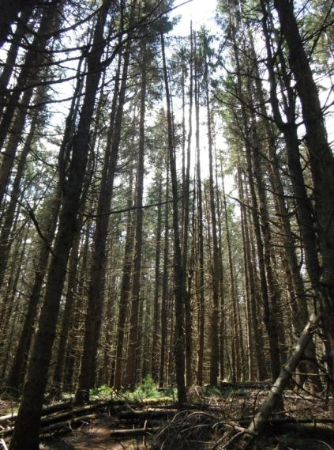
Our Purpose
To protect …. our natural areas, farmland, and water resources by cooperating …. and sharing resources necessary for the prevention and control of invasive species ……
across ownership boundaries

Slide 12
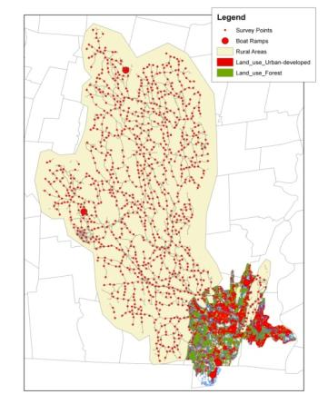
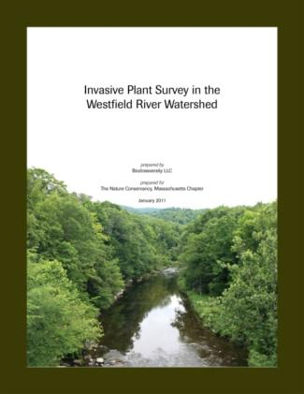

What have we accomplished?
Launched partnership in December 2009 with ARRA grant
Mapped invasive species in watershed
Drafted a guidance document for Conservation Commission use in permitting invasive species work.
Partnered with TNC’s Forest Health Program on “Don’t Move Firewood” Campaign in Western MA

Slide 13
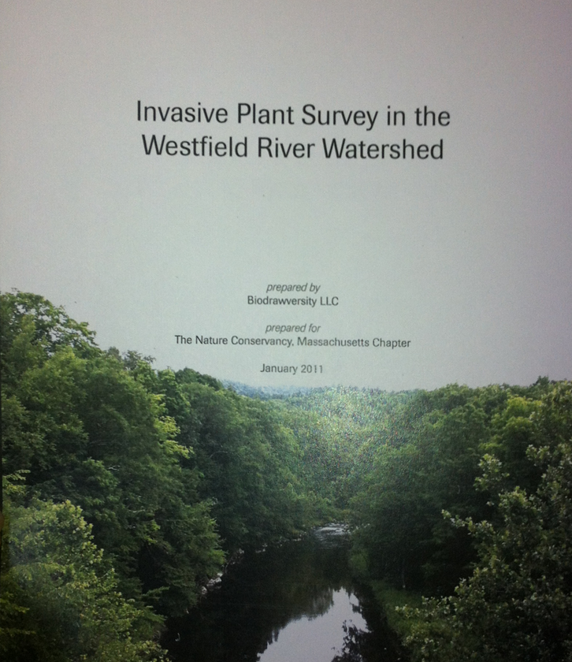
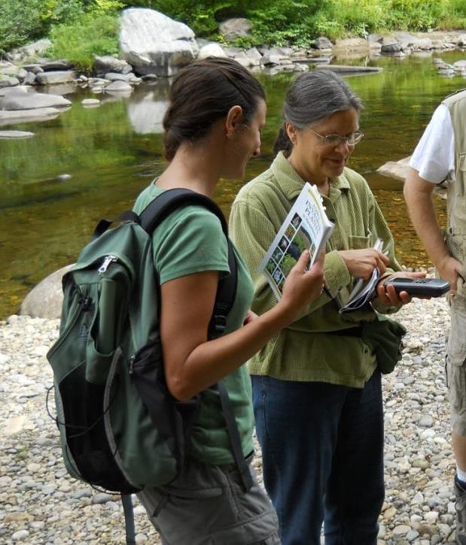
Prevention

Slide 14
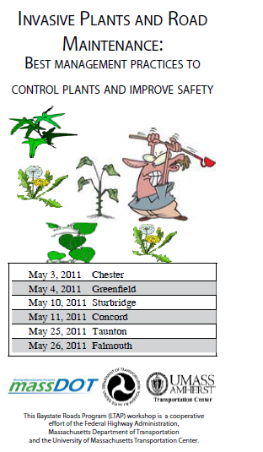
What have we accomplished?
Held a roads and invasive
species workshop
Created key planning documents
and EDRR list

Slide 15
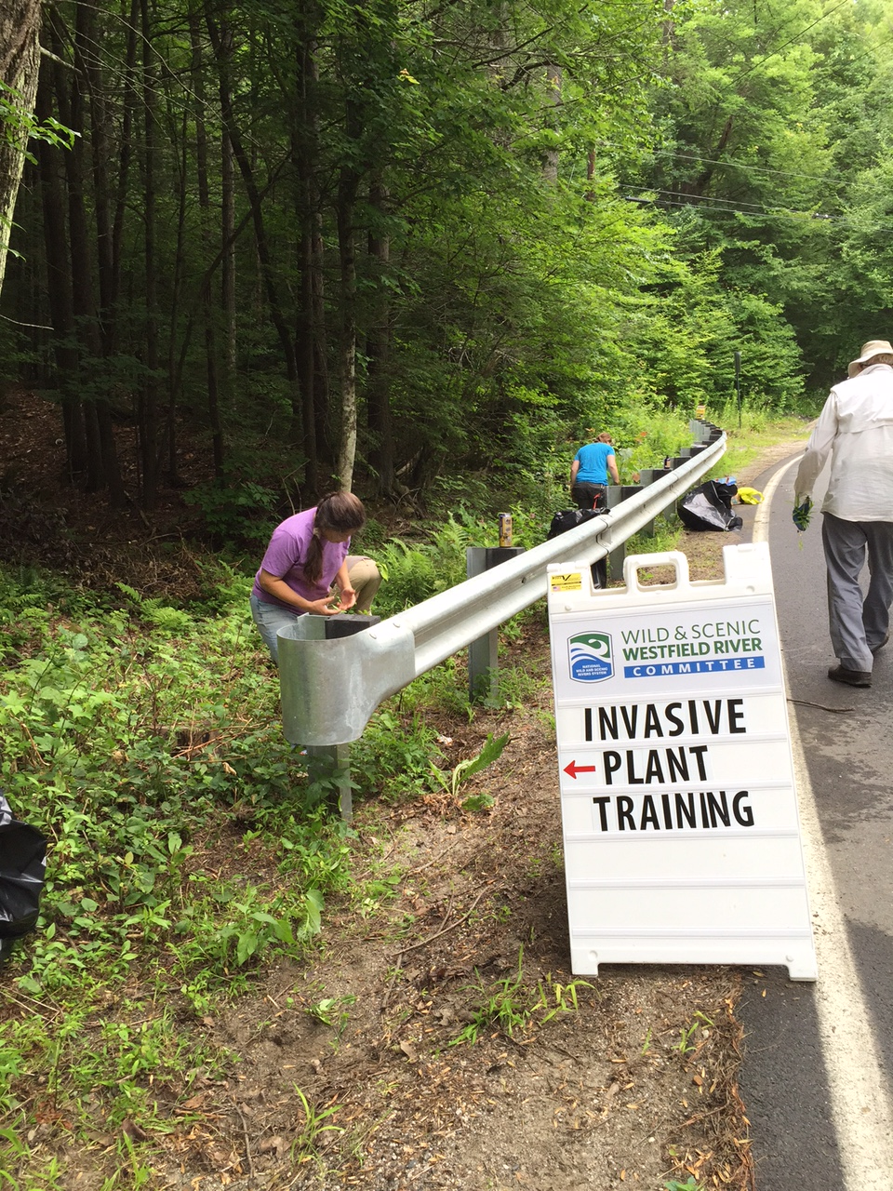
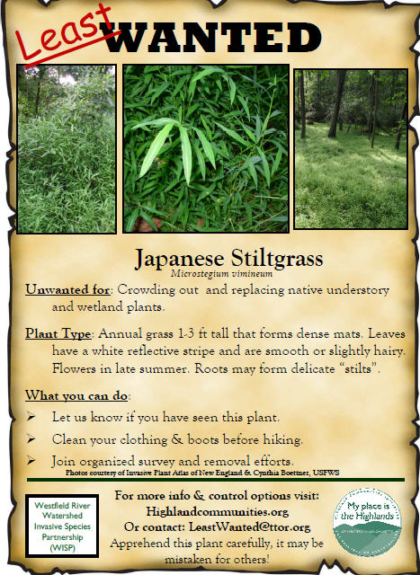
Early Detection Rapid Response

Slide 16
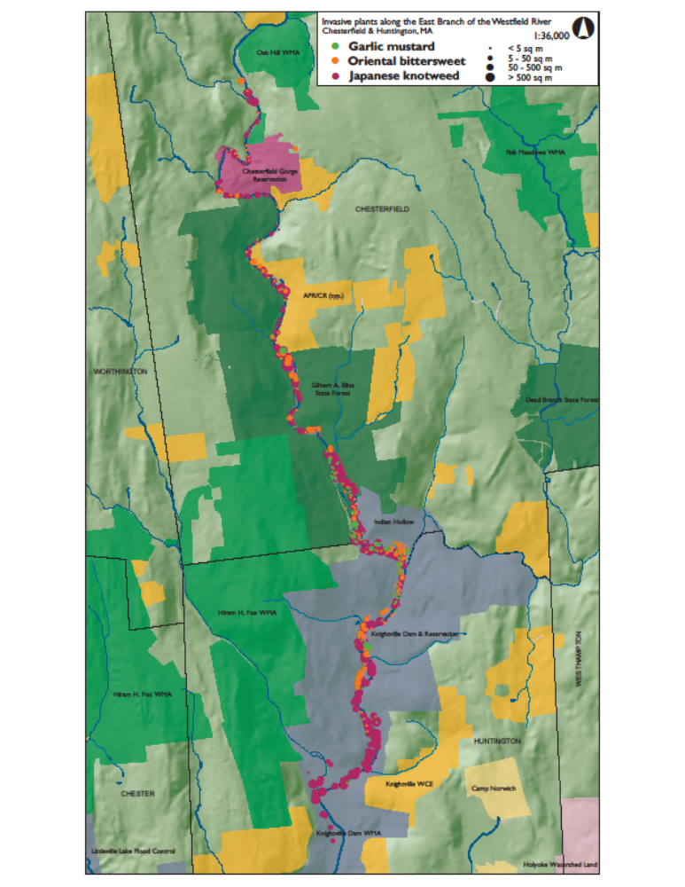
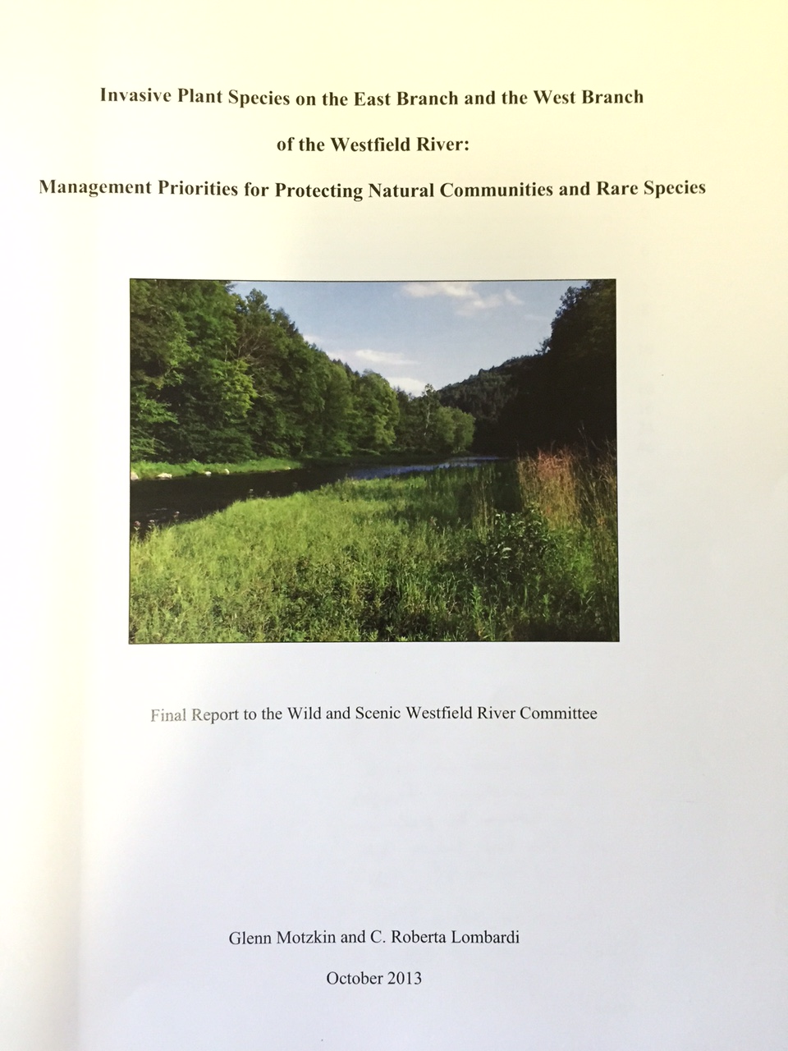
What have we accomplished?

Slide 17

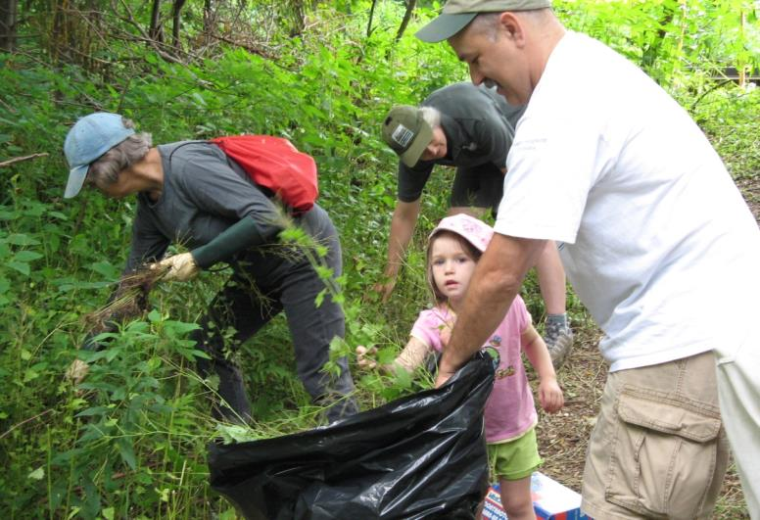
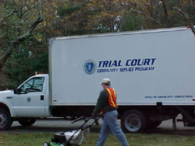
Control & Management

Slide 18

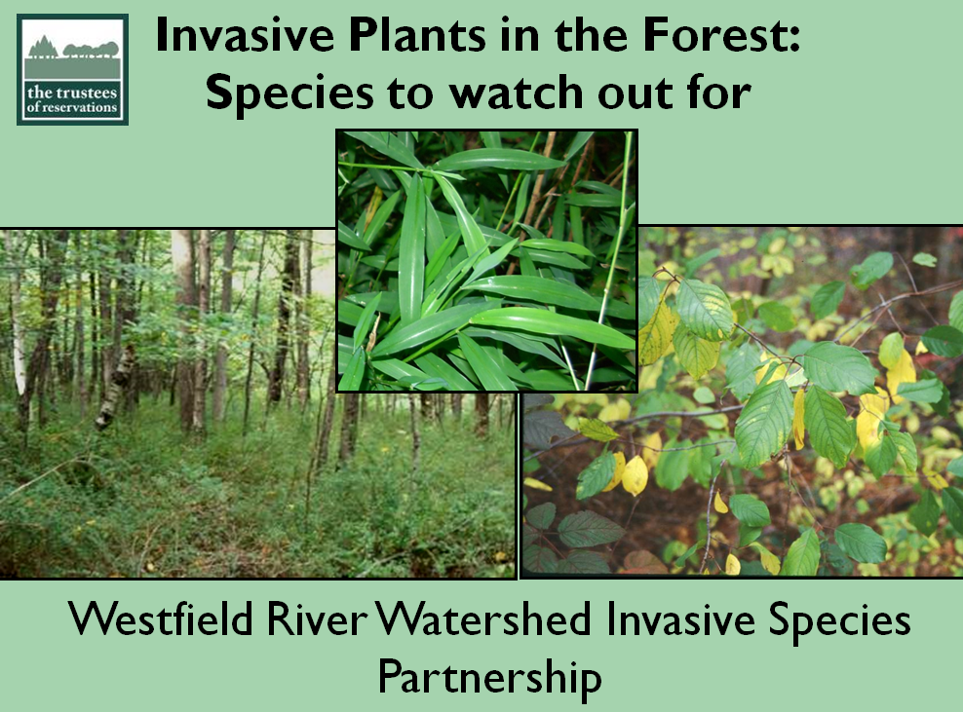
What have we accomplished?
Created a wide range of outreach and educational material
Presented to local towns, regional, and state-wide conferences

Slide 19
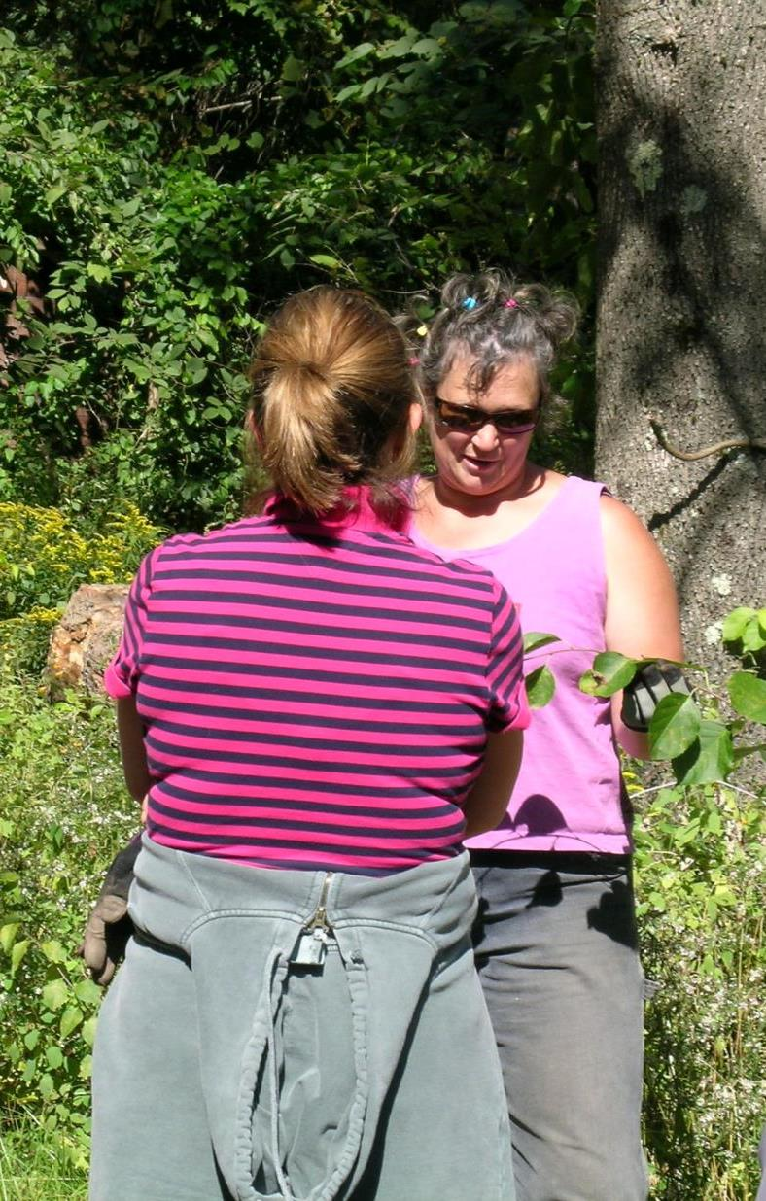


Some people learn with their eyes and ears,
others their hands, etc.
Notes:
Co-speaker at a workshop brought in specimens!

Slide 20
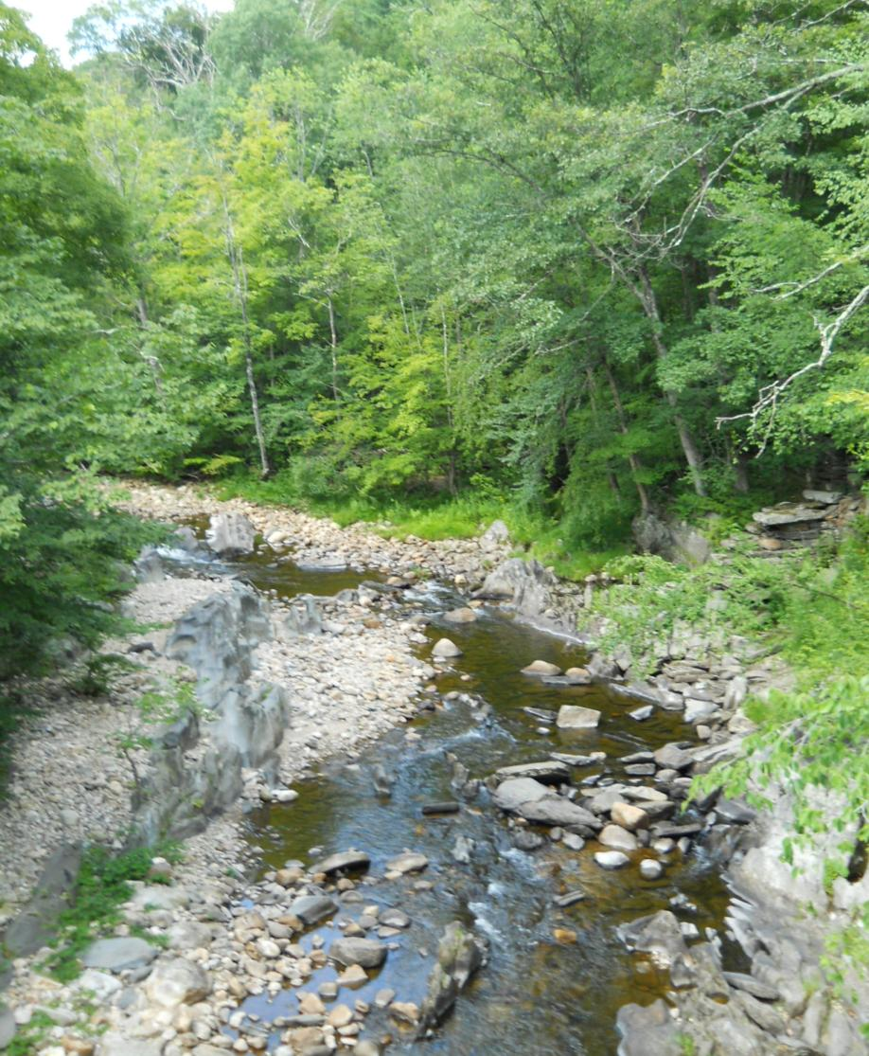
What’s next?
Implement priority management projects
Continue outreach and partnership building.
Learn from/share knowledge with other similar groups

Slide 21
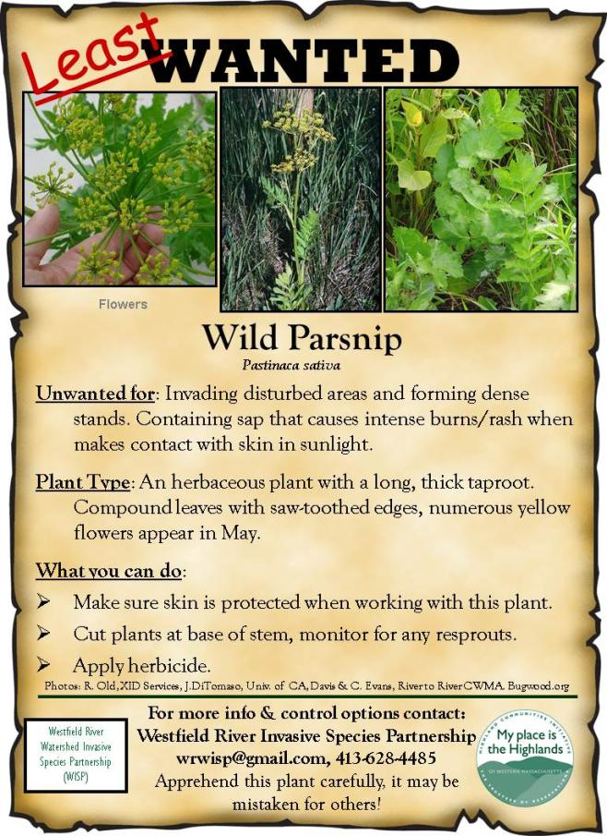
How can you help?
Identify invasive species on your property and in your town
Develop a strategy for dealing with them
Talk to your neighbors
Participate as a partner!
When in doubt contact us!
wrwisp@gmail.com

Slide 22
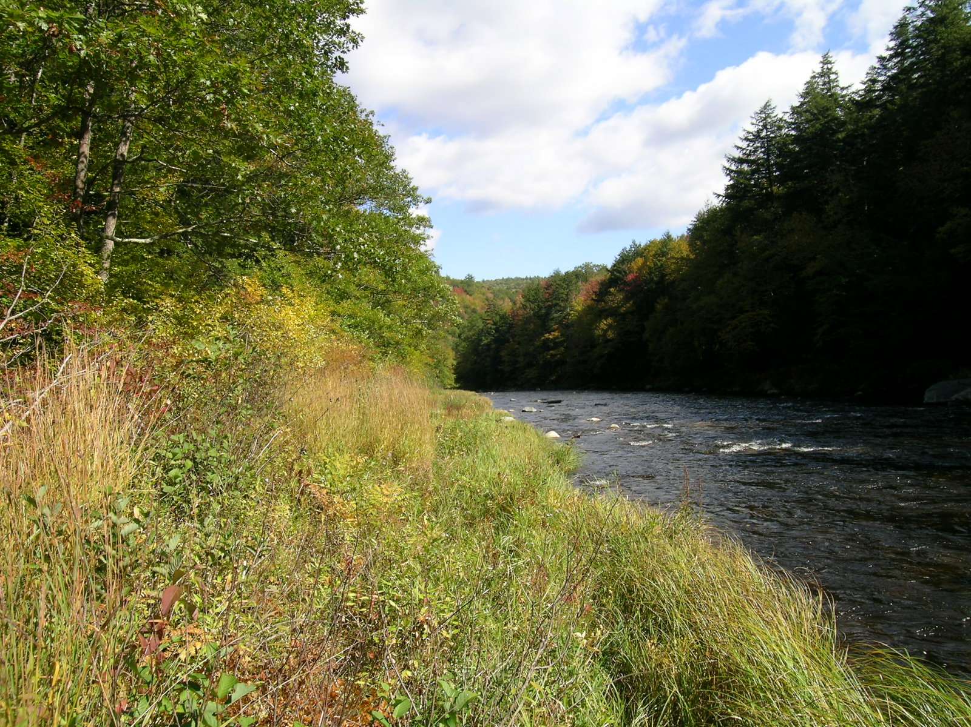
What do you
want?

Slide 23
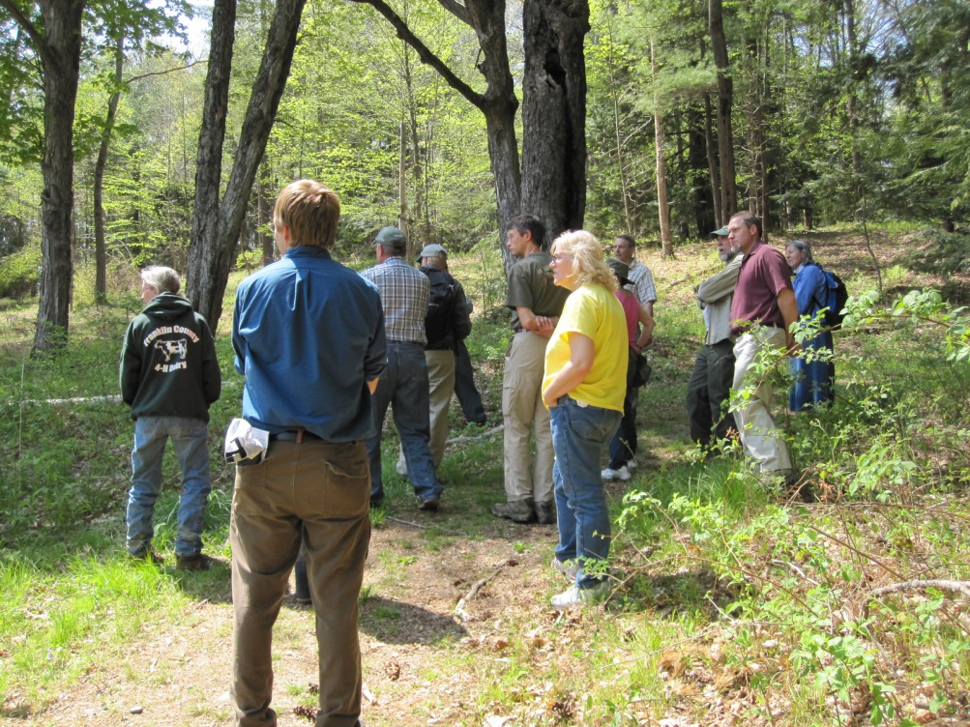
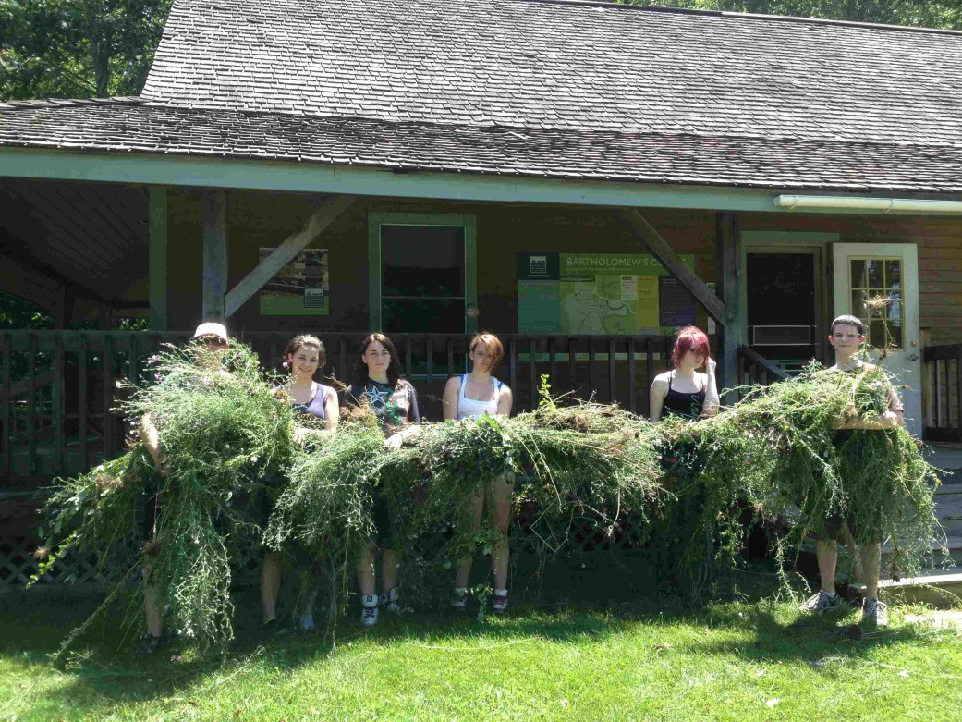
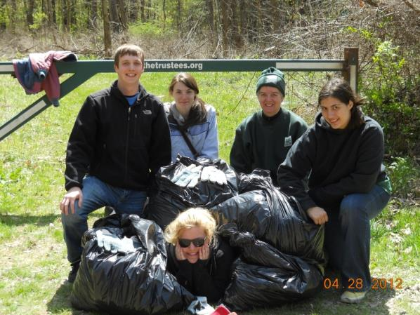
A few helpful hints…….
Make it social
Make it fun

Slide 24
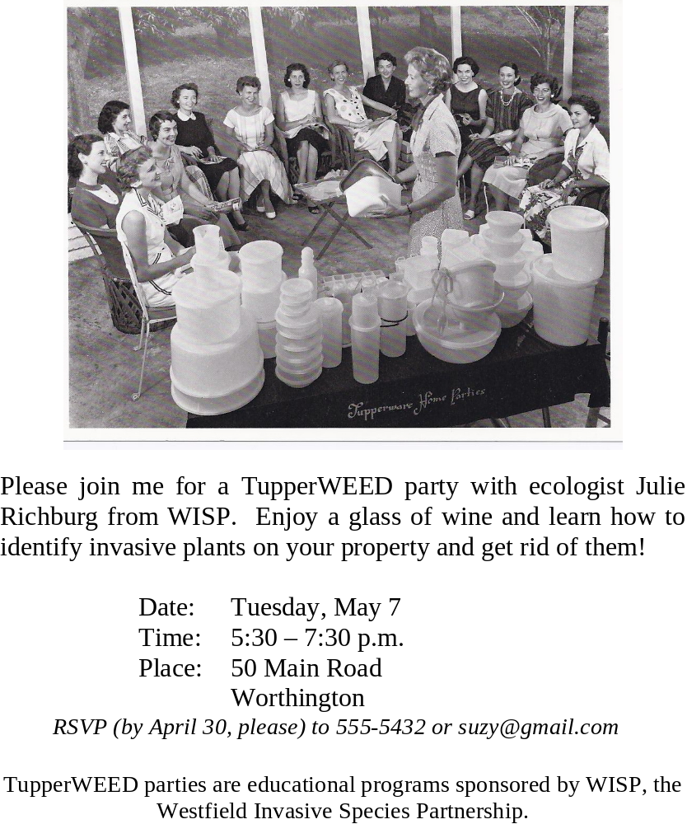
TupperWEED
Find a willing host
Introduce WISP
Walk about
Build local interest
See the results!

Slide 25
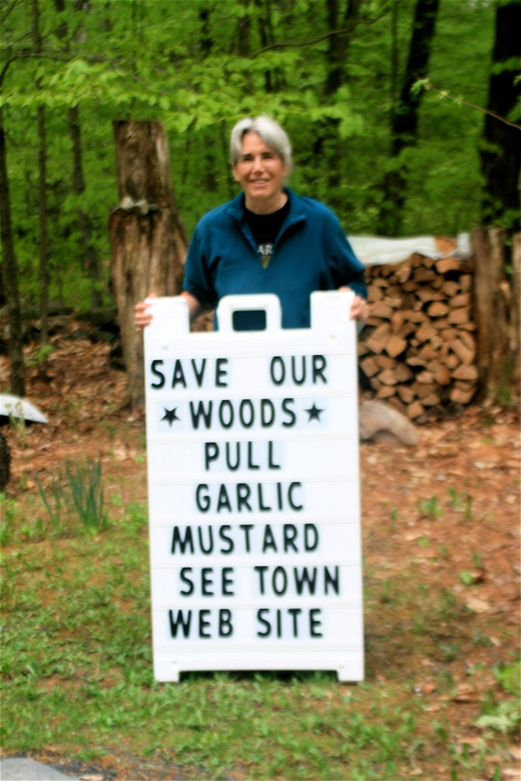
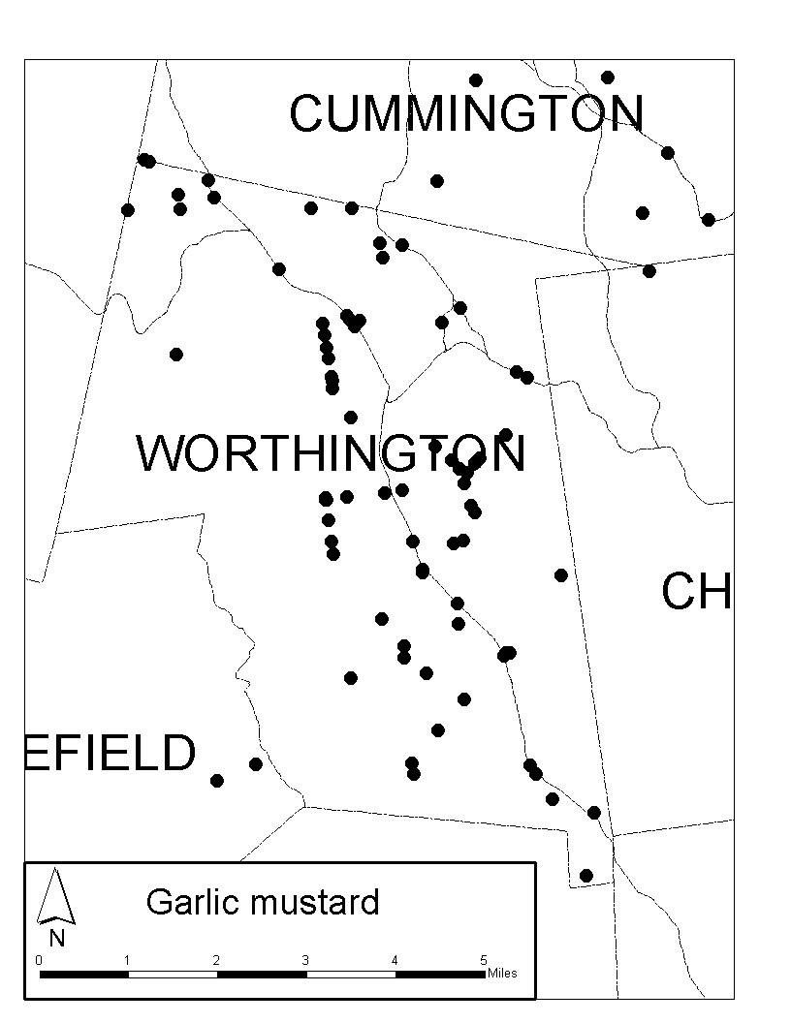
The power of
ONE

Slide 26
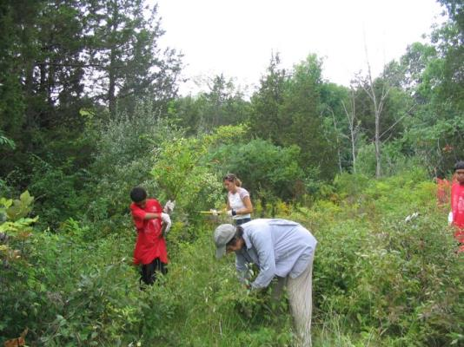

We are willing
to share!
WestfieldRiverWatershed
InvasiveSpeciesPartnership
westfieldriver.org/education/invasives.html
wrwisp@gmail.com

Slide 27
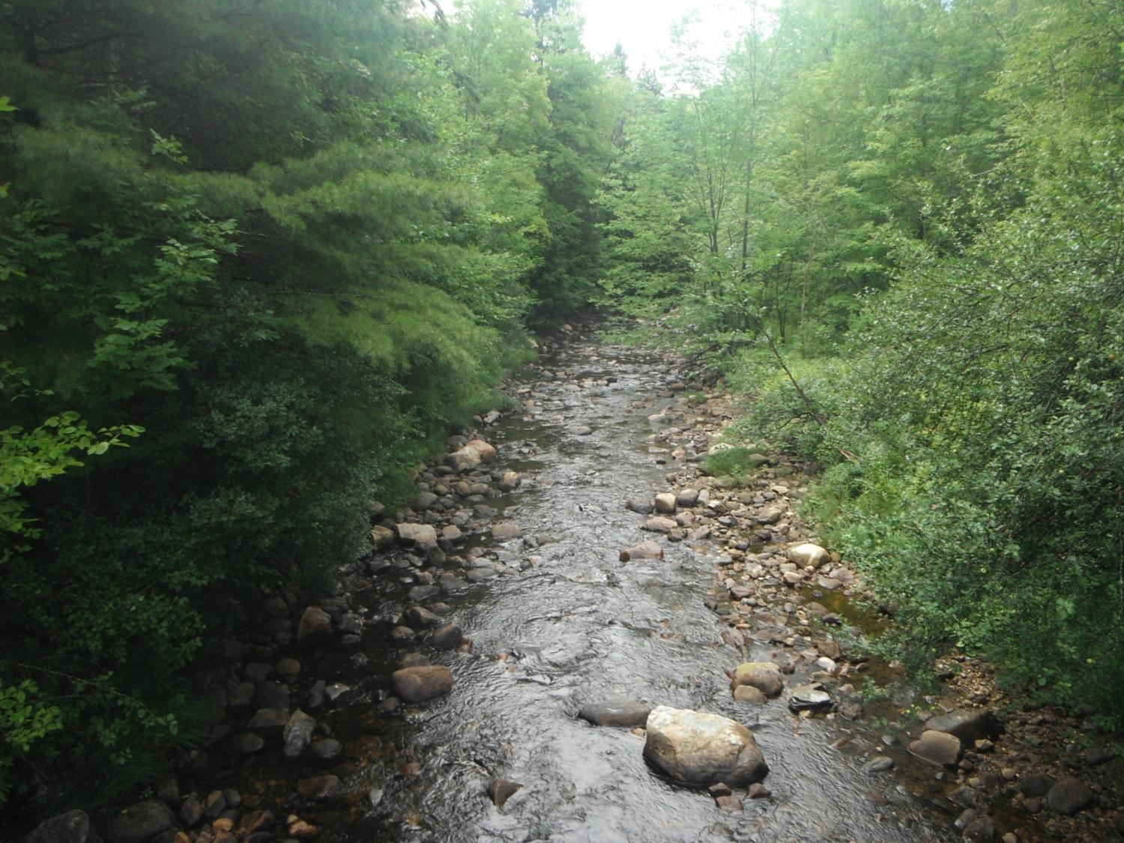
Thank you
Feel free to contact me
at jrichburg@thetrustees.org

