Slide 1

Invasive Species Management in the SuAsCo watershed
By: Amber Carr

Slide 2

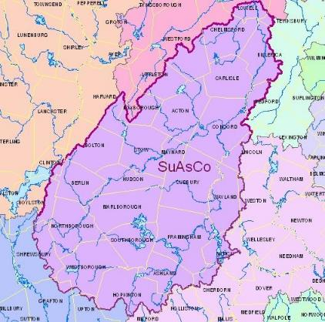
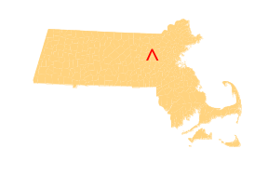
Our Location
Sudbury, Assabet and Concord Rivers are designated as “Wild and Scenic” under the Wild and Scenic River Act
Approximately 60,000 acres of the watershed is considered permanently protected open space
The watershed is comprised of 36 towns, covering 377 square miles

Slide 3
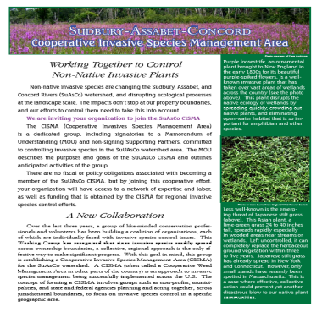


How we began
New England Invasive plant summit Sept. 2005
Called SuAsCo ITF from 2005-2008
In 2008 changed name to SuAsCo CISMA
May 1st 2009 signed our “Memorandum of Understanding” MOU

Slide 4
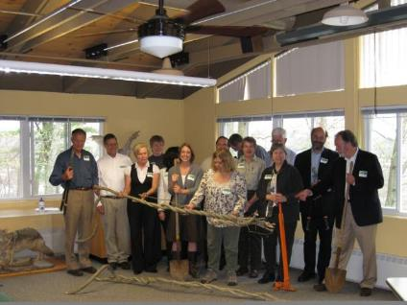

MOU signing
We signed our MOU (memorandum of understanding) on May 1st 2009
13 of our current 41 partner organizations signed the MOU that day

Slide 5
What is it?
The SuAsCo CISMA is:
“ a group of federal, state, and local land owners and land managers committed to controlling invasive species within the watershed”
Acton Conservation Commission
Carlisle Conservation Commission
Carlisle Conservation Foundation
Chelmsford Conservation Commission
Concord Land Conservation Trust
Concord Natural Resources Commission
Friends of Assabet River National Wildlife Refuge
Harvard Conservation Commission
Hop Brook Protection Association
Lincoln Conservation Commission
Lincoln Land Conservation Trust
Littleton Conservation Commission
Littleton Conservation Trust
Marlborough Conservation Commission
Massachusetts Audubon Society
Massachusetts Division of Ecological Restoration
(Dept of Fish and Game)
Massachusetts Natural Heritage and Endangered
Species Program
Maynard Conservation Commission
Middlesex Conservation District
Natick Garden Club
National Park Service
New England Forestry Foundation
New England Wild Flower Society
OARS: For the Assabet Sudbury and Concord Rivers
Southborough Open Land Foundation
Stow Conservation Commission
Stow Conservation Trust
SuAsCo Watershed Community Council
SuAsCo Wild& Scenic River Stewardship Council
Sudbury River Watershed Organization
Sudbury Valley Trustees
The Trustees of Reservations
The Walden Woods Project
Town of Sudbury
U.S. Department of Agriculture- Natural Resources Conservation Science
U. S. Fish and Wildlife Service
Wayland Conservation Commission
Wayland Surface Water Quality Committee
Westborough Community Land Trust
Westborough Conservation Commission
Westford Conservation Trust

Slide 6
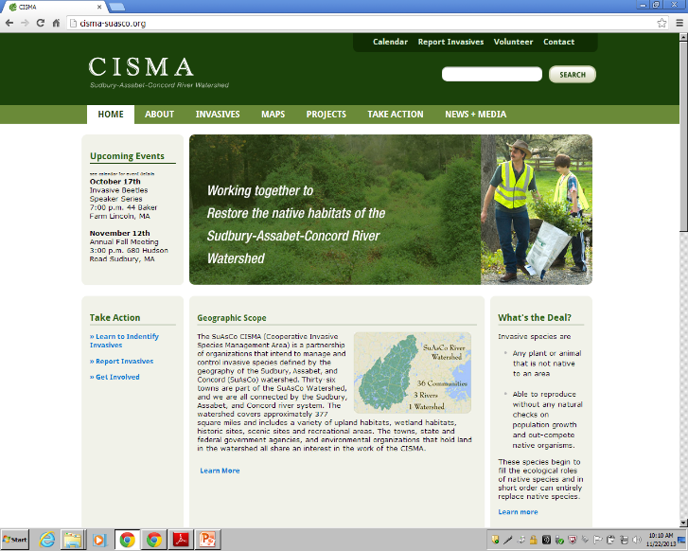
http://cisma-suasco.org/

Slide 7
Funding Sources over the Years
The Sudbury Foundation
Administrative start up
National Fish and Wildlife Foundation
Early detection trainings
Early successional habitat
The River Stewardship Council
CISMA small grants program
Administrative support
NYANZA natural resource damages grant
Management of water chestnut and purple loosestrife

Slide 8
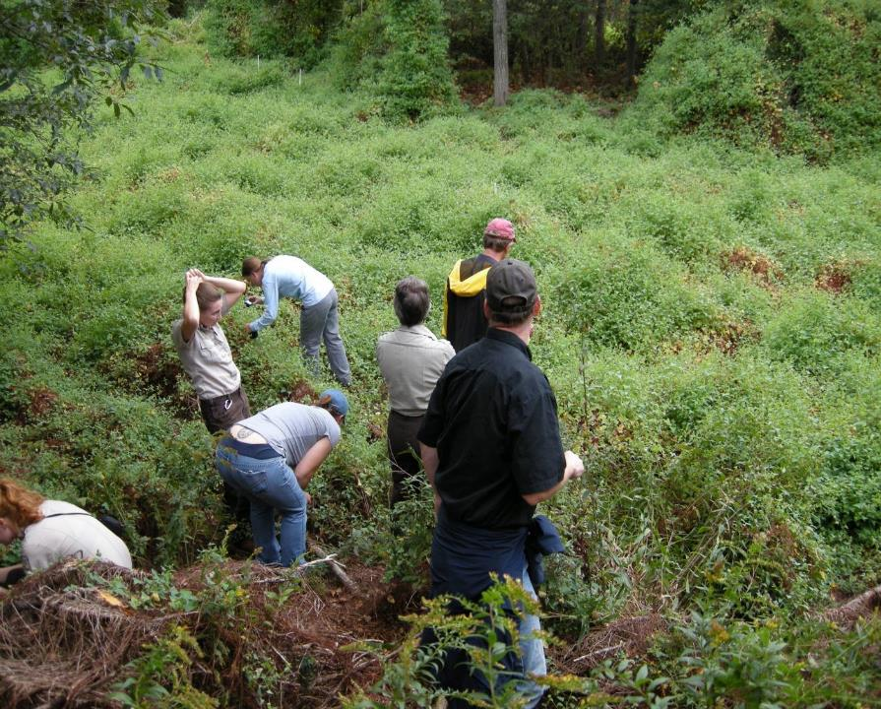
Early Detection Invasive Plant Species in the SuAsCo CISMA-2015

Slide 9
DEFINITIONS
Invasive Plant: a plant that is introduced to a region, spreads rapidly, displaces native flora, persists in natural landscapes, impacts natural biodiversity
Early Detection Invasive: a) An introduced plant with a limited presence in a region but based on its spread in adjacent areas will quickly become invasive b) a species that is still possible to control successfully in the region
Why focus on early detection?
Will spread rapidly and have serious impacts on natural habitats
Possible to control or even eliminate the species from the region with a rapid, coordinated management response
Prevent further dispersion of the species
Well-established invasives are too widespread to reverse in a short-term project
Notes:
Species based response; volunteer motivation

Slide 10
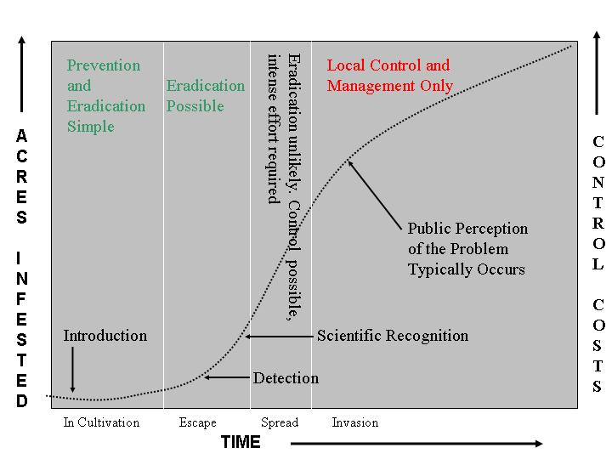
INVASION, DETECTION, AND RESPONSE
Tom Rawinski

Slide 11
EARLY DETECTION SPECIES FOR
SuAsCo CISMA
Trees
Amur corktree (Phellodendron amurense)
Callery (Bradford) Pear (Pyrus calleryana)
Shrubs
Black or European alder (Alnus glutinosa)
Wineberry (Rubus phoenicolasius)
Rusty willow (Salix atrocinerea; S. cinerea)
Woody vines
Kudzu (Pueraria montana)
Herbaceous Plants
Wild chervil (Anthriscus sylvestris)
Narrow-leaf bittercress (Cardamine impatiens)
Lesser celandine (Ficaria verna)
Giant hogweed (Heracleum maximum)
Broad-leaved pepperweed (Lepidium latifolium)
Wall lettuce (Mycelis muralis)
Mile-a-minute (Persicaria perfoliata)
Creeping buttercup (Ranunculus repens)
Aquatics
Brazilian waterweed (Egeria densa)
Hydrilla (Hydrilla verticillata)
Several others to consider for Early Detection
Yellow floating heart (Nelumbo lutea)—CT, RI
Wild parsnip (Pastinaca sativa)-VT, western MA
Hybrid coltsfoot (Petasites hybridus)-VT
Running bamboo (Phyllostachys aurea and P. nigra)-CT
Swollen bladderwort (Utricularia inflata)-CT, MA, RI

Slide 12
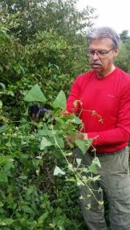




Mile-a-minute
5 Years later
Notes:
Control of an invasive plant species, MAM, by a concerted volunteer effort

Slide 13
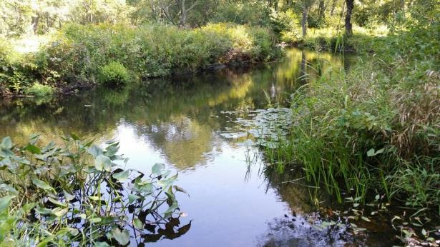
Westford Conservation Trust
Our Mission:
Preserve and Protect Westford’s Open Space and Natural resources
Notes:
Westford Conservation Trust – Now in its 31st year

Slide 14
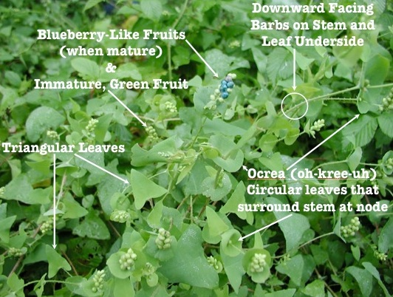
Westford Mile-a-minute
Invasive Species Control Program
Notes:
The Trust initiated the Mile-a-minute control program for the town of Westford in 2010

Slide 15
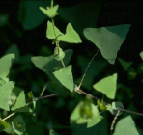
Where it all began
2009
  2 Residents spotted an “unusual” plant on their walks
2010
  4 residents attend SuAsCo-CISMA ED/RR
    Invasive plants survey – Create a database
    Propose a Invasive Species Control Program “a la” SuAsCo-CISMA
  BIG NEWS - Mile-a-minute was identified in Littleton
  “OMG that’s what we saw”
  WCT/Cons Comm/DCR chain of reporting/verification
  More surveys find a much bigger problem
  Submit the RDA paperwork – WPA Form 1
  Too late to do more than one small pull before first hard frost
Notes:
It started in 2009 with two residents noticing a “very unusual” plant while on their walks.

Slide 16
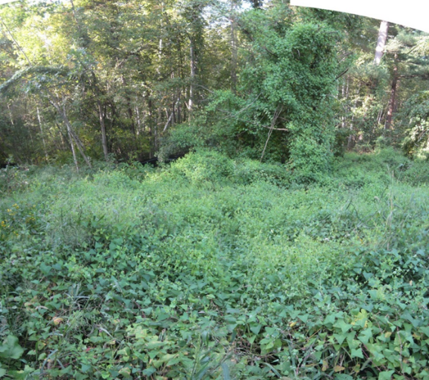
MAM at Lowell Rd
First Major Sighting - 2010
Notes:
Surprise! After the initial sightings, a large MAM infestation was found adjacent to a small brook at the edge of a new housing development.

Slide 17
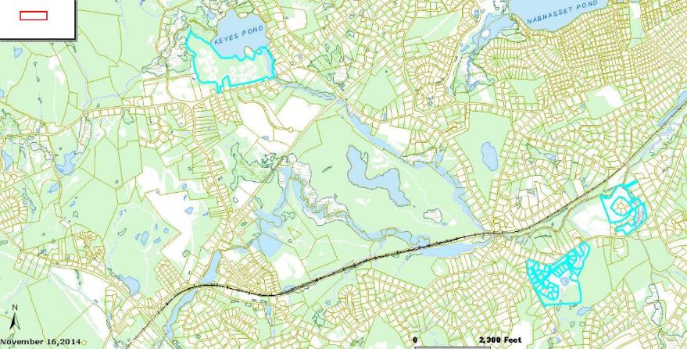
3 Pulling Sites – Stony Brook
Notes:
Three MAM sites were found in the Stony Brook Watershed – 1. A former plant nursery adjacent to an unnamed feeder brook to the Stony Brook, 2. A new housing development along the Tadmuck Brook and 3. Behind a condo unit adjacent to Keyes Pond and Brook

Slide 18
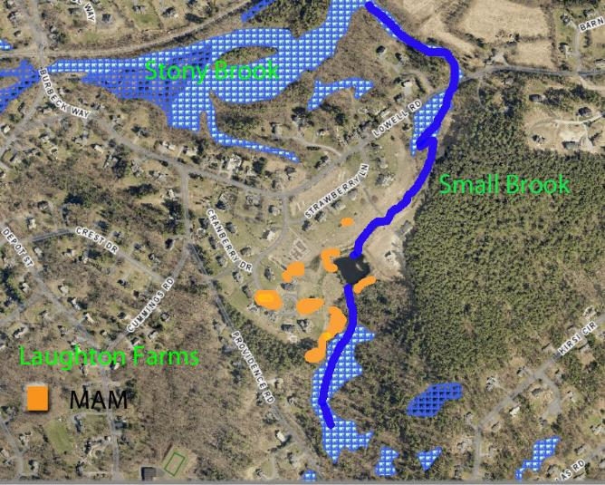
Lowell Rd MAM Locations
Notes:
The Lowell Rd MAM sites were located on the compost piles in the middle of the development and along the brook which flows along the southern boundary of the development. The brook then turns north and flows into the Stony Brook the watershed for the north half of Westford. Its destination is the Merrimack River.

Slide 19
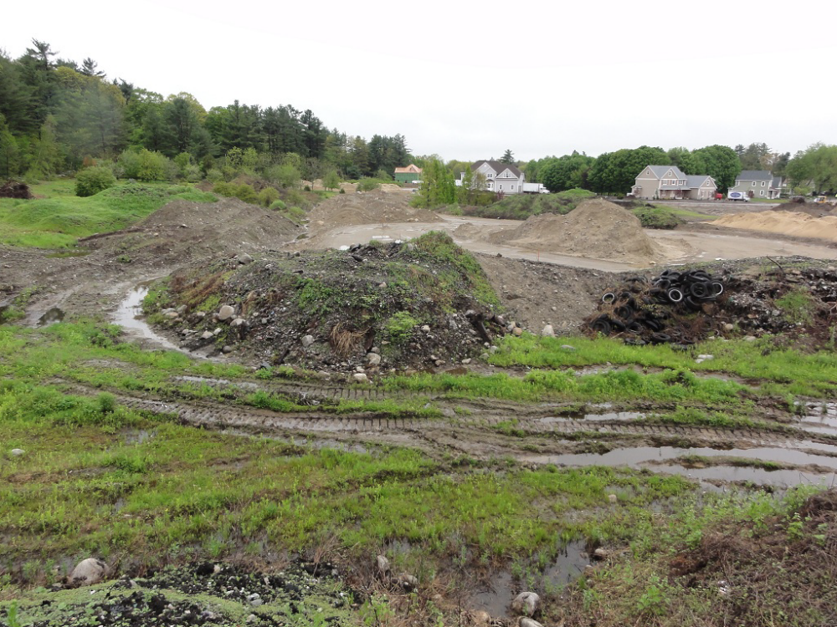
Lowell Rd – Compost Piles
Notes:
The Lowell Rd site was a former plant nursery and composting site. The MAM was located on the composting piles and along a brook at the edge of the property abutting a small brook which empties into the Stony Brook, a watershed for the northern part of town.

Slide 20
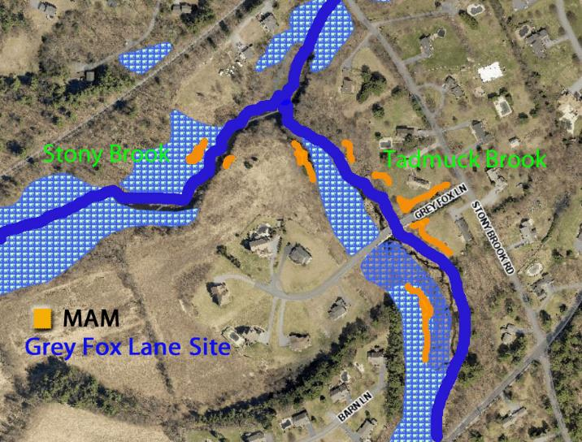
Grey Fox Lane MAM Locations
Notes:
Grey Fox Lane is a new housing development which required a new road , Grey Fox Lane, and a bridge across the Tadmuck Brook. Remnants of silt barriers are still found where the MAM grows along both banks of the Tadmuck Brook and along the edges of the new road. The Tadmuck Brook flows into the Stony Brook, the main watershed for the northern half of Westford. The Stony Brook flows into the Merrimack River. It was interesting to note at this site that the MAM plants would grow up to the water’s edge but never in it. Conversely the cat tail plants were just the opposite so a clear demarcation was made at the water’s boundary.

Slide 21
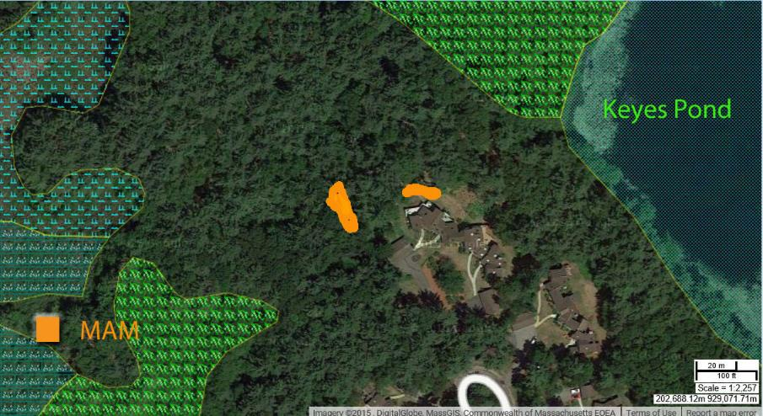
Old Colony Rd MAM Site
Notes:
The Old Colony RD MAM site is behind a condo complex and in close proximity to Keyes Pond and Keyes Brook which flows onto the Stony Brook. The site on the left was used as a dump by landscapers. A possible source for the MAM plants if they were disposing of construction silt barrier hay bales that contained MAM seeds.

Slide 22
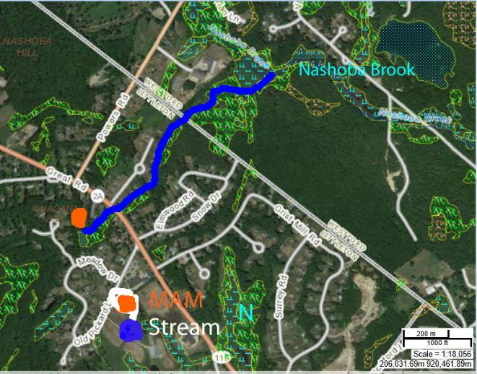
Littleton MAM Site
Notes:
MAM was first found in Littleton adjacent (100 ft) to a small brook which feeds Nashoba Brook the main water shed for the southern half of Westford. It flows into the Assabet River in west Concord.

Slide 23
First Steps for Control
2011
  WCT approves ISCP – Creates committee
  Committee starts planning MAM Control program
  2 additional residents attend ED/RR Workshop
  Eagle Scout candidate referred to the Trust
    Good fit – Agree to work together
    Trust will continue program for 4 additional years
  Get permission from Cons Comm and Developer
  DCR supports our initial efforts – Hand pulling chosen
  Team Leader training June 4th
  First pulls at two sites June 10th and 11th – 40 bags
Notes:
The first steps started with the Westford Conservation Trust approving the formation of an Invasive Species Control Committee and Plan

Slide 24
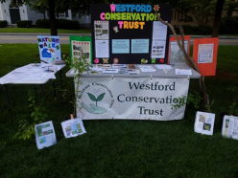
Next Steps – Getting the word out
  Abutters notified – included DCR “Wanted” flyer
  Solicited volunteers
    WCT members, Trail stewards, High school community service, residents
  “Pulling” notices in the local newspaper
  “Controlling Invasives in your backyard” training offered
  Encouraged residents to call if they suspected MAM
  Invasives info table at the Garden Club Plant Sale
  Info tables added for other Town functions

Slide 25
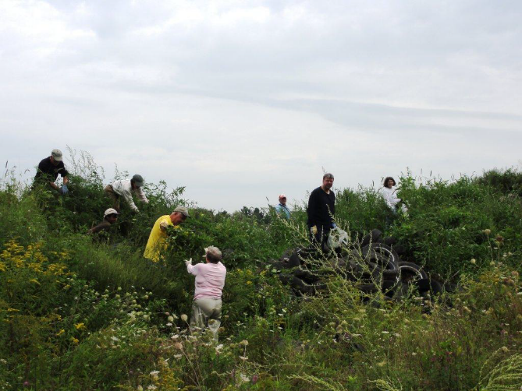
Then we pulled and pulled and pulled and pulled

Slide 26

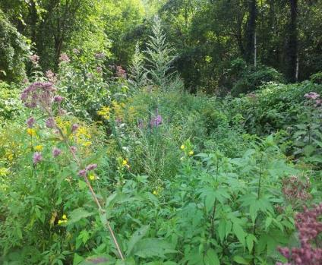
MAM at Lowell Rd
2010
2015
Notes:
MAM is now under control and native vegetation has recovered. Still will continue monitoring the sites.

Slide 27
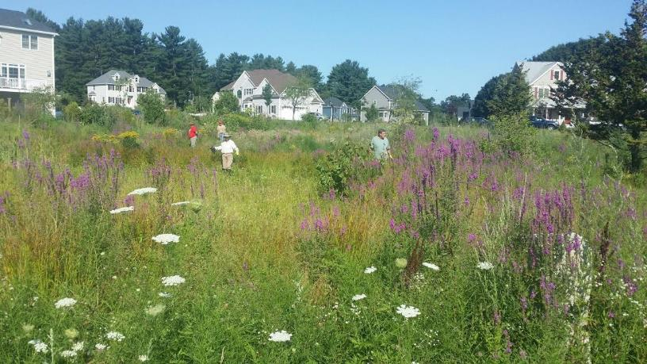
Where’s the MAM?
Former Compost Piles - Lowell Rd 2015
Notes:
The condition of the location of the former compost piles at the Lowell Rd site in 2015

Slide 28
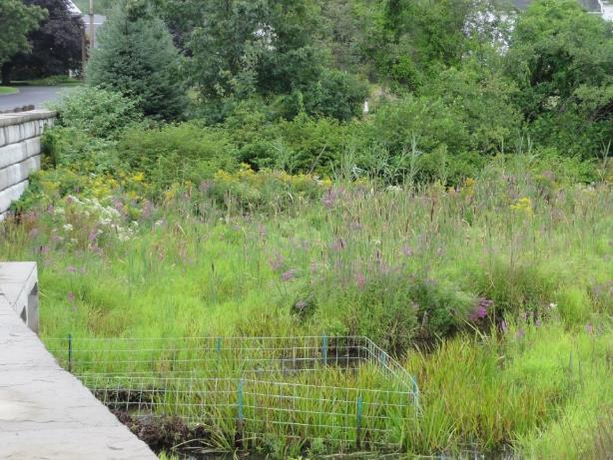
Where’s the MAM?
Grey Fox Lane – Along Tadmuck Brook 2015
Notes:
The condition of the banks of the Tadmuck Brook in 2015. In 2010 the trees just behind the golden rod were covered with MAM

Slide 29

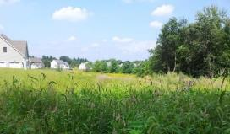
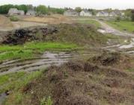
2015 - Status of the program
5th year of pullings completed
Fourth year of SuAsCo-CISMA small program grants
Volume is greatly diminished
Natural beauty returning to the sites
Much greater awareness of invasives in town
Able to provide support for Littleton’s MAM control
Will continue program as long as we have willing volunteers
Notes:
New plants being found per pulling are in the single digits!

Slide 30
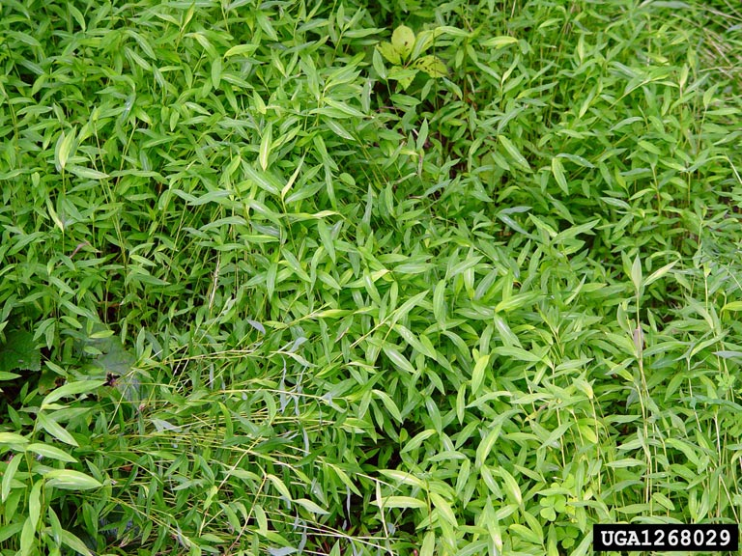
Japanese Stiltgrass
(Microstegium vimineum)
Invasion status in the SuAsCo River Watershed

Slide 31
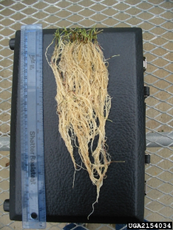
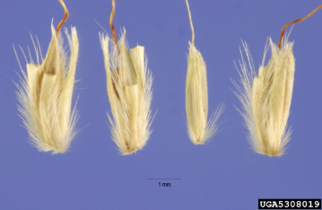
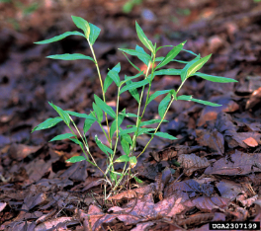
Japanese Stiltgrass
(Microstegium vimineum)
Poaceae
Annual grass
Rich woods, alluvial forests, edges of fields, yards, roadsides, right-of-ways, almost anywhere!
Native to Eastern Asia
Earliest North American record –
Tennessee 1919 from packing material

Slide 32
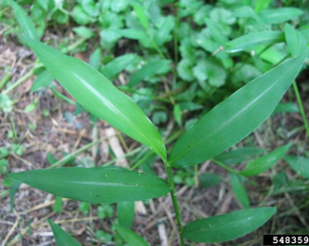
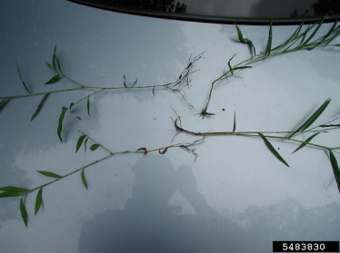
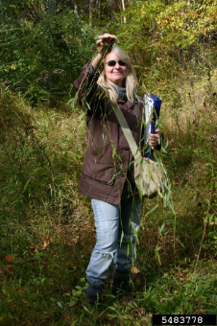
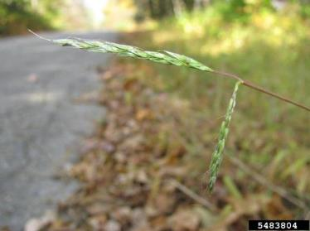
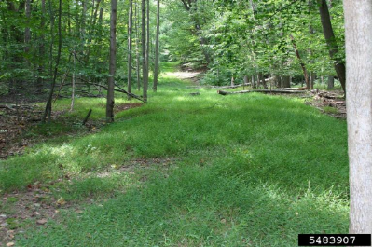
Japanese Stiltgrass
(Microstegium vimineum)

Slide 33
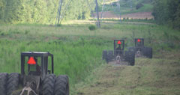
Japanese Stiltgrass
(Microstegium vimineum)
Dispersed by:
Water, wildlife, birds
People – clothing, pets
Field equipment – packs, presses, vehicles (canoes)
Trucks, equipment, MOWERS!

Slide 34
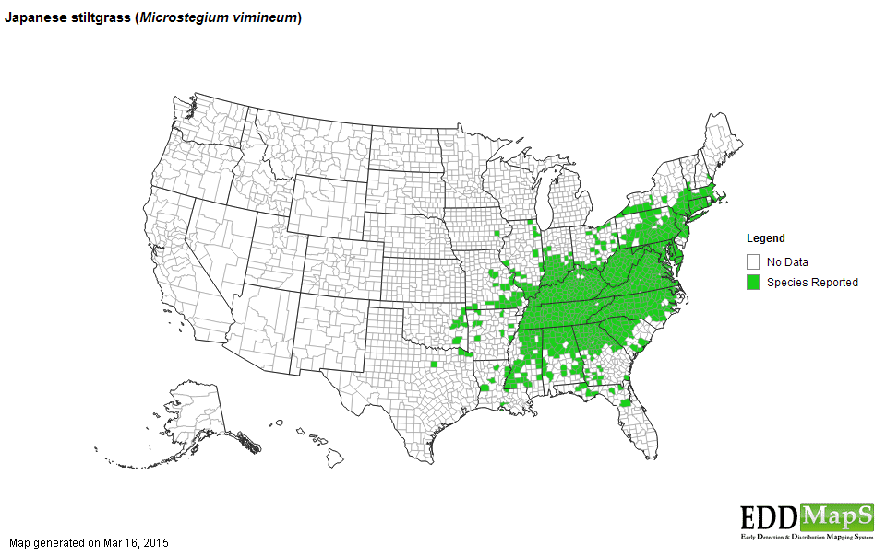
Knoxville, TN – 1919
Pennsylvania – 1938
New Jersey – 1959
Branford, CT – 1984
West Springfield , MA – 2003

Slide 35
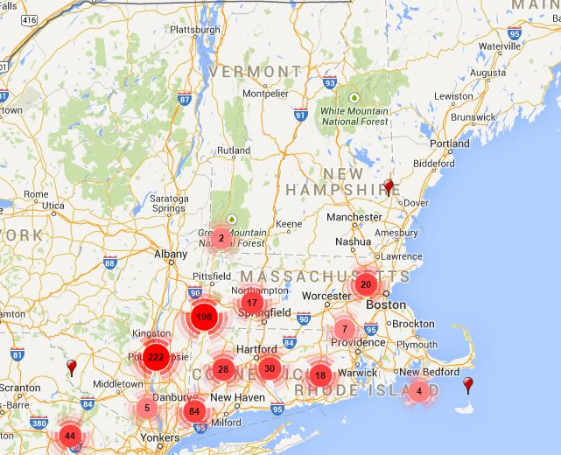
Japanese Stiltgrass
(Microstegium vimineum)
240 records across 40 towns

Slide 36
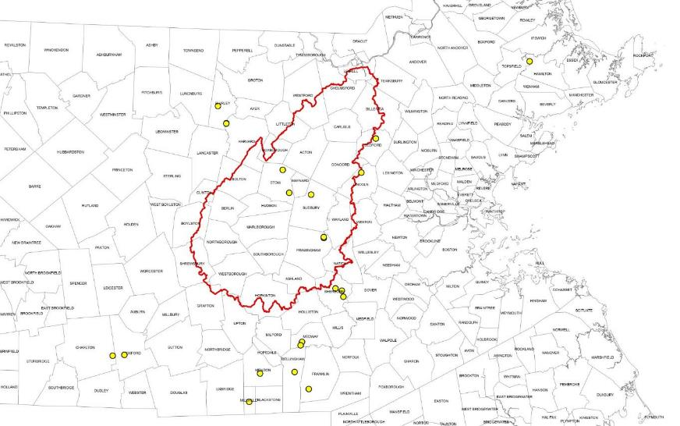
Japanese Stiltgrass
(Microstegium vimineum)
6 sites in CISMA
14 additional nearby

Slide 37
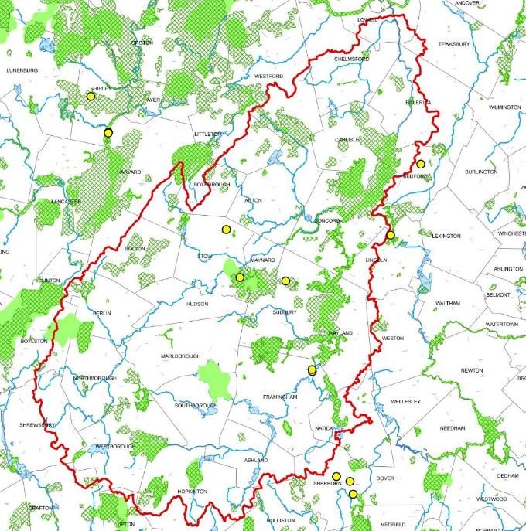

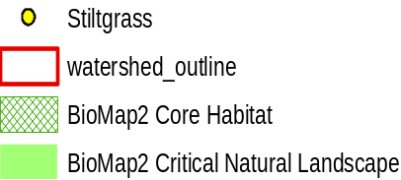
Japanese Stiltgrass
(Microstegium vimineum)
CIMSA Distribution

Slide 38
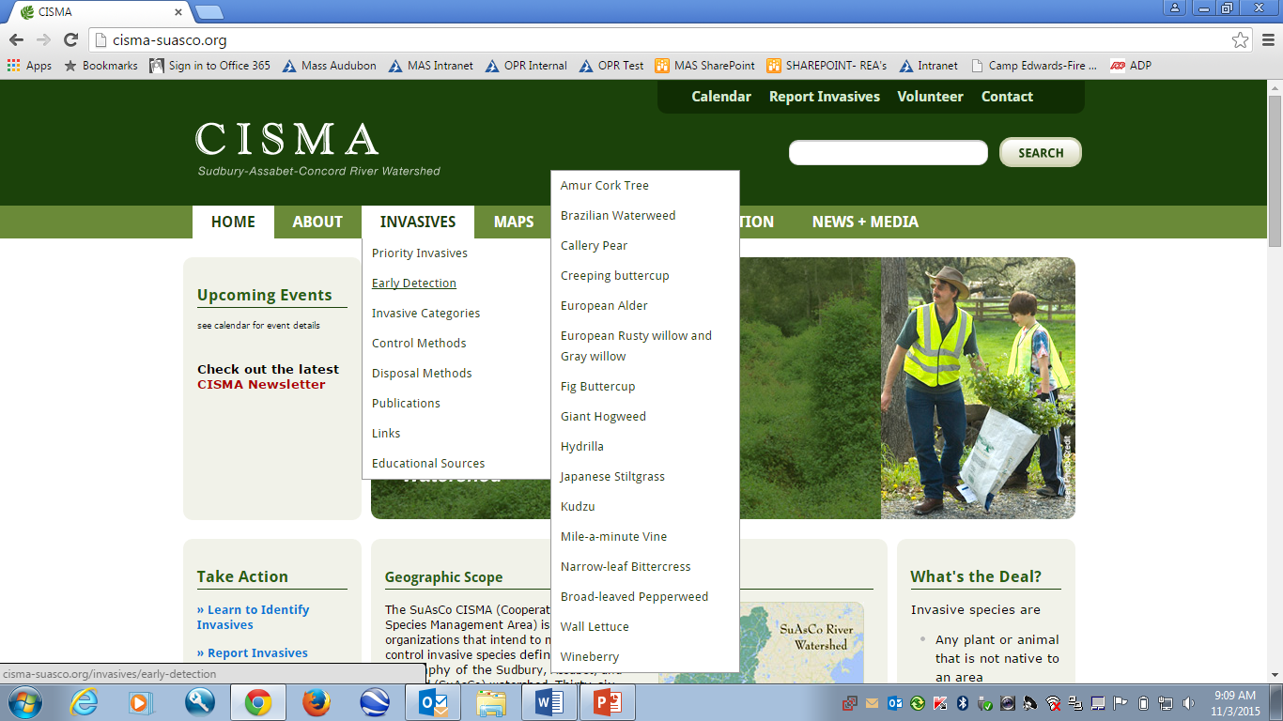

Slide 39
EARLY DETECTION SPECIES FOR
SuAsCo CISMA
Trees
Amur corktree (Phellodendron amurense)
Callery (Bradford) Pear (Pyrus calleryana)
Shrubs
Black or European alder (Alnus glutinosa)
Wineberry (Rubus phoenicolasius)
Rusty willow (Salix atrocinerea; S. cinerea)
Woody vines
Kudzu (Pueraria montana)
Herbaceous Plants
Wild chervil (Anthriscus sylvestris)
Narrow-leaf bittercress (Cardamine impatiens)
Lesser celandine (Ficaria verna)
Giant hogweed (Heracleum maximum)
Broad-leaved pepperweed (Lepidium latifolium)
Wall lettuce (Mycelis muralis)
Mile-a-minute (Persicaria perfoliata)
Creeping buttercup (Ranunculus repens)
Aquatics
Brazilian waterweed (Egeria densa)
Hydrilla (Hydrilla verticillata)
Several others to consider for Early Detection
Yellow floating heart (Nelumbo lutea)—CT, RI
Wild parsnip (Pastinaca sativa)-VT, western MA
Hybrid coltsfoot (Petasites hybridus)-VT
Running bamboo (Phyllostachys aurea and P. nigra)-CT
Swollen bladderwort (Utricularia inflata)-CT, MA, RI

Slide 40
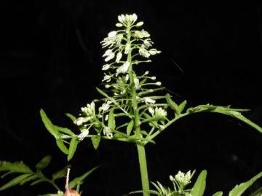
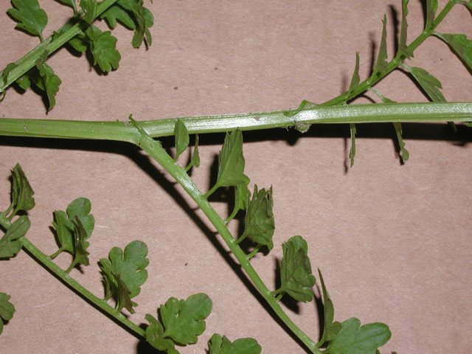
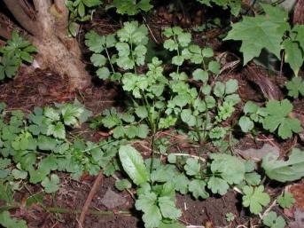
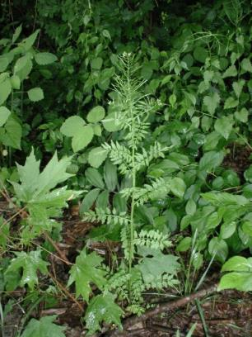
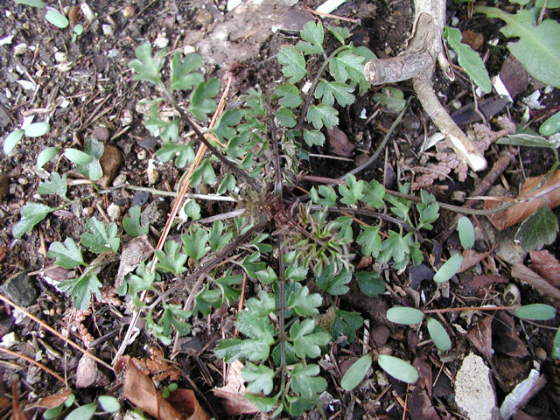
Narrow-leaf bittercress (Cardamine impatiens)
Narrow-leaf bittercress is an annual or biennial, May to June-blooming member of the mustard family with sharply divided stem leaves, and an upper stem cluster of small, white, 4-petalled flowers. It grows to 2+ feet in height. Key features are the leaf base that clasps the stem and the sharp-pointed leaflets. Narrow-leaf bittercress occurs in moist woods, stream corridors, and roadsides.
Photos: IPANE

Slide 41
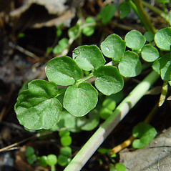
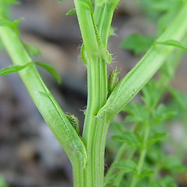
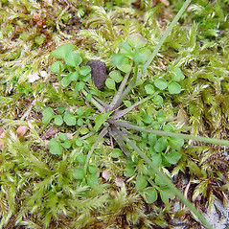
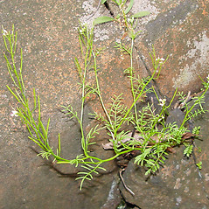

Narrow-leaf Bittercress and Look-a-Likes
Photos: Arthur Haines/GoBotany, except lower right Ben Kimball/GoBotany
Narrow-leaf bittercress
Cuckoo-flower
(Cardamine pratensis)
Hairy bittercress
(Cardamine hirsuta)
Small-flowered bittercress
(Cardamine parviflora)
Pennsylvania bittercress
(Cardamine pensylvanica)

Slide 42


Slide 43



Maps for Cardamine impatiens

Slide 44




Giant Hogweed (Heracleum mantegazzianum)
Giant hogweed is a biennial or sometimes perennial member of the parsley family that can grow 15-20 feet in height. The stem is hollow and blotched with purple. The inflorescence (umbel) can reach two feet in diameter, and the sharply divided leaves can reach five feet in width. Giant hogweed is phytotoxic—exposure to the sap in sunlight can cause serious skin burns and blisters. The plant grows in disturbed sites and shaded stream corridors. It prefers moist soils and partial shade.
Photos: IPANE

Slide 45




Hogweed Continued…
The primary hogweed inflorescence has 50-150 branches. Cow-parsnip, a native look-a-like, has 15-40 branches in its primary inflorescence.
Photos: IPANE

Slide 46





Giant Hogweed and Look-a-Likes
Glen Mittelhauser/GoBotany
Arthur Haines/GoBotany
Arthur Haines/GoBotany
Giant hogweed
Purple-stem angelica
(Angelica atropurpurea)
Cow-parsnip
(Heracleum maximum)
Wild parsnip
(Pastinaca sativa)
Poison hemlock
(Conium maculatum)
John Bush
John Bush

Slide 47



Heracleum mantegazzianum Maps

Slide 48


Slide 49
I found seven localized occurrences about 8-years ago or so, mostly in the Connecticut River Valley and one property in the Seacoast Region. I was able to remove the live plants, and put down black plastic sheeting to smother/solarize the soil to kill off any viable seeds and I believe that it’s been successful, at least I have not heard back from the property owners as of yet. Every year newspaper articles are published about Giant hogweed and, as usual, I get a flurry of reports of “Giant hogweed”, which mostly end up being Cow parsnip. I don’t have any reports in EDDMapS because I feel we may have eradicated it. If it rears its ugly head again then I’ll probably go ahead and list it.
Douglas Cygan, Invasive Species Coordinator
New Hampshire Department of Agriculture,
Markets & Food,
Division of Plant Industry

Slide 50




Perennial Pepperweed
(Lepidium latifolium)
George Batchelor/MADOT
Les Mehrhoff/IPANE/Bugwood.org
Perennial pepperweed infests salt marshes and cordgrass meadows, occasionally occurring inland along salted roadways. It is a biennial member of the mustard family, with gray-green leaves and clusters of very small, white 4-petalled flowers. It grows 2-3 feet in height and has very tough stems. The roots smell strongly of horse radish. First documented in Connecticut and Massachusetts in the 1930’s, it has recently spread to Maine.
Jean Pawek, CalPhotos
Les Mehrhoff/IPANE/Bugwood.org

Slide 51



Lepidium latifolium maps

Slide 52






Wall lettuce (Mycelis muralis)
Image: Roger Latour
Photo: forestryimages.org
GoBotany
GoBotany
GoBotany
GoBotany
Wall lettuce is an annual or biennial member of the aster family with a branching inflorescence of many, small yellow, 5-petalled flowers, and sharply divided basal and stem leaves. The terminal segment of the leaf is larger than the lateral segments. The leaf petiole has a clasping base. The stems are smooth, sometimes bluish, with a whitish bloom. Wall lettuce blooms in late spring and early summer, growing 2-4 feet in height. It invades rich deciduous and mixed deciduous-conifer forests, shaded stream corridors, and wetland edges. NEWFS has infestations in 3 of our sanctuaries (NH and VT).
GoBotany

Slide 53






Wild lettuce
Panicled Hawkweed
Photo: CalPhotos
GoBotany
GoBotany
GoBotany
GoBotany
There are a number of native and non-native members of the aster family with small, yellow, dandelion-like flowers that resemble wall lettuce. The hawkweeds (Hieracium) , sow-thistles (Sonchus), and wild yellow lettuces (Lactuca) are a few of the species that could be mistaken for it. Key identification features of wall lettuce: 1) 5-petalled flowers, and 2) the sharply segmented leaf with the large terminal segment and the clasping base. Wild yellow lettuce (Lactuca canadensis) and panicled hawkweed (Hieracium paniculatum), two native species with similar features, are pictured above.

Slide 54



Mycelis muralis maps
State # First Latest
CT 0
MA 1 1990
NH 2 1966 2006
VT 8 1979 2012

Slide 55




Mile a minute vine
(Persicaria perfoliata)
Mile-a-minute is an annual herbaceous vine covered with barbs. Its leaves are broadly triangular and long-petioled. The flowers are tiny, closed, greenish-white. The berry-like fruits are deep blue when ripe. Flowers and fruits are underlain by circular, leaf-like bracts that are pierced by the stem. Mile-a-minute climbs and scrambles over fields, thickets, and woodland edges, occurring in dry, moist, and wet soils. It spreads very rapidly and forms massive infestations. Former scientific name: Polygonum perfoliatum.
Photos: IPANE

Slide 56






Mile-a-Minute and Look-a-Likes
Donald Cameron/GoBotany
Arthur Haines/GoBotany
Climbing false buckwheat
(Fallopia scandens)
Arrow-leaf tearthumb
(Persicaria sagittata)
Lisa Groves
Glen Mittelhauser/GoBotany
Glen Mittelhauser/GoBotany
Halberd-leaf tearthumb
(Persicaria arifolia)
Mile-a-Minute
Hedge bindweed
(Calystegia sepium)

Slide 57




Persicaria perfoliata maps
State # First Latest
CT 3 2004 2012
MA 2 2009
NH 1 2011
VT 0

Slide 58


Slide 59





Wineberry
(Rubus phoenicolasius)
Wineberry has a bristly stem with longer, straight thorns intermingled between the glandular bristles. The leaves are three-parted, with the terminal leaflet longer and wider than the two side leaflets. The leaves are whitened underneath. The fruit is very sweet. Wineberry grows in old fields, thickets, and open woodlands.
Photos: IPANE

Slide 60



Allegheny Blackberry- Rubus allegheniensis
Arthur Haines/GoBotany
Allegheny blackberry: Compound leaf with 5 leaflets. Leaves green on both sides. Terminal leaflet larger than laterals, but same shape. Spines stout, with broad base.
Red raspberry –Rubus idaeus
Red raspberry: Compound leaf with 5 leaflets. Leaves green above, whitened underneath. Leaflets all of approximately same size and shape.
Boot Boutwell/GoBotany

Slide 61



Maps of Rubus phoenicolasius

Slide 62



Kudzu (Pueraria montana var. lobata)
Kudzu is a woody vine that can reach 60 feet in height, climbing up trees and smothering thickets and meadows. It has a large, rounded, three-parted leaf. Flowers are arranged in a purple spike, which develop into hairy pods up to 8 inches in length.
Photos: IPANE

Slide 63






Round-leaf tick-trefoil (above)
Ground-nut (above)
Lisa Groves
Kudzu infestations in Needham (lower left) and Martha’s Vineyard (lower right), MA. There is no other plant like it: big 3-parted leaf , high-climbing habit, purple flowers, large hairy pods. However, note groundnut (Apios americana) and round-leaf tick-trefoil (Desmodium rotundifolium). Upper photos: GoBotany.

Slide 64

Needham Kudzu Site, July 2012

Slide 65



Maps of Pueraria montana

Slide 66
Questions? COMMENTS? Concerns?
?
Thank You:
SuAsCo CISMA
Westford Conservation Trust
New England Wild Flower Society
Mass Audubon
River Stewardship Council
National Fish and Wildlife Foundation
NYANZA Trustees

